Slide 1
Purcellville
Lower Classroom
Makeover
John Dubelko

Slide 2
Overview
History: The lower building classroom has been exclusively used by MITRE to store company equipment and do drone research. They are there once or twice a week depending on weather. This was not a big deal during the pandemic but as we add more classes, the organization needs more areas to for events and equipment. The issue is lockable storage. MITRE is happy to continue to use the location but needs a way of locking up their equipment.
Proposal: To invest in the lower building so that it can be a common meeting area for all membership. MITRE would have priority of the space during the day on workdays. This investment will allow the space to be another area for classes, events and member to do projects. Another possibility is to move equipment such as 3d Printers into the space and setup computer workstations. This would be in ideal location for a laser cuter also.

Slide 3
Improvements
Deep Cleaning
Paint cabinets, floors, doors, walls (where needed)
Replace ceiling tiles- all matching & help with smell
Mount AC unit from Leesburg in wall – rewire outlet
Add large lockable storage cabinets
Replace chairs
Add light to bathroom
Add mini frig
Fix Doors
Sell/Donate/Trash unneeded items

Slide 4
Investment
Item | Cost
Ceiling Tiles | $150
Paint | $250
Cabinets | $2,100
Bathroom Light | $100
Misc. | $150
Total | $2,700
The project would also utilize the trash disposal budget for a dumpster or “Got Junk” pickup.

Slide 5
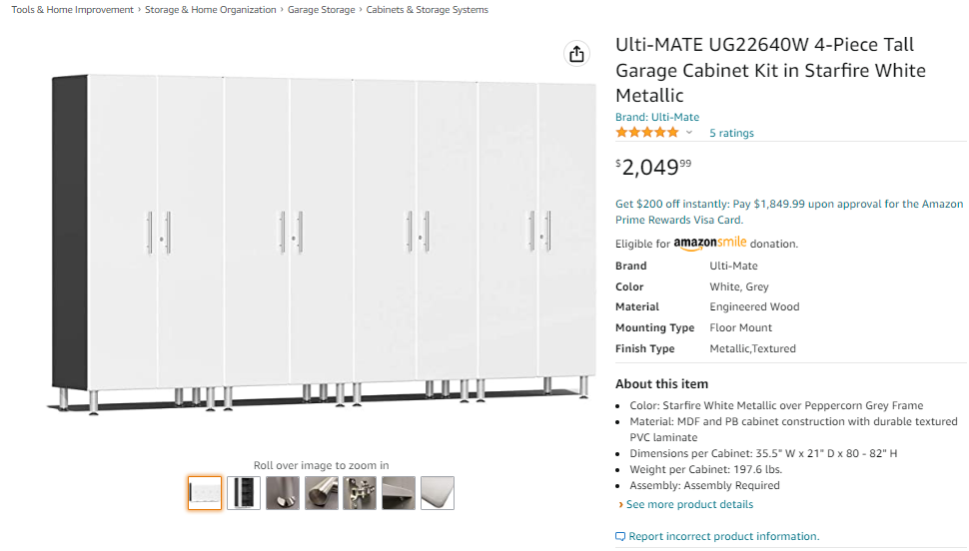
Cabinets

Slide 6
Motion
Issue: The lower Building at Purcellville is exclusively used by one of the corporate members for storage and meeting space. During the pandemic this was not and issue but with more classes and events Makersmiths needs more areas to meet.
Solution: Invest in lockable cabinets that the corporate member can use and open the space for use by all members.
Tax Exempt Status: None
Motion: 1)Appoint John Dubelko as room steward for the Purcellville lower building classroom. 2) Authorized the expenditure of up to but not exceeding $2,750 for improvement to the lower building classroom, including adding lockable storage.

