Slide 1
May 2022
Financials

Slide 2
May 2022
Month
Year to Date
Income: $18,542.02
Expenses: $10,697.46
Net Income: $ 7,844.56
End of Month
Bank Account Balance: $30,009.29
Building Reserve Fund: $49,650
Equipment Reserve Fund: $47,906
Interest earned: $3.08
Transfers of April did not occur in May. Transfers of April and May will occur in June. Transfer of $4,375 to Building Reserve Fund and $4,375 to Equipment Reserve Fund. Transfer of $1744 from Equipment Reserve Fund to checking account for purchase of helical heads.
Income: $81,983.40
Expenses: $52,396.10
Net Income: $29,587.30
Fixed Assets
Furniture & Equipment: $133,192.56 (Dec 31, 2021)
[2021 Tax Filing]
Liabilities
Kickstarter: $4,560.00
UV Printer Loan: $25,340.45
MSL Metal Shop reimbursement to Brad Hess: $709.23

Slide 3


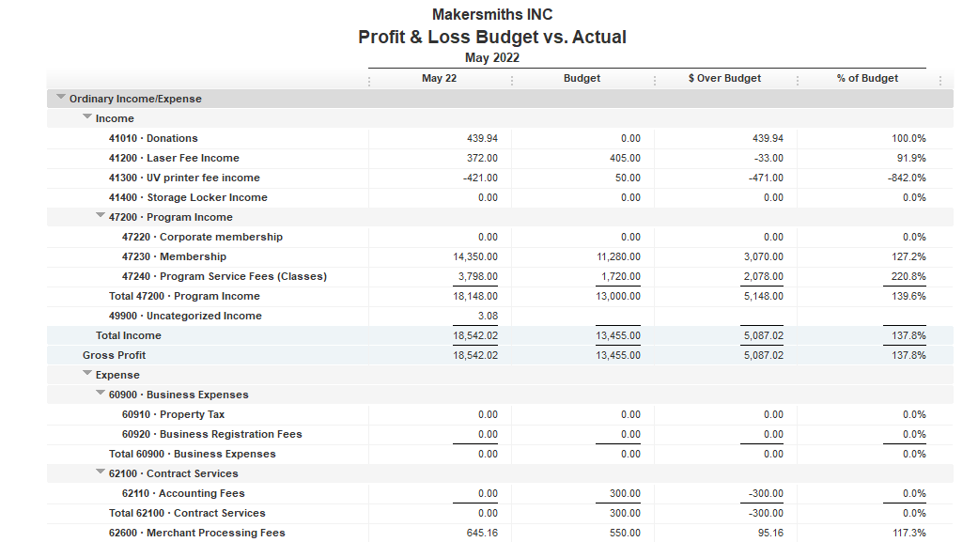




Slide 4
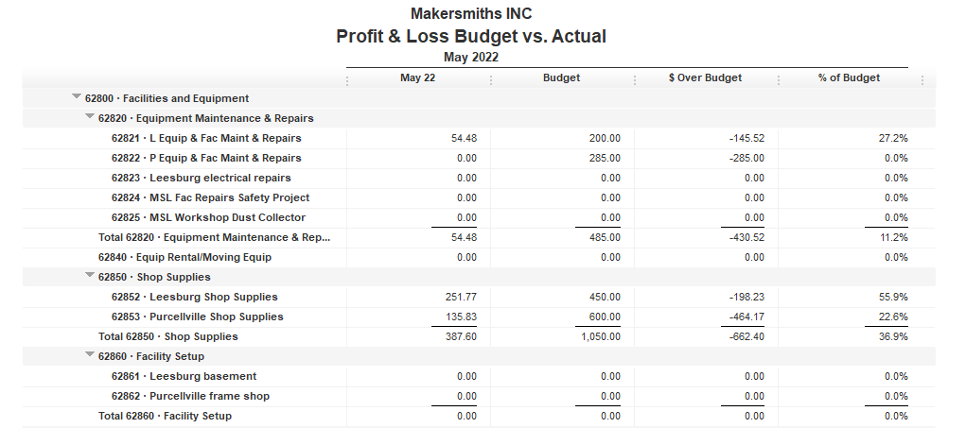


Slide 5
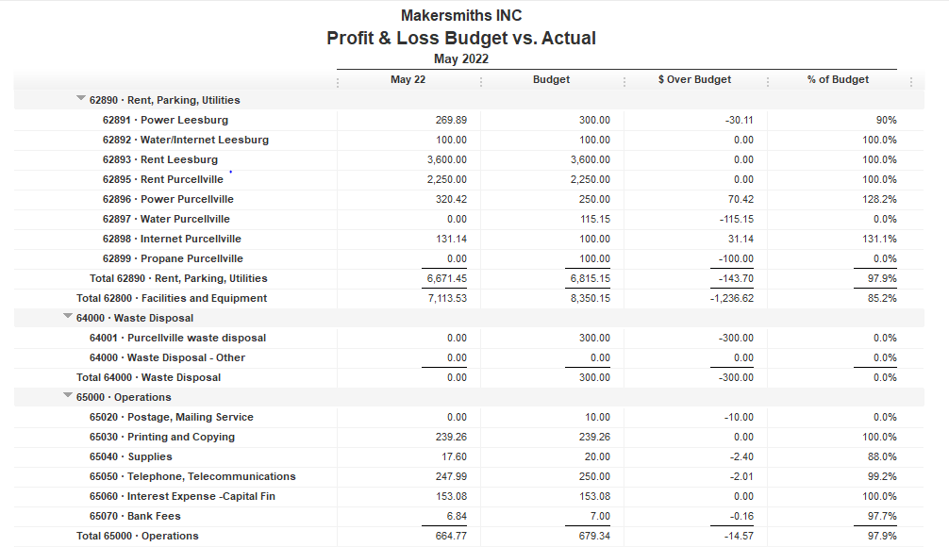

Slide 6

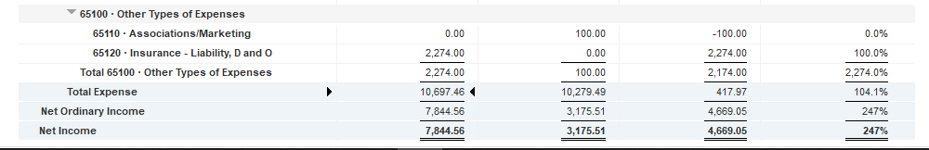

Slide 7
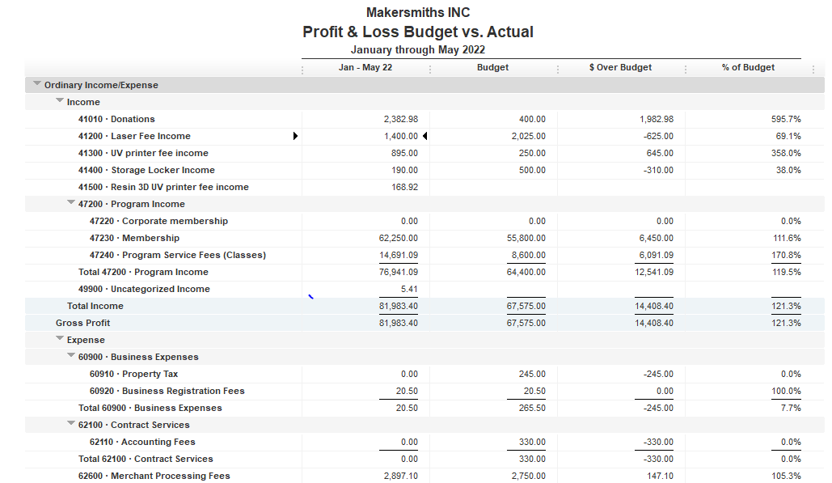

Slide 8
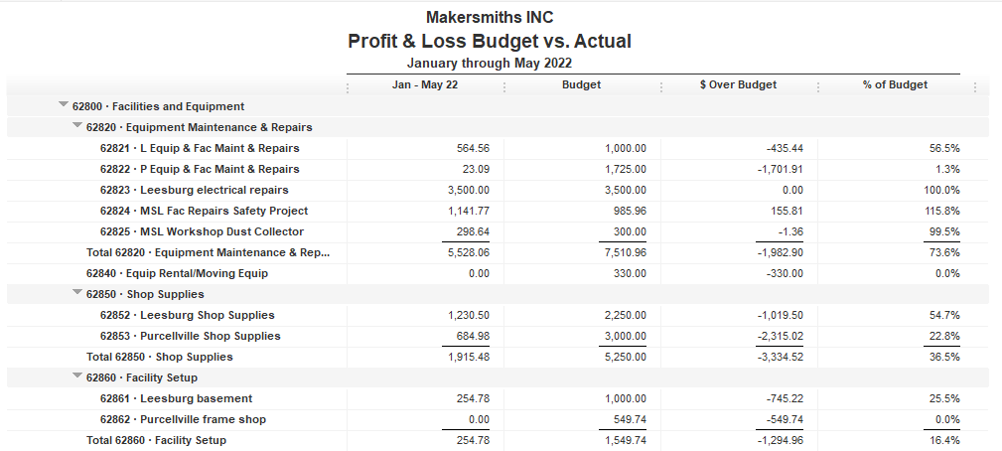

Slide 9
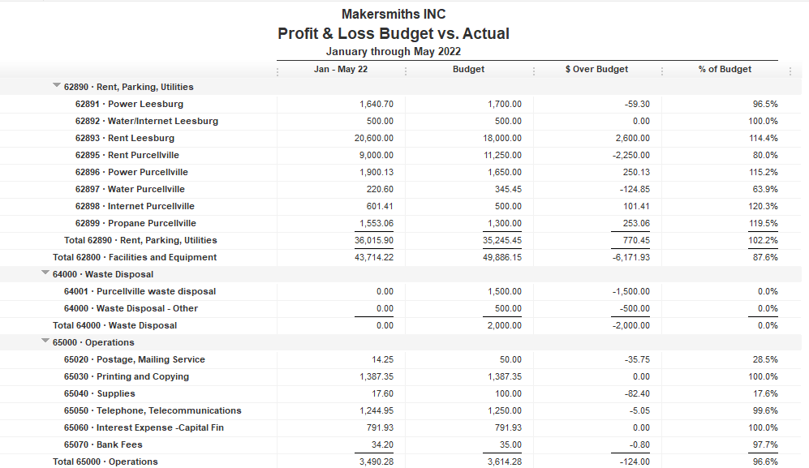

Slide 10
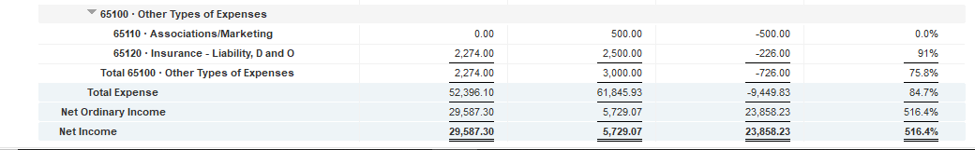

Slide 11
Approved Projects Budgets & Expenditures
Summary
Carryover from 2021 Remaining
Purcellville Frame Shop $ 549.74 $ 549.74
Basement Buildout $1,000.00 $ 745.22
Leesburg Metal Shop $ 709.23 $ 709.23
Machine Access Control Boxes $3,900 $ 3,900
TOTAL $6,158.97 $5,904.19

Slide 12
Kickstarter Liability
No change from last month
$4,560.00 in outstanding credits – Top 9 listed below

