Slide 1
April 2022
Financials

Slide 2
April 2022
Month
Year to Date
Income: $14,164.33
Expenses: $11,766.80
Net Income: $ 2,397.53
End of Month
Bank Account Balance: $30,000.40
Building Reserve Fund: $46,260
Equipment Reserve Fund: $44,516
Interest earned: $2.33
Transferred $985 to Building Reserve Fund and $985 to Equipment Reserve Fund. Transferred $1,744 from Equipment Reserve Fund to checking account for purchase of helical heads
Income: $63,441.38
Expenses: $41,698.54
Net Income: $21,742.74
Fixed Assets
Furniture & Equipment: $133,192.56 (Dec 31, 2021)
[2021 Tax Filing]
Liabilities
Kickstarter: $4,560.00
UV Printer Loan: $25,793.05
MSL Metal Shop reimbursement to Brad Hess: $709.23

Slide 3




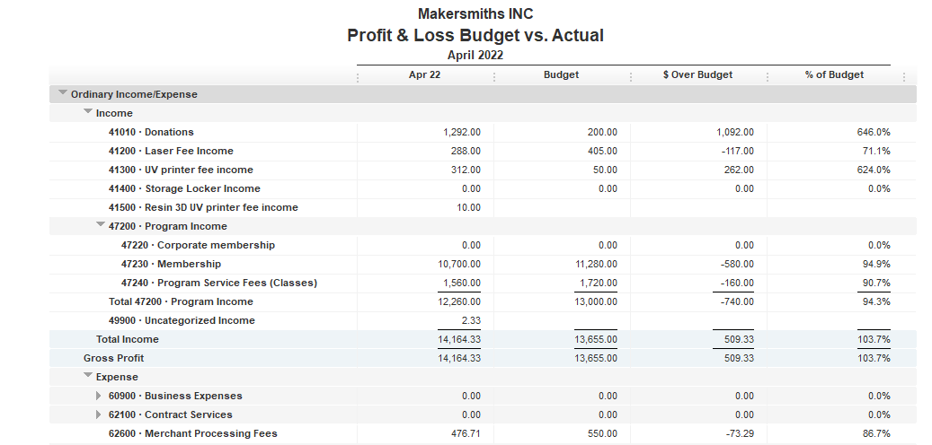

$1000 from LVED for Open House May 4
$2.33 interest earned on savings account

Slide 4
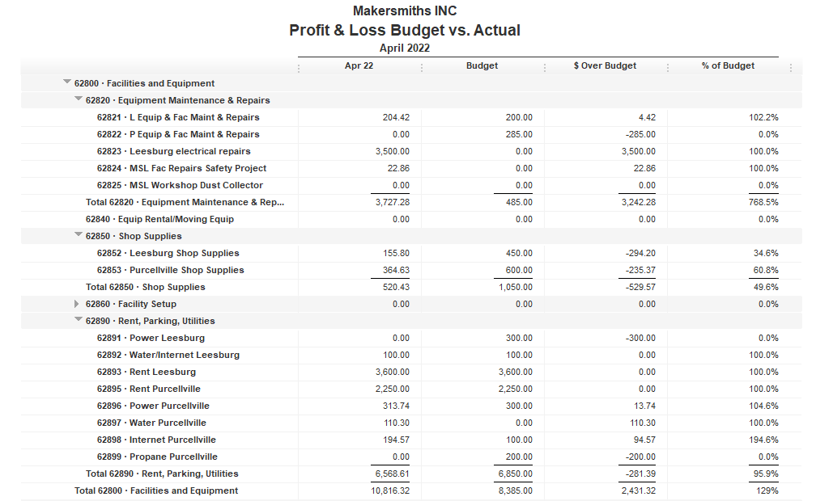


Slide 5
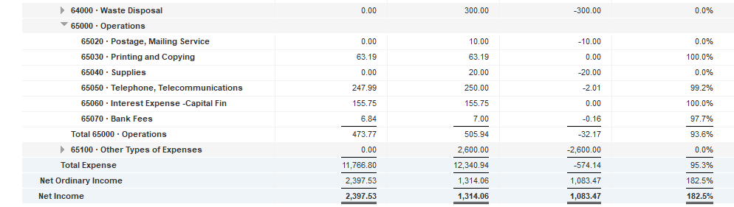

Slide 6
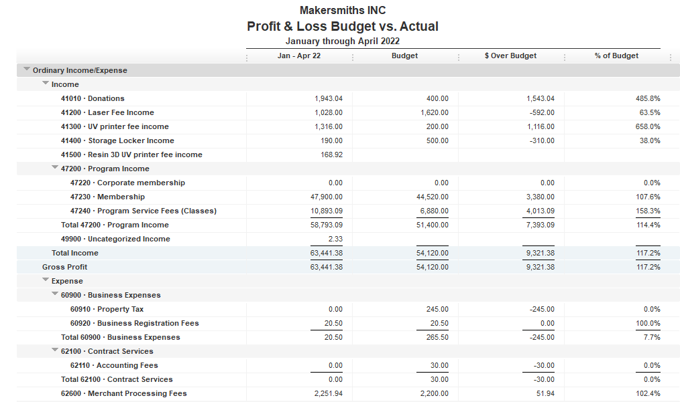

Slide 7
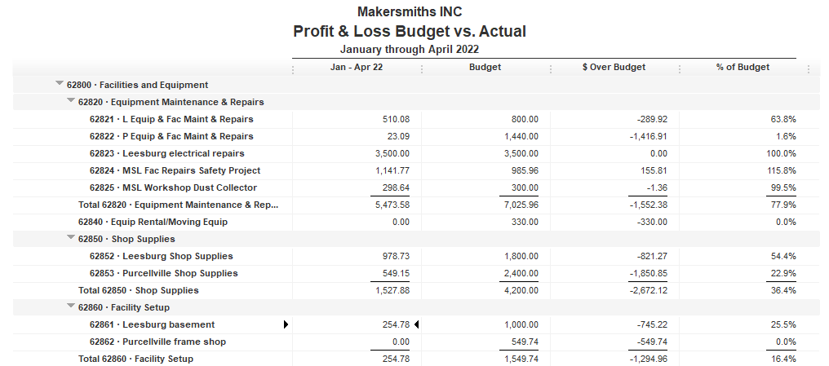

Slide 8
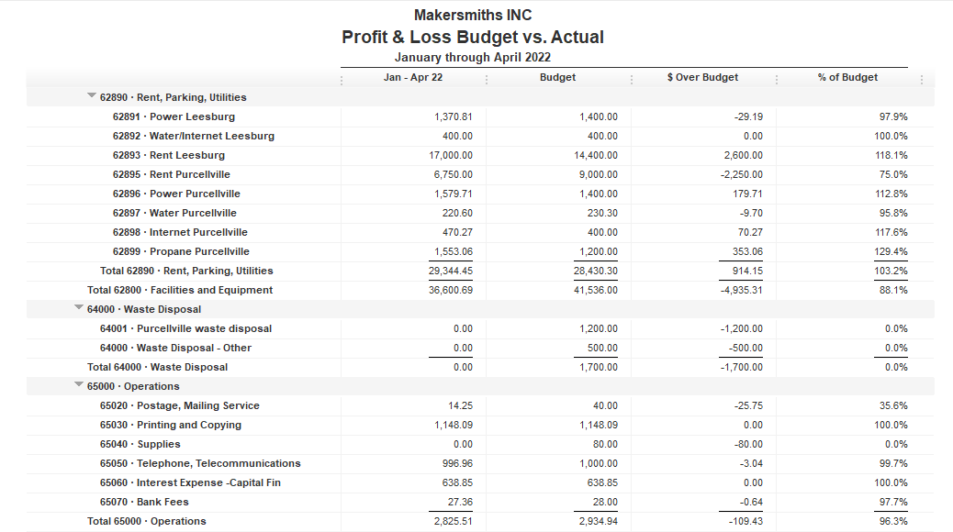
Budget changed to reflect actual costs through May

Slide 9
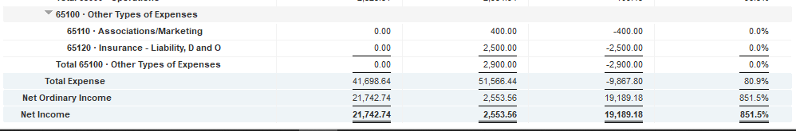

Slide 10
Approved Projects Budgets & Expenditures
Summary
Carryover from 2021 Remaining
Purcellville Frame Shop $ 549.74 $ 549.74
Basement Buildout $1,000.00 $ 745.22
Leesburg Metal Shop $ 709.23 $ 709.23
Machine Access Control Boxes $3,900 $ 3,900
Leesburg Electrical $3,500 $ 0
Leesburg Facility Projects $6,753.60 $ 498.11
TOTAL $16,412.57 $ 6,402.30

Slide 11
Kickstarter Liability
No change from last month
$4,560.00 in outstanding credits – Top 9 listed below

