Slide 1
March 2022
Financials

Slide 2
March 2022
Month
Year to Date
Income: $17,301.58
Expenses: $10,825.63
Net Income: $ 6,475.95
End of Month
Bank Account Balance: $30,025.12
Building Reserve Fund: $45,275
Equipment Reserve Fund: $45,275
Transferred $2,025 to Building Reserve Fund and $2,025 to Equipment Reserve Fund
Income: $49,277.05
Expenses: $29,931.84
Net Income: $19,345.21
Fixed Assets
Furniture & Equipment: $96,206.97 (Dec 31, 2020)
[2021 Inventory and Tax Filing is in progress]
Liabilities
Kickstarter: $4,560.00
UV Printer Loan: $26,242.97
MSL Metal Shop reimbursement to Brad Hess: $709.23

Slide 3


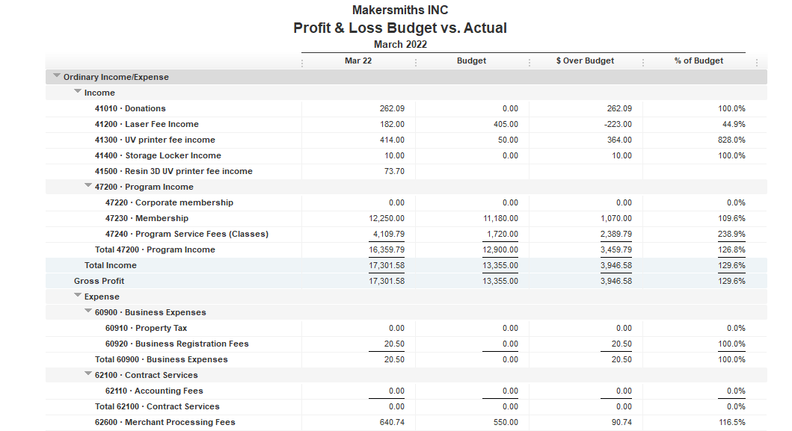




Slide 4
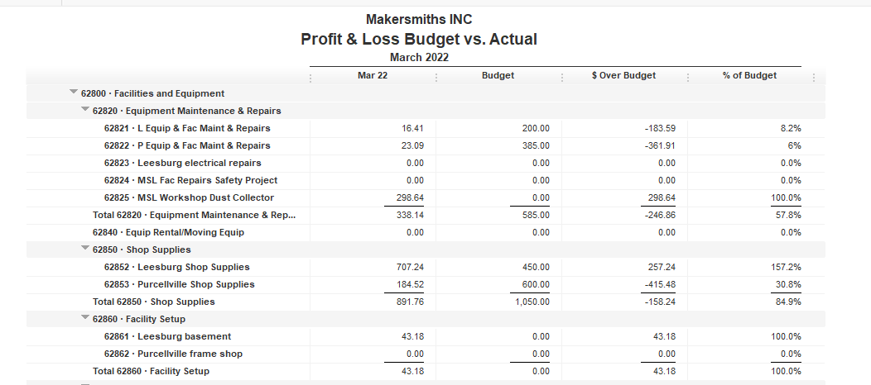


Slide 5
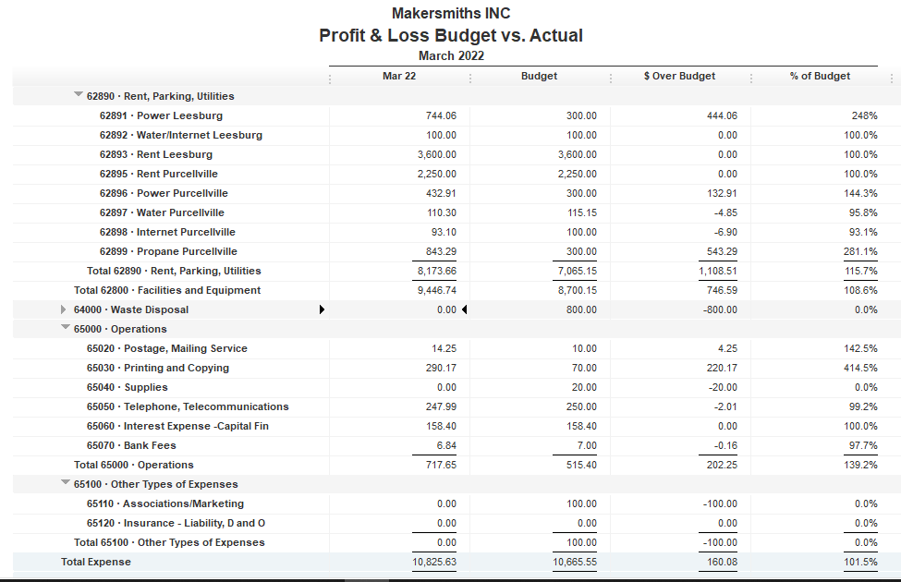

Slide 7
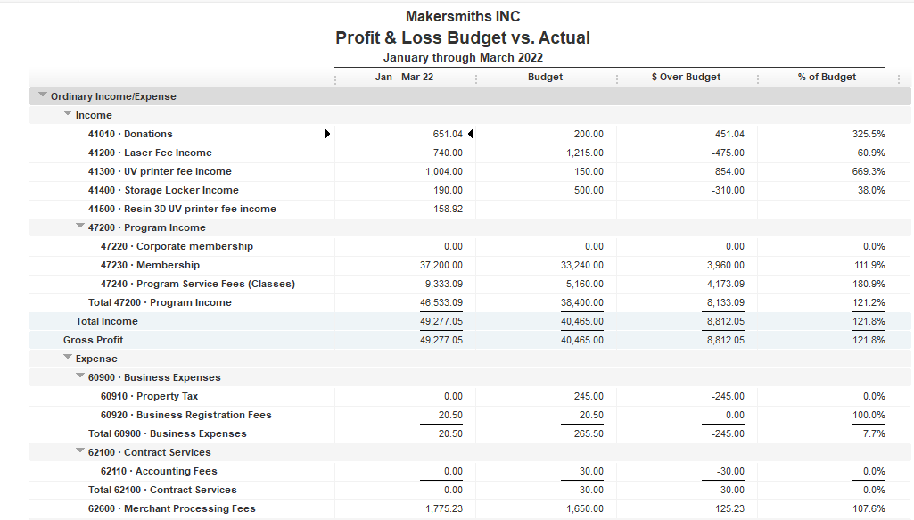

Slide 8
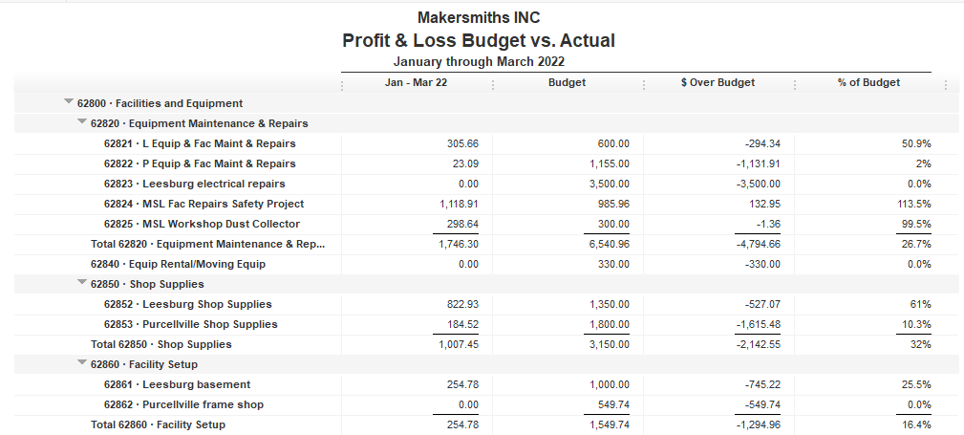

Slide 9
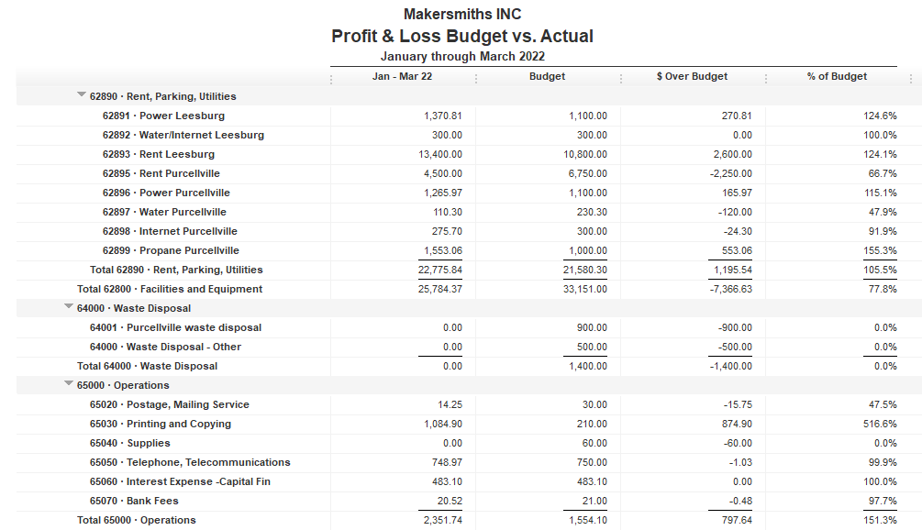

Slide 10

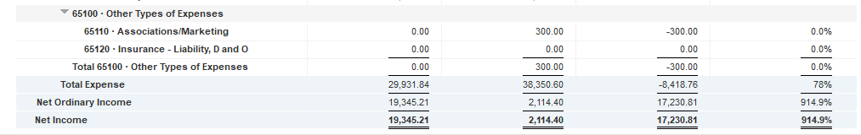

Slide 11
Approved Projects Budgets & Expenditures
Summary
Carryover from 2021 Remaining
Purcellville Frame Shop $ 549.74 $ 549.74
Basement Buildout $1,000.00 $ 745.22
Leesburg Metal Shop $ 709.23 $ 709.23
Leesburg Woodshop Dust Collector $ 300.00 $ 1.36
Machine Access Control Boxes $3,900 $ 3,900
Leesburg Electrical $3,500 $ 3,500
Leesburg Facility Projects $6,753.60 $ 520.97
TOTAL $16,712.57 $ 9,956.14

Slide 12
Kickstarter Liability
No change from last month
$4,560.00 in outstanding credits – Top 9 listed below

