Slide 1
February 2022
Financials

Slide 2
February 2022
Month
Year to Date
Income: $13,985.35
Expenses: $ 8,726.80
Net Income: $ 5,258.55
End of Month
Bank Account Balance: $30,299.44
Building Reserve Fund: $43,250
Equipment Reserve Fund: $43,250
Transferred $2,750 to Building Reserve Fund and $2,750 to Equipment Reserve Fund
Income: $31,975.47
Expenses: $19,106.21
Net Income: $12,869.26
Fixed Assets
Furniture & Equipment: $96,206.97 (Dec 31, 2020)
[2021 Inventory and Tax Filing is in progress]
Liabilities
Kickstarter: $4,560.00
UV Printer Loan: $26,690.24
MSL Metal Shop reimbursement to Brad Hess: $709.23

Slide 3


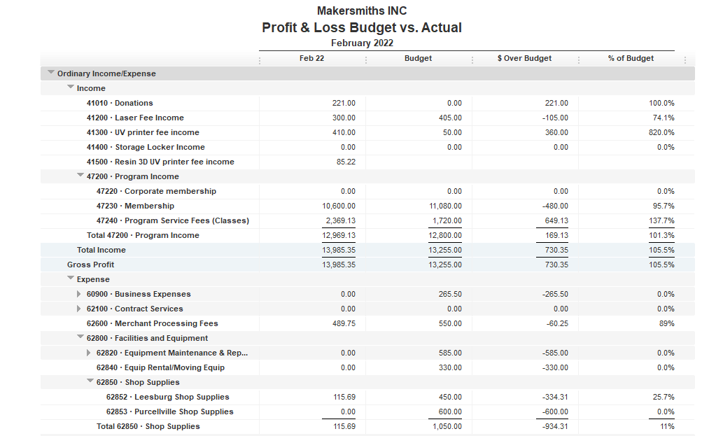




Slide 4
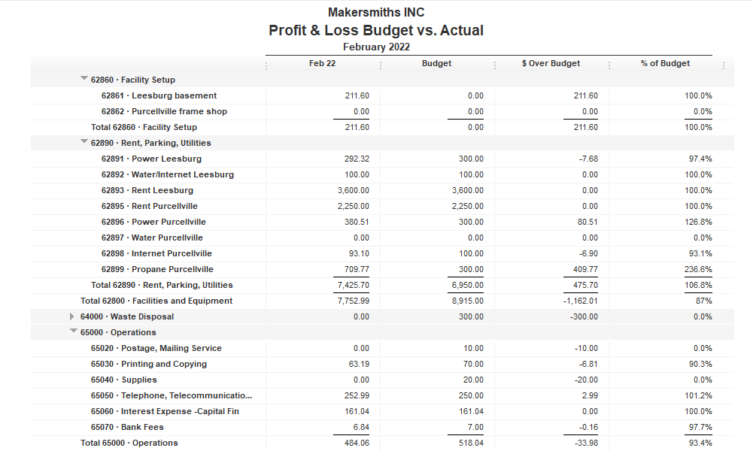


Slide 6
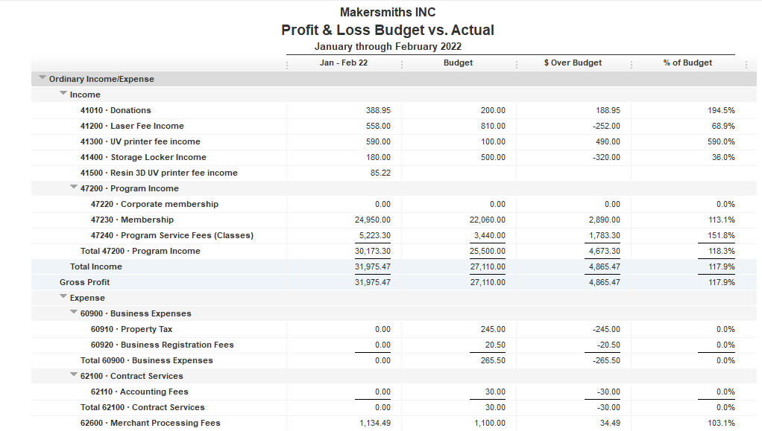

Slide 7
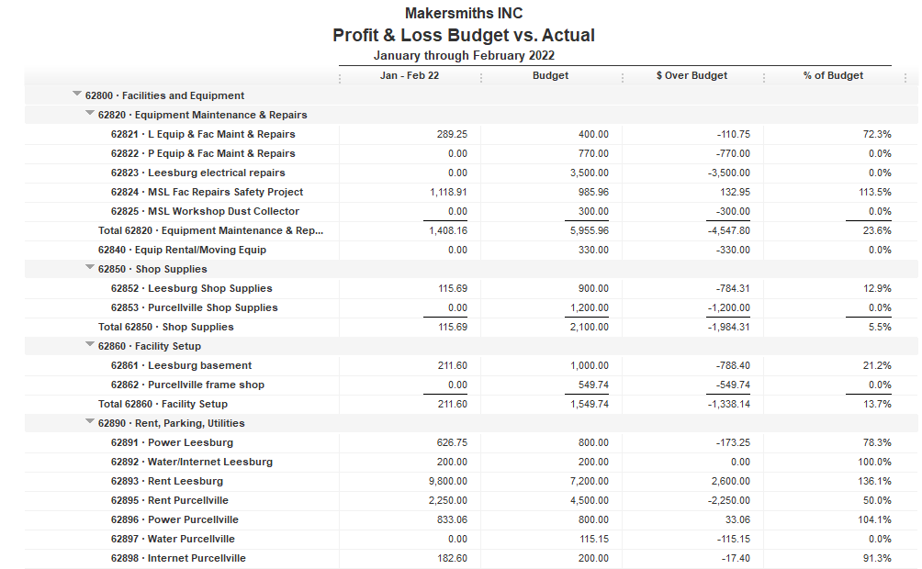

Slide 8
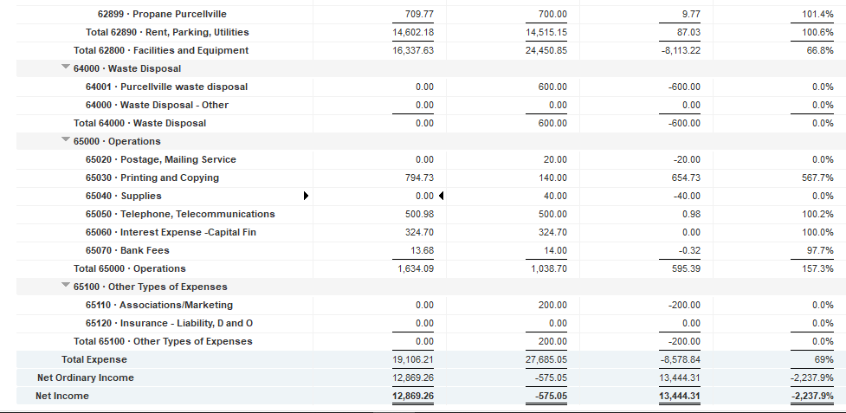

Slide 9
Approved Projects Budgets & Expenditures
Summary
Carryover from 2021 Remaining
Purcellville Frame Shop $ 549.74 $ 549.74
Basement Buildout $1,000.00 $ 745.22
Leesburg Metal Shop $ 709.23 $ 709.23
Leesburg Woodshop Dust Collector $ 300.00 $ 1.35
Machine Access Control Boxes $3,900 $ 3,900
Leesburg Electrical $3,500 $ 3,500
Leesburg Facility Projects $6,753.60 $ 520.97
TOTAL $16,712.57 $ 9,956.13

Slide 10
Kickstarter Liability
No change from last month
$4,560.00 in outstanding credits – Top 9 listed below

