Slide 1
January 2022
Financials

Slide 2
January 2022
Month
Year to Date
Income: $17,990.12
Expenses: $ 9,209.21
Net Income: $ 8,780.91
End of Month
Bank Account Balance: $41,985.52
Building Reserve Fund: $35,000
Equipment Reserve Fund: $35,000
Recommend transfer of $5,500 to Building Reserve Fund and $5,500 to Equipment Reserve Fund
Income: $17.990.12
Expenses: $ 9,209.21
Net Income: $ 8,780.91
Fixed Assets
Furniture & Equipment: $96,206.97 (Dec 31, 2020)
[2021 Inventory and Tax Filing is in progress]
Liabilities
Kickstarter: $4,560.00
UV Printer Loan: $27,134.87

Slide 3





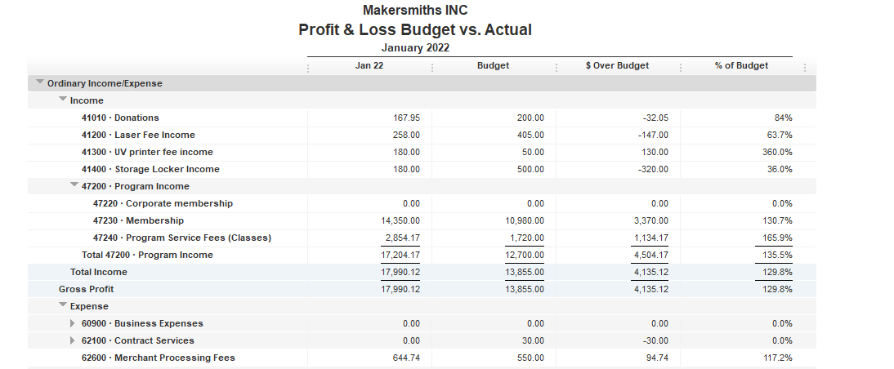
Locker rentals did not meet budget

Slide 4
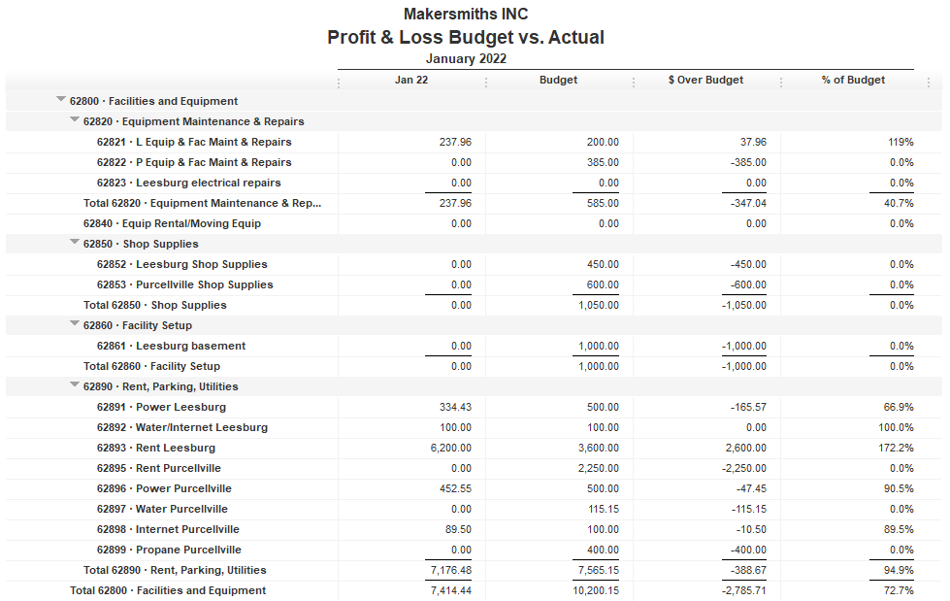

Leesburg equipment expenses occurred in 2021
PVL rent did not clear bank in Jan
PVL propane check did no clear bank in Jan

Slide 5
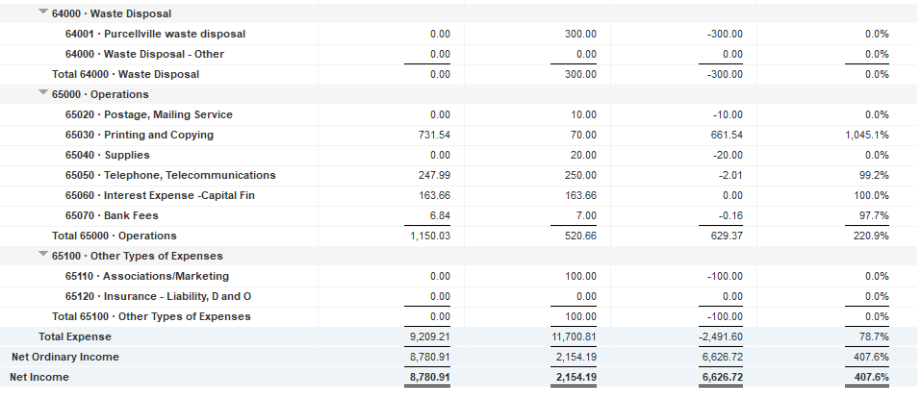
Color copy costs for May – Dec 2021

Slide 6
Approved Projects Budgets & Expenditures
Summary
Remaining
Purcellville Frame Shop $ 549.74
Basement Buildout $1,000
Leesburg Metal Shop $ 709.23
Leesburg Woodshop Dust Collector $ 300
Machine Access Control Boxes $3,900
Leesburg Electrical $3,500
Leesburg Facility Projects $ 945.46
TOTAL $10,904.43

Slide 7
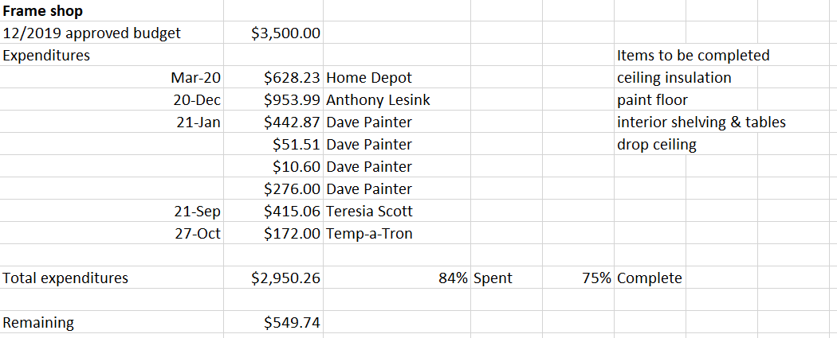
Approved Projects Budgets & Expenditures

Slide 8
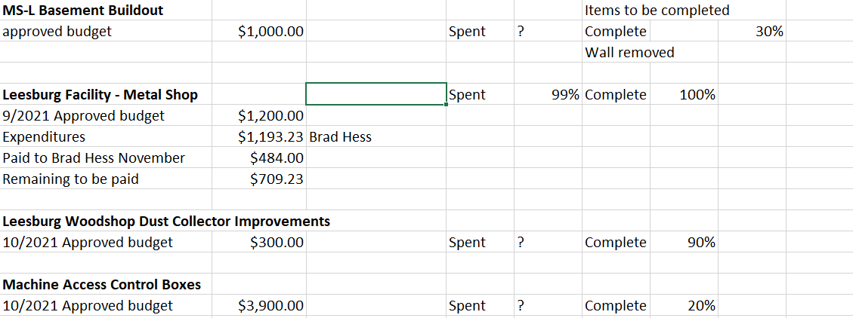
Approved Projects Budgets & Expenditures

Slide 9
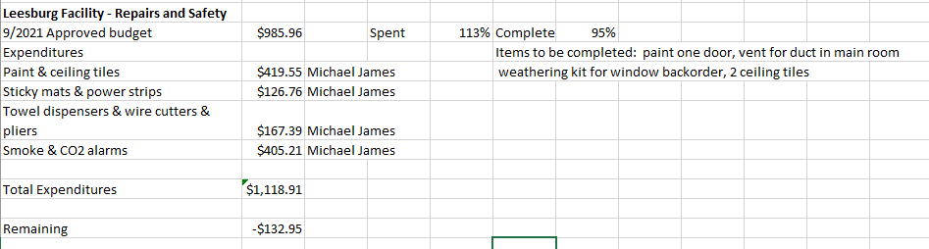
Approved Projects Budgets & Expenditures

Slide 10
Approved Projects Budgets & Expenditures

Slide 11

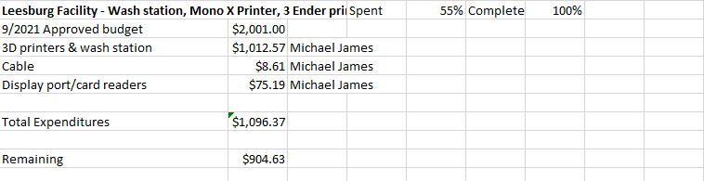

Slide 12
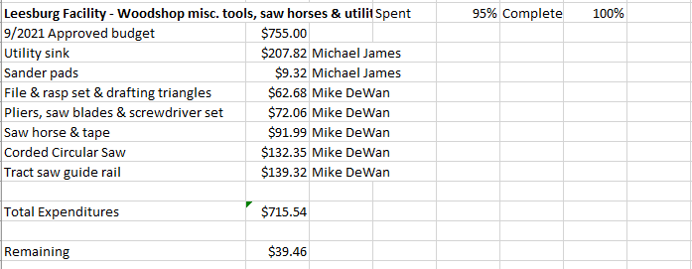

Slide 13
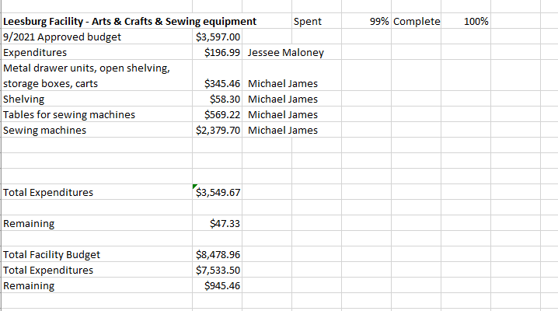

Slide 14
Kickstarter Liability
No change from last month
$4,560.00 in outstanding credits – Top 9 listed below

