Slide 1
January 2022
Financials

Slide 2
January 2022
Month
Year to Date
Income: $17,990.12
Expenses: $ 9,209.21
Net Income: $ 8,780.91
End of Month
Bank Account Balance: $41,985.52
Building Reserve Fund: $35,000
Equipment Reserve Fund: $35,000
Recommend transfer of $5,500 to Building Reserve Fund and $5,500 to Equipment Reserve Fund
Income: $17.990.12
Expenses: $ 9,209.21
Net Income: $ 8,780.91
Fixed Assets
Furniture & Equipment: $96,206.97 (Dec 31, 2020)
[2021 Inventory and Tax Filing is in progress]
Liabilities
Kickstarter: $4,560.00
UV Printer Loan: $27,134.87

Slide 3





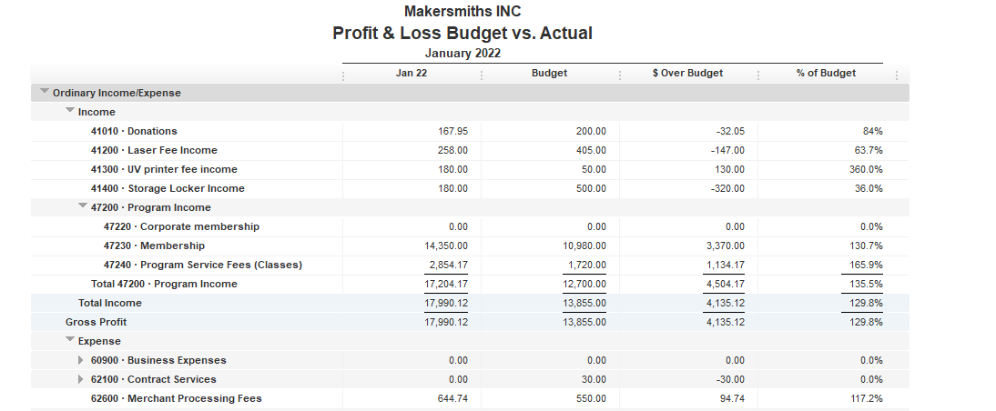
Locker rentals did not meet budget

Slide 4
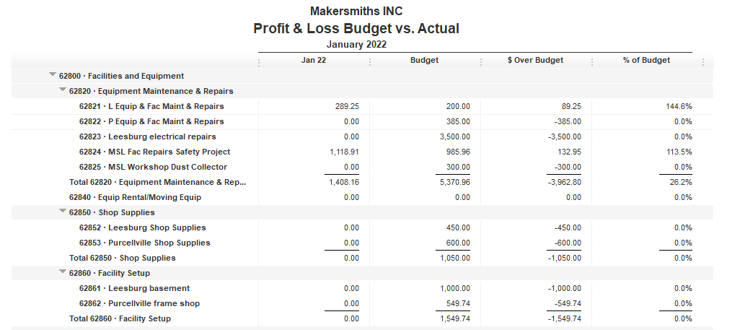

Leesburg equipment expenses occurred in 2021
Leesburg Facility Repairs & Safety Project budget carryover and expenses in 2021
Leesburg Woodshop dust collector project carryover, expenses expected in February

Slide 5
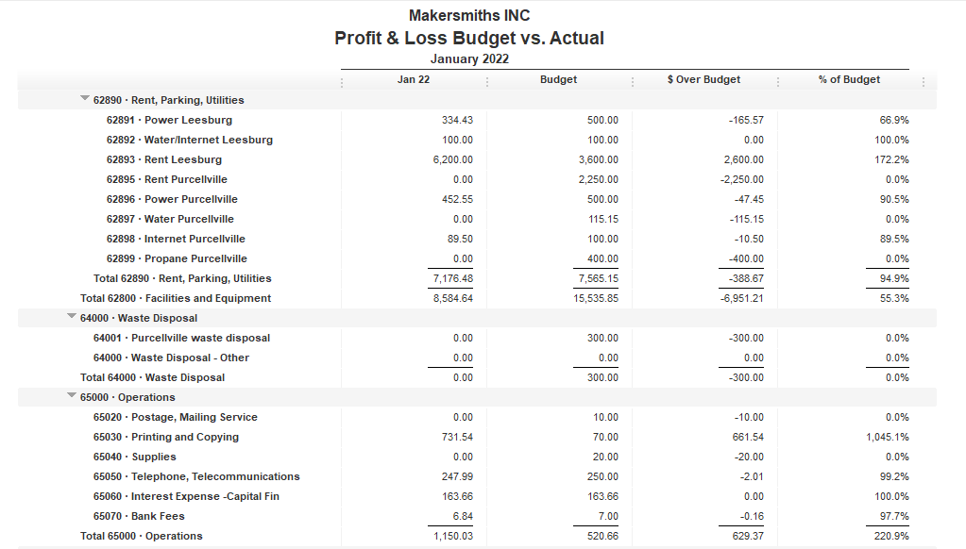
PVL rent did not clear bank in Jan
PVL propane check did not clear bank in Jan
Color copy costs for May – Dec 2021

Slide 6
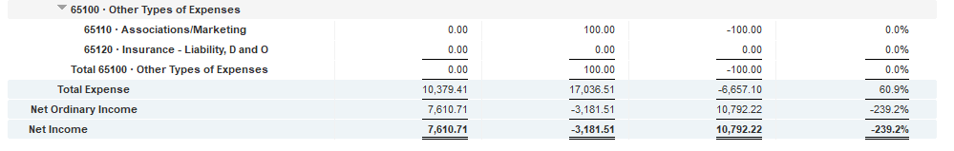

Slide 7
Approved Projects Budgets & Expenditures
Summary
Carryover from 2021 Remaining
Purcellville Frame Shop $ 549.74 $ 549.74
Basement Buildout $1,000.00 $ 774.84
Leesburg Metal Shop $ 709.23 $ 709.23
Leesburg Woodshop Dust Collector $ 300.00 $ 1.35
Machine Access Control Boxes $3,900 $ 3,900
Leesburg Electrical $3,500 $ 3,500
Leesburg Facility Projects $6,753.60 $ 520.97
TOTAL $16,712.57 $ 9,956.13

Slide 8
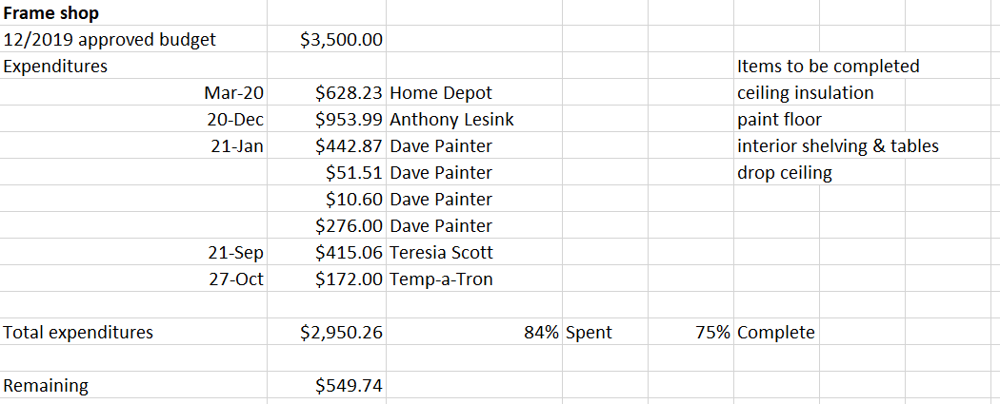
Approved Projects Budgets & Expenditures

Slide 9
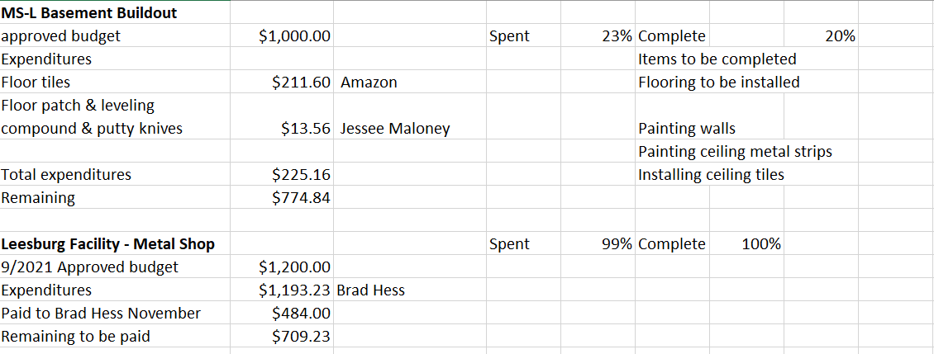
Approved Projects Budgets & Expenditures

Slide 10
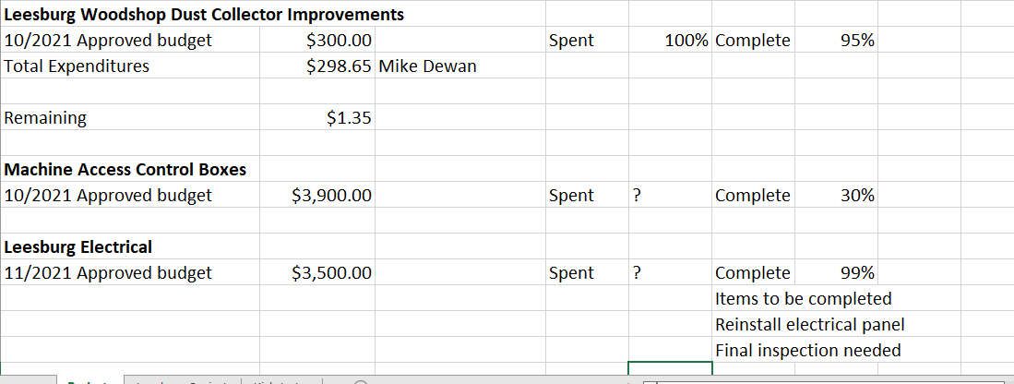
Approved Projects Budgets & Expenditures

Slide 11
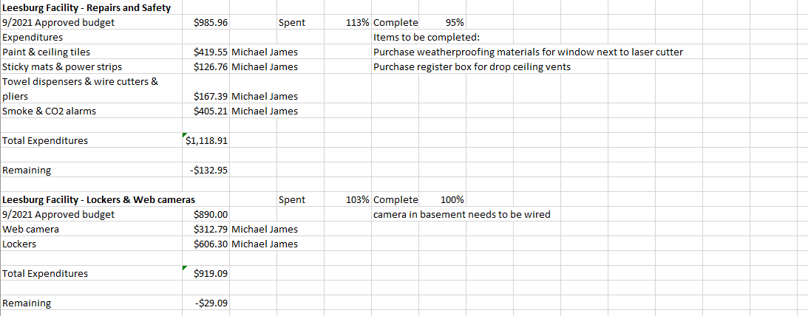
Approved Projects Budgets & Expenditures

Slide 12
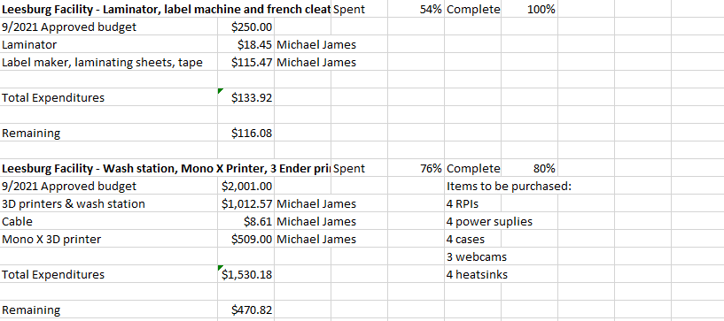
Approved Projects Budgets & Expenditures

Slide 13

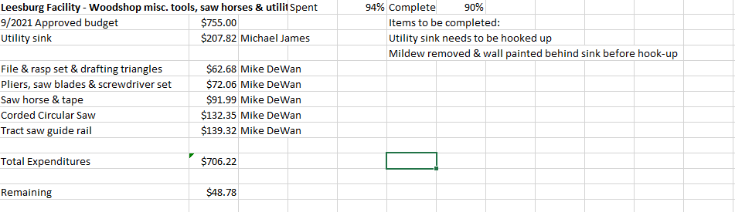

Slide 14
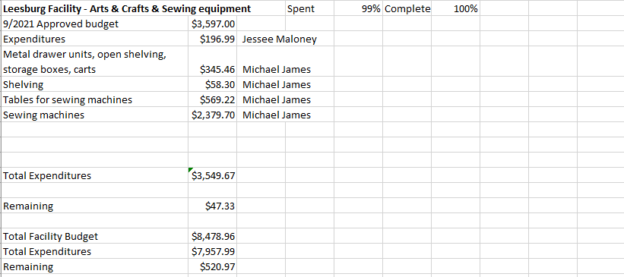

Slide 15
Kickstarter Liability
No change from last month
$4,560.00 in outstanding credits – Top 9 listed below

