Slide 1
December 2021
Financials

Slide 2


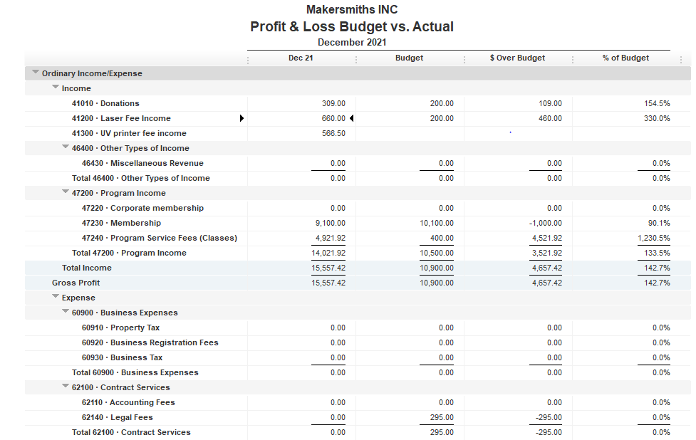



Total Income $15,557.42
Total Expenses $11,803.29
Net Income $ 3,754.13
EOM Nov 2021
Bank Account Balance $40,526.70
Building Reserve Fund $35,000.00
Equipment Reserve Fund $35,000.00

Slide 3
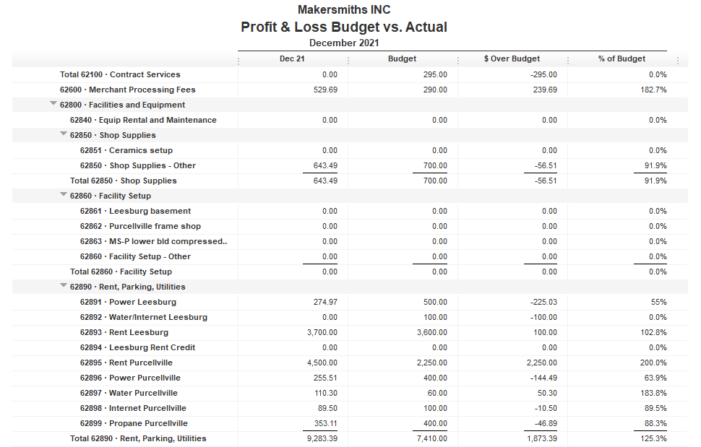

Back rent paid

Slide 4
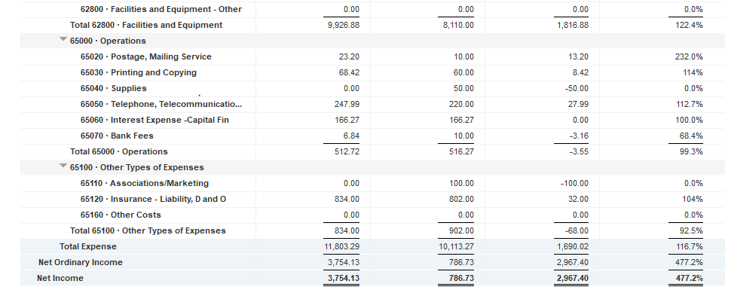

Slide 5
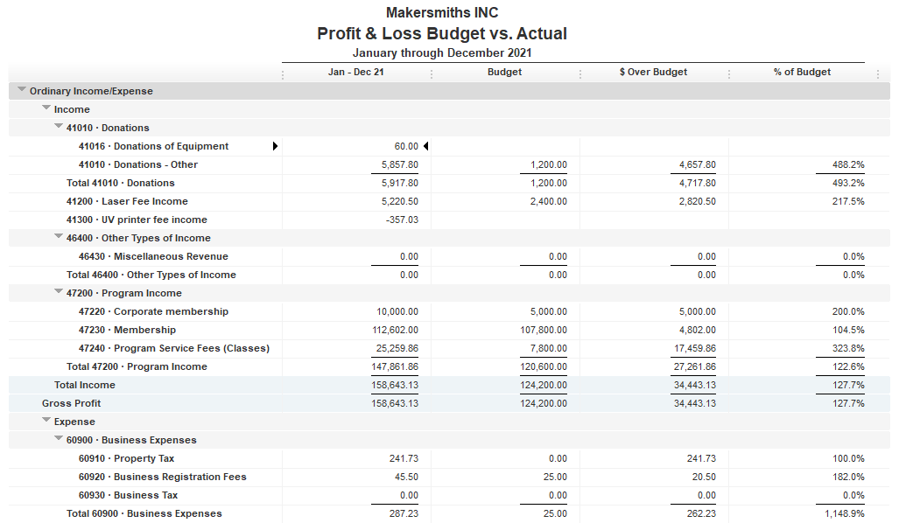

Slide 6
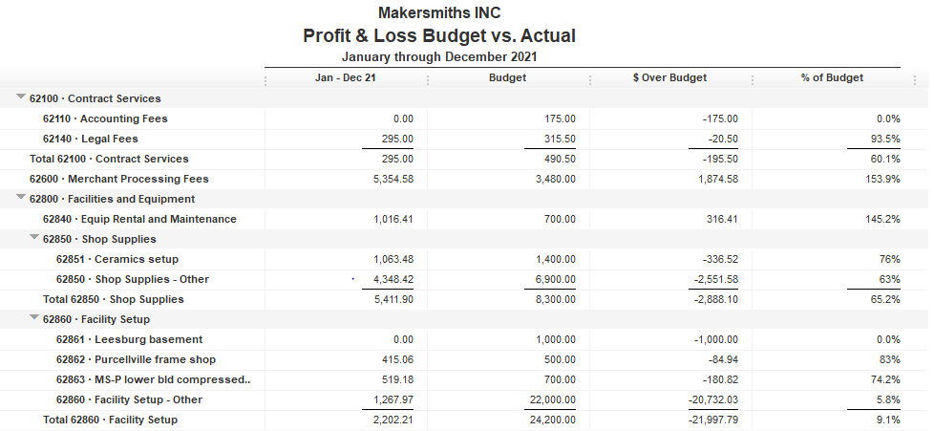

Slide 7
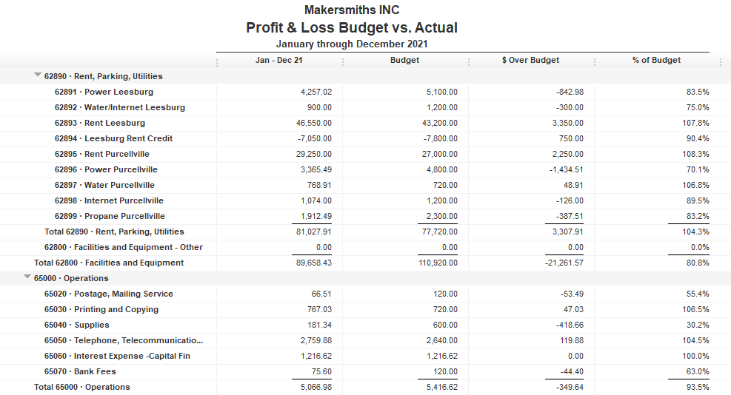

Slide 8

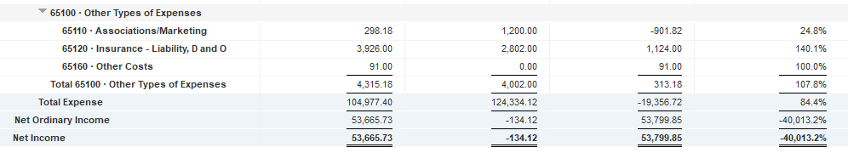

Slide 9
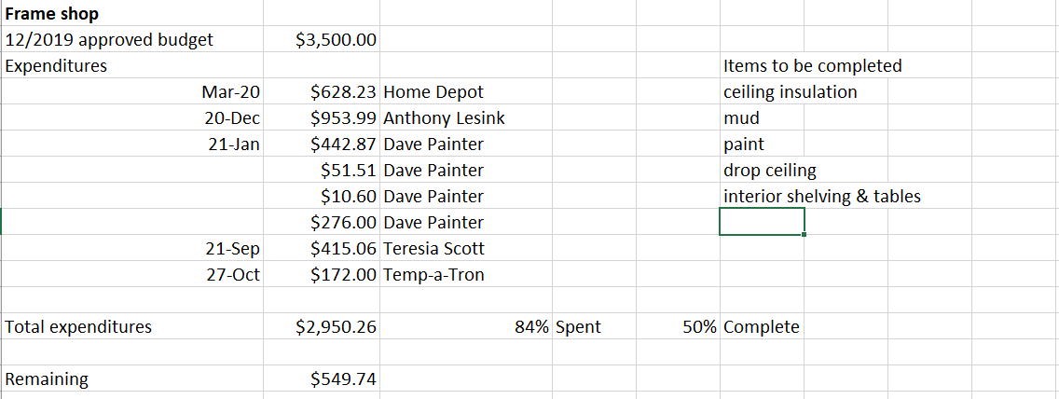
Approved Projects Budgets & Expenditures

Slide 10
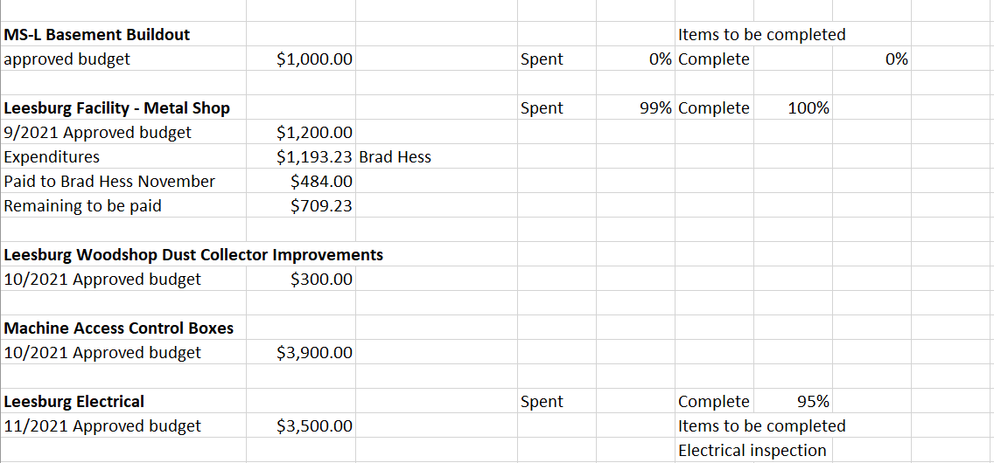
Approved Projects Budgets & Expenditures

Slide 11
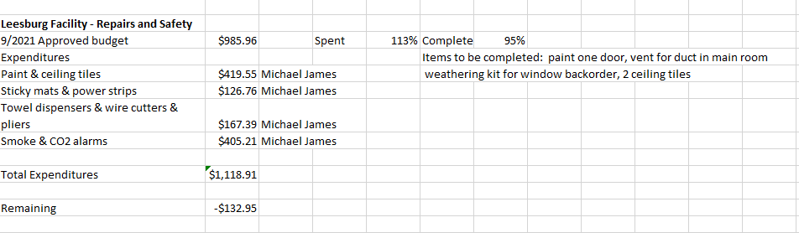
Approved Projects Budgets & Expenditures

Slide 12
Approved Projects Budgets & Expenditures

Slide 13

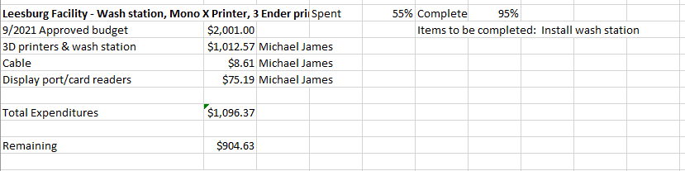

Slide 15
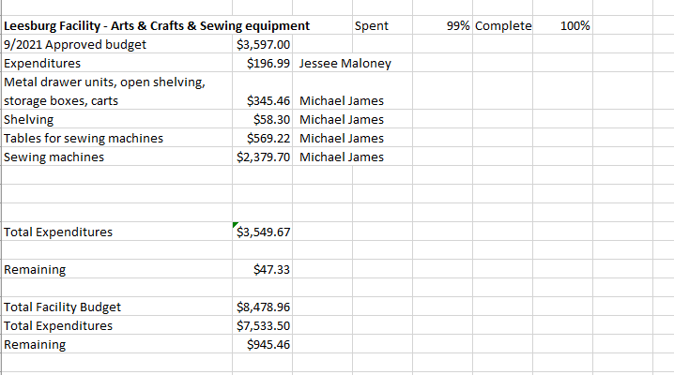

Slide 16
Kickstarter Liability
No change from last month
$4,560.00 in outstanding credits – Top 9 listed below

