Slide 1
November 2021
Financials

Slide 2


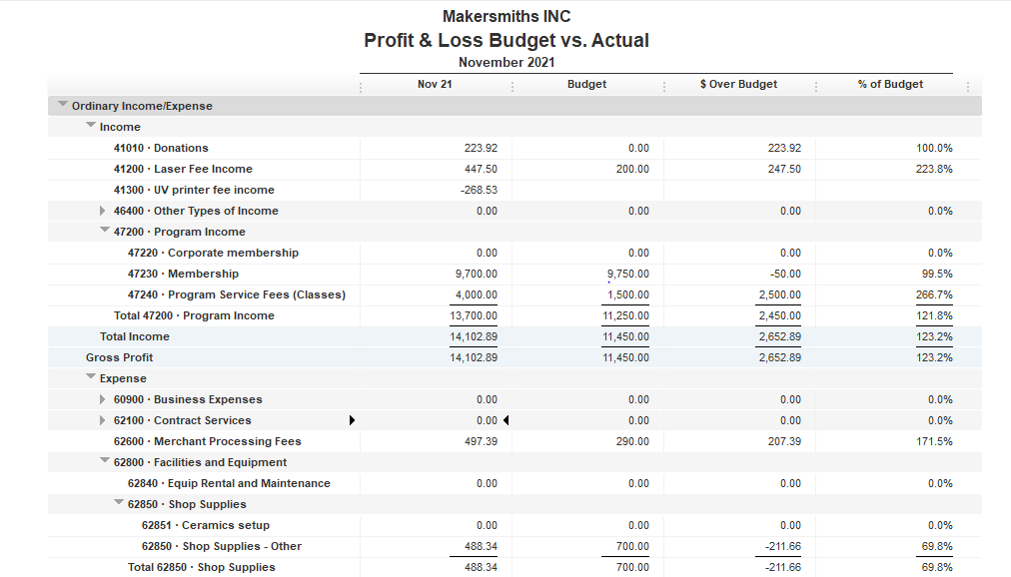



Total Income $14,102.89
Total Expenses $14,529.52
Net Income $ - 426.63
EOM Nov 2021
Bank Account Balance $38,194.37
Building Reserve Fund $35,000.00
Equipment Reserve Fund $35,000.00

Slide 3
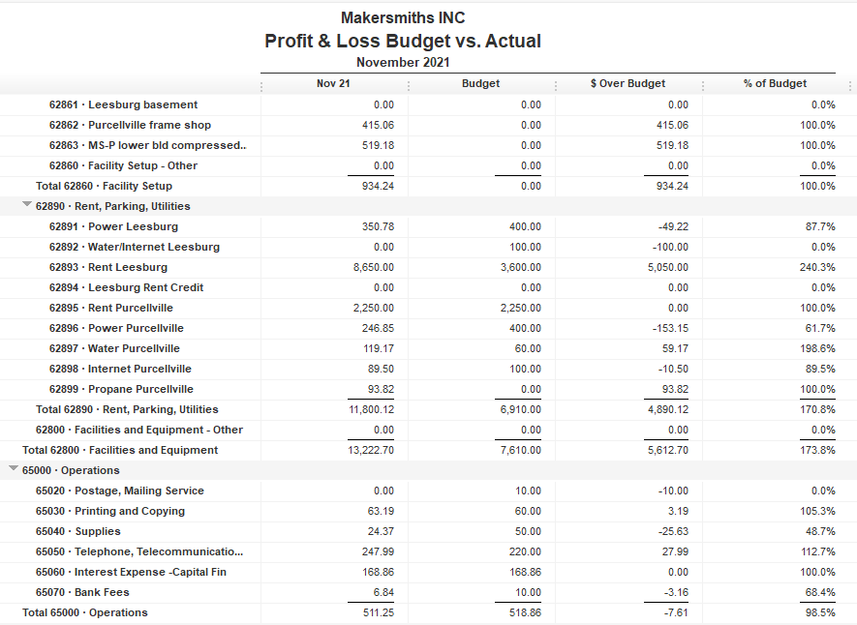

Back rent paid

Slide 4

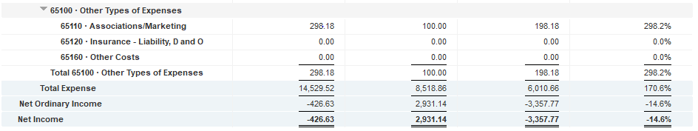

Slide 5
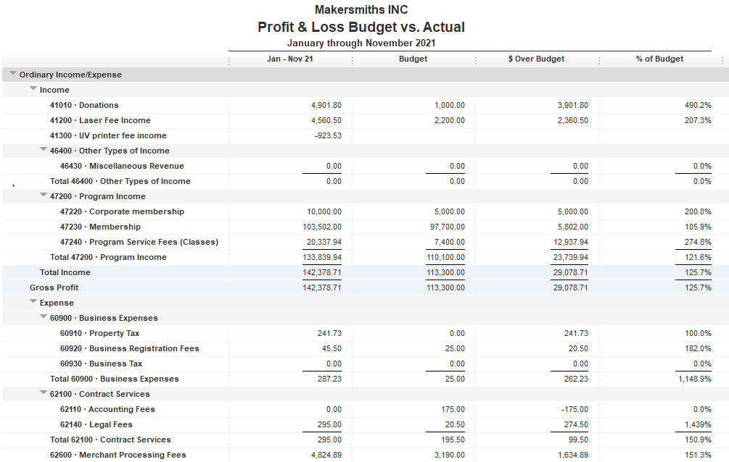

Slide 6
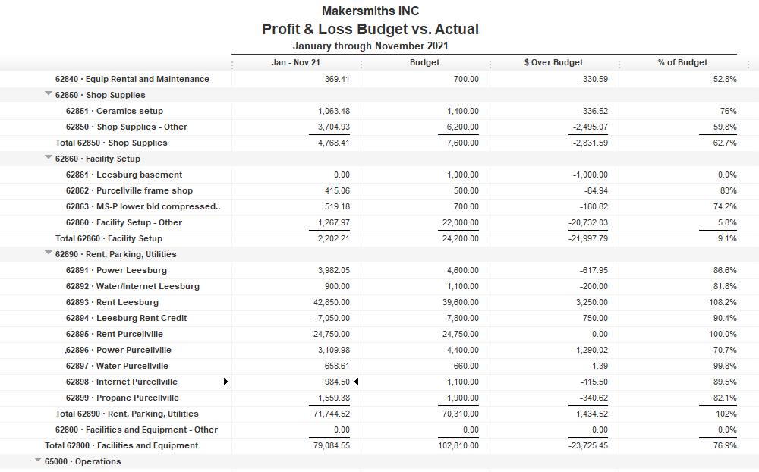

Slide 7
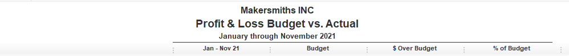
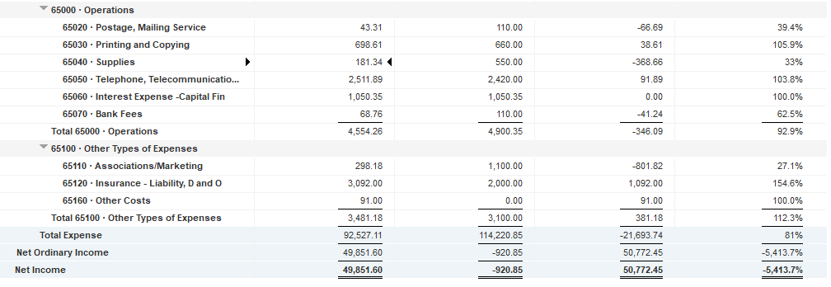

Slide 8
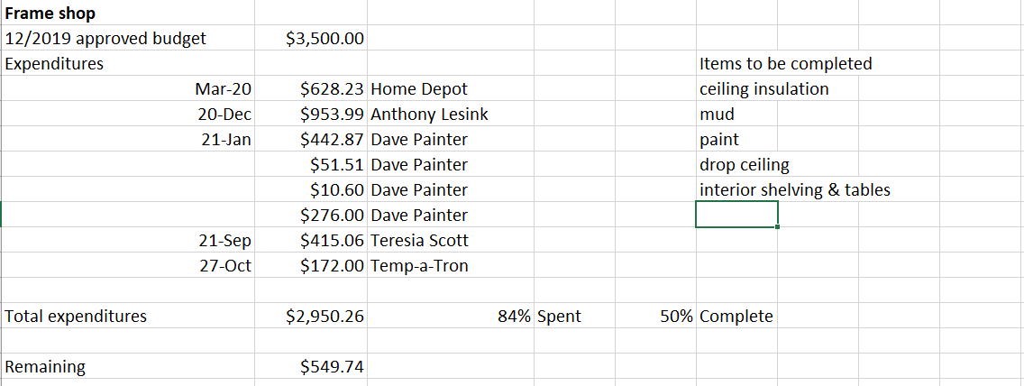
Approved Projects Budgets & Expenditures

Slide 9
Approved Projects Budgets & Expenditures

Slide 10

Approved Projects Budgets & Expenditures

Slide 11
Approved Projects Budgets & Expenditures

Slide 12


Slide 14
Expenses paid in December

Slide 15
Kickstarter Liability
No change from last month
$4,560.00 in outstanding credits – Top 9 listed below

