Slide 1
October 2021
Financials

Slide 2


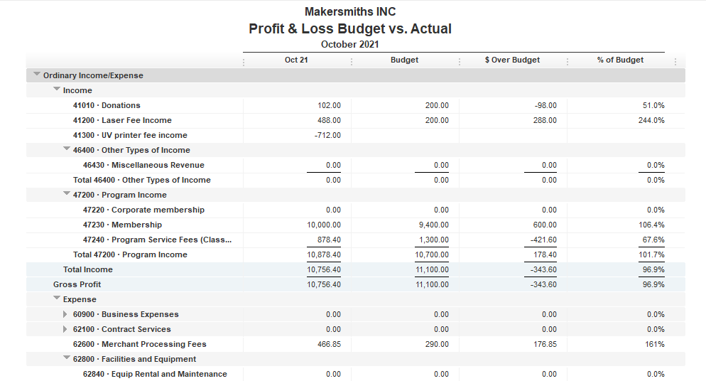



Total Income $10,756.40
Total Expenses $ 6,662.26
Net Income $ 4,094.14
EOM Oct 2021
Bank Account Balance $39,237.49
Building Reserve Fund $35,000.00
Equipment Reserve Fund $35,000.00

Slide 3
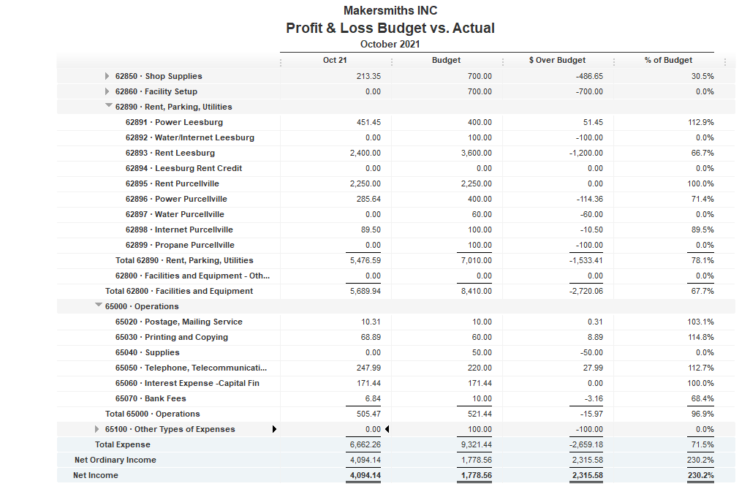


Slide 4
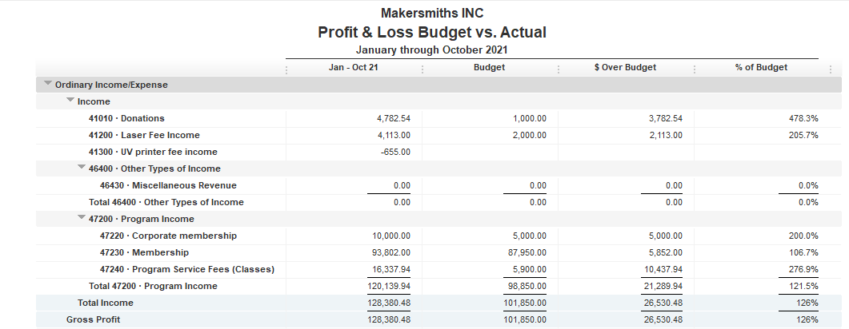

Slide 5
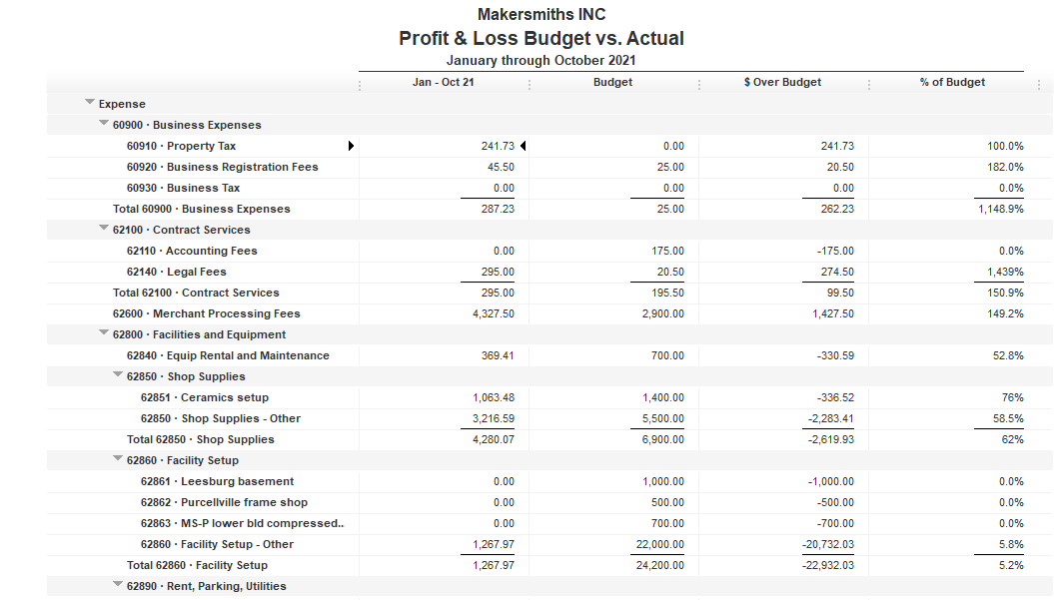

Slide 6
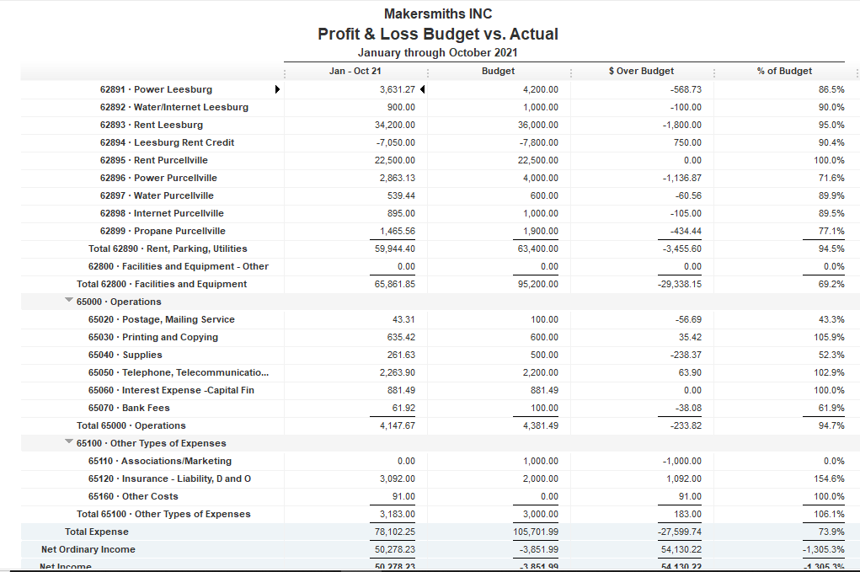

Slide 7
Leesburg Rent

Slide 8
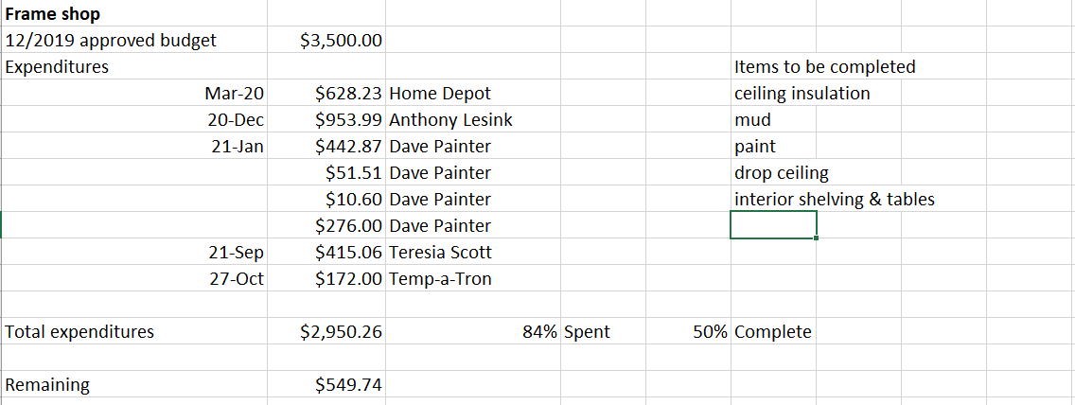
Approved Projects Budgets & Expenditures

Slide 9
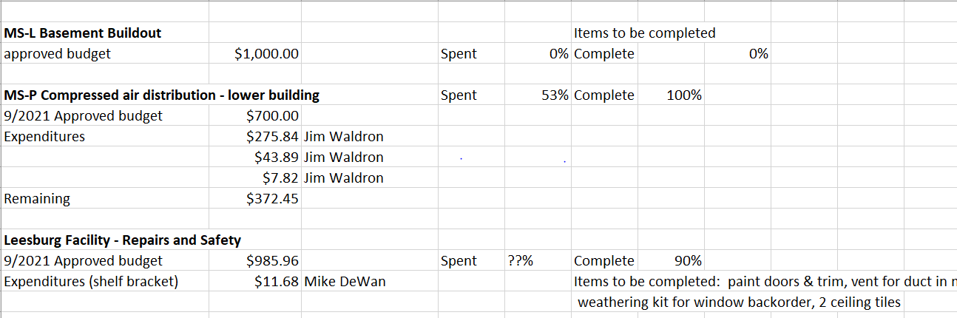
Approved Projects Budgets & Expenditures

Slide 10
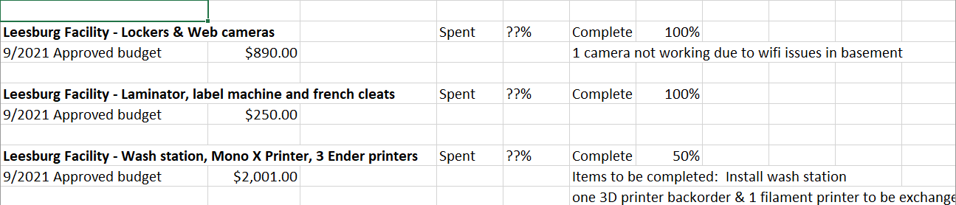
Approved Projects Budgets & Expenditures

Slide 11
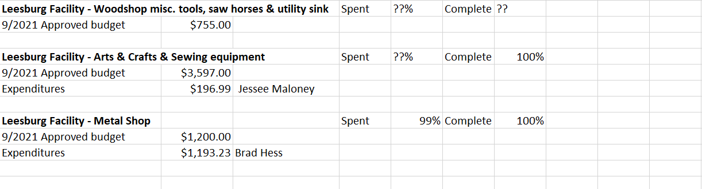
Approved Projects Budgets & Expenditures

Slide 12
Kickstarter Liability
No change from last month
$4,560.00 in outstanding credits – Top 9 listed below

