Slide 1
September 2021
Financials

Slide 2
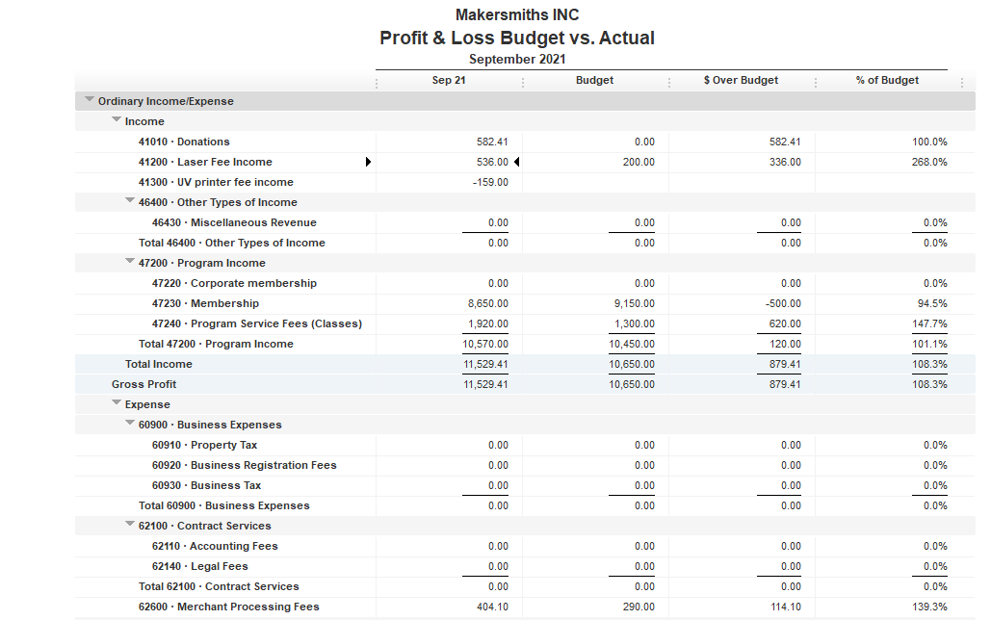





Total Income $11,529.41
Total Expenses $ 4,276.38
Net Income $ 7,253.03
EOM Sep 2021
Bank Account Balance $30,774.57
Building Reserve Fund $37,500.00
Equipment Reserve Fund $37,500.00

Slide 3
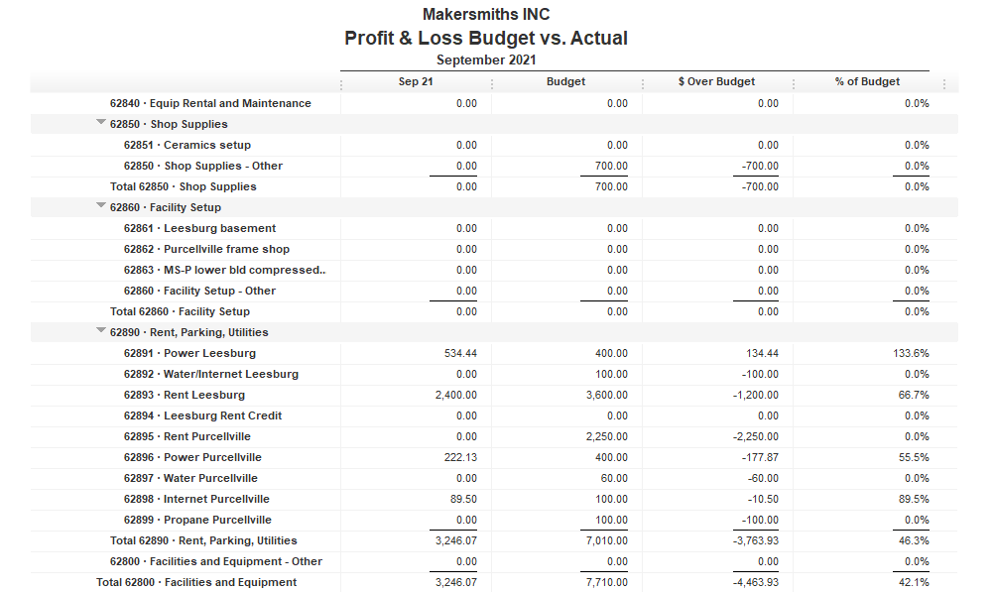


Slide 4

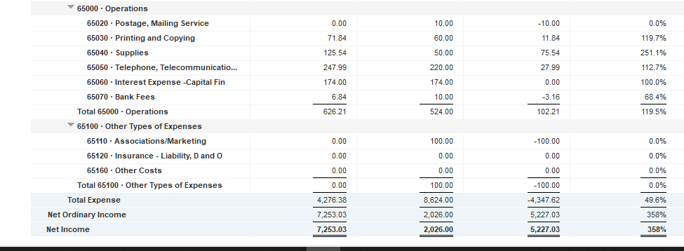

Slide 5
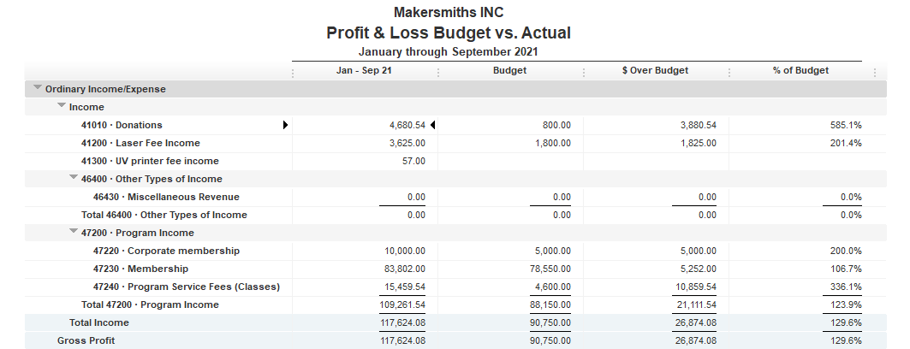

Slide 6
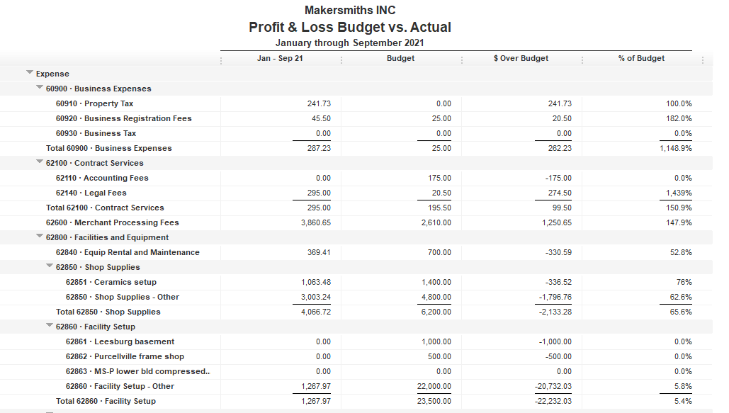

Slide 7
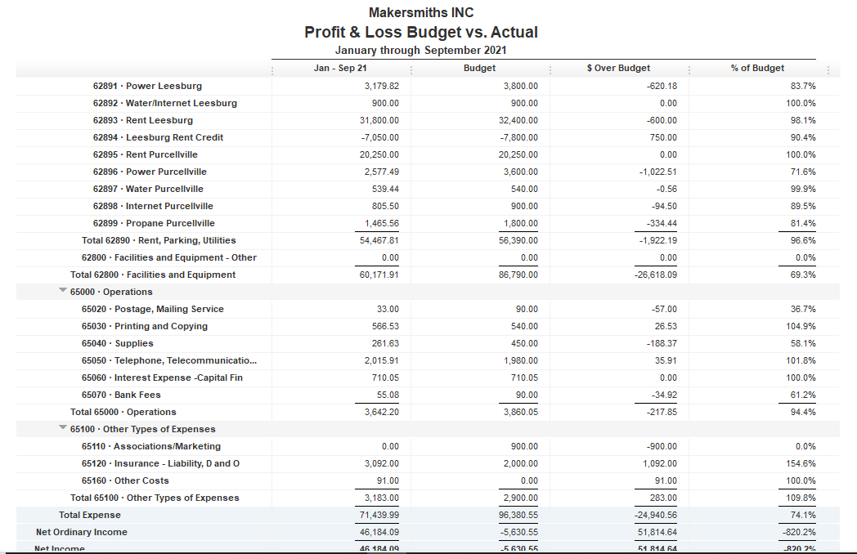

Slide 8
Leesburg Rent

Slide 9
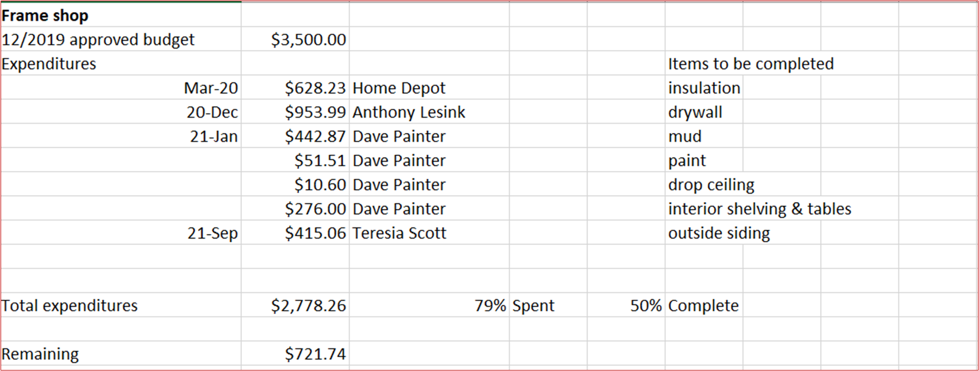
Approved Projects Budgets & Expenditures

Slide 10
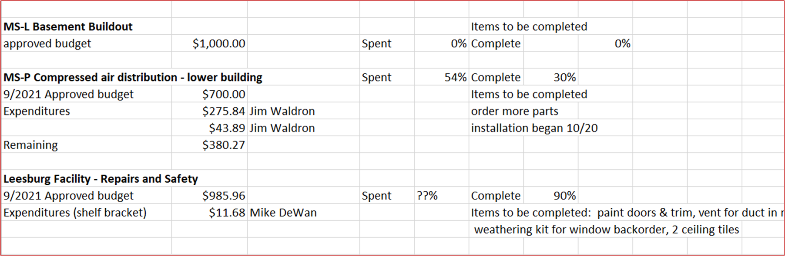
Approved Projects Budgets & Expenditures

Slide 11
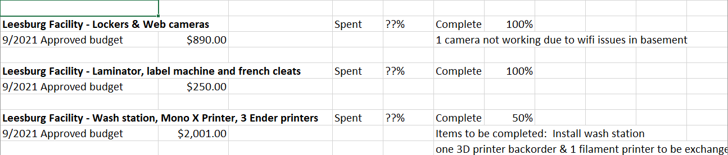
Approved Projects Budgets & Expenditures

Slide 12
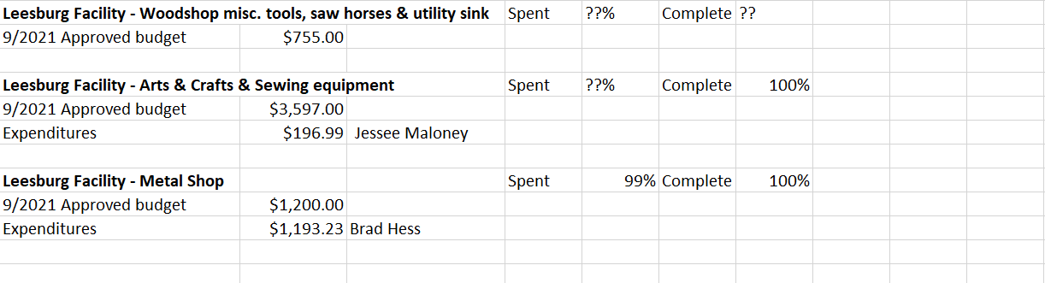
Approved Projects Budgets & Expenditures

Slide 13
Kickstarter Liability
No change from last month
$4,560.00 in outstanding credits – Top 9 listed below

