Slide 1
August 2021
Financials

Slide 2


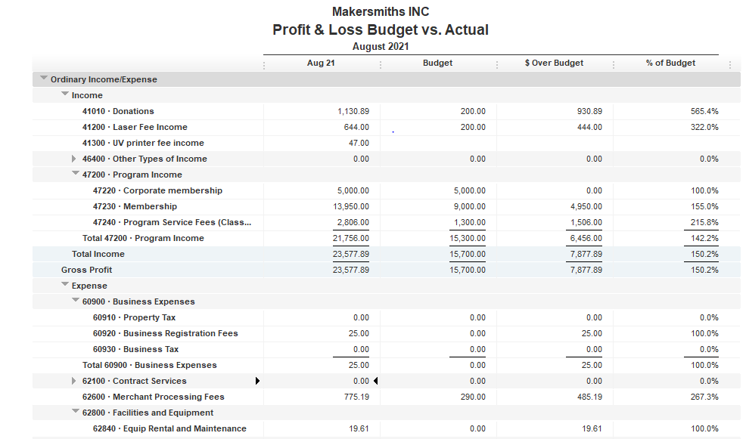
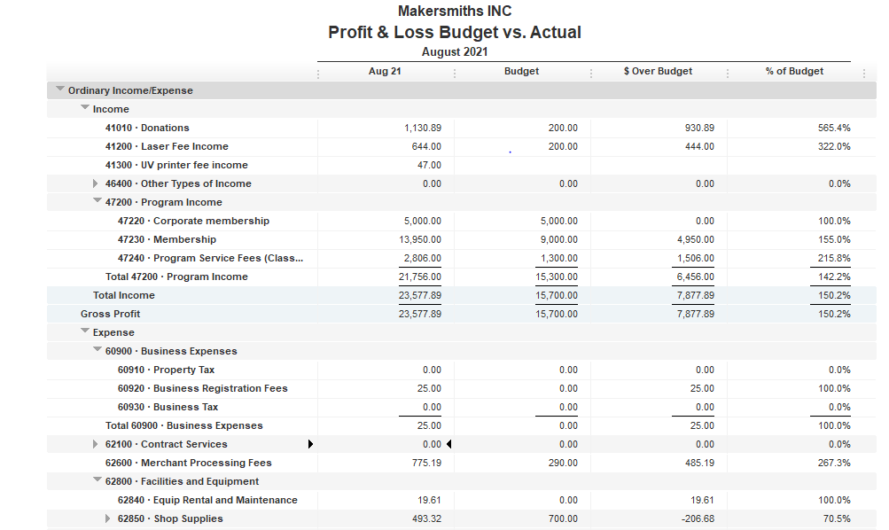



Total Income $23,577.89
Total Expenses $ 10,248.50
Net Income $ 13,329.39
Bank Account Balance
EOM Aug 2021 $98,953.21

Slide 3
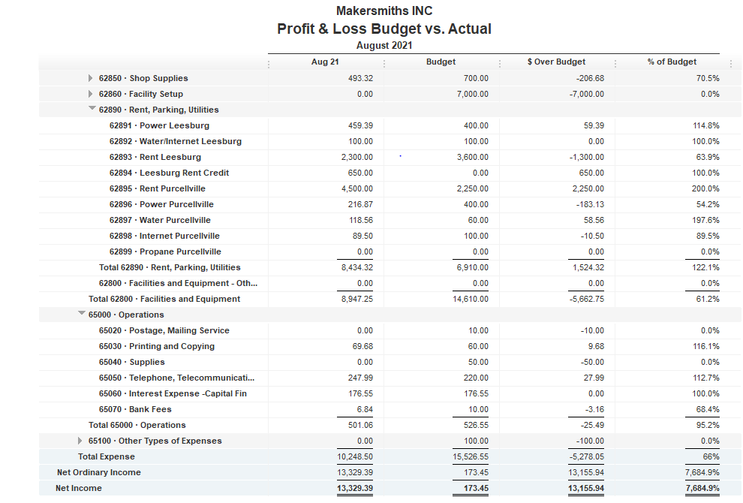


Slide 4
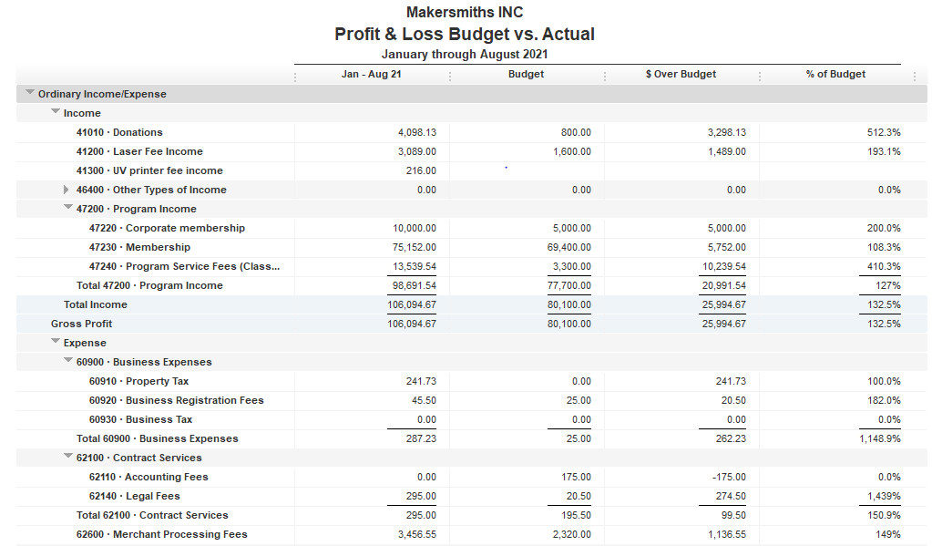
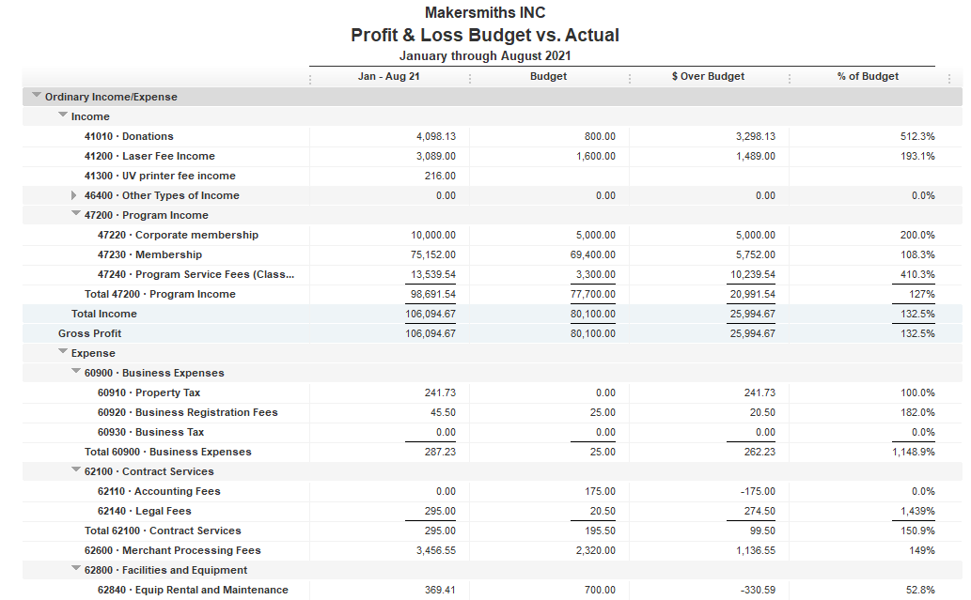

Slide 5
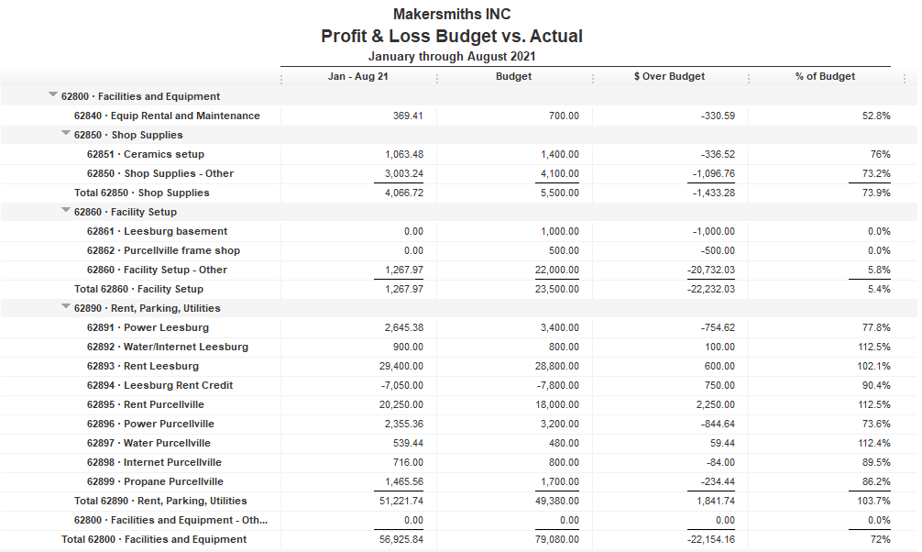

Slide 6
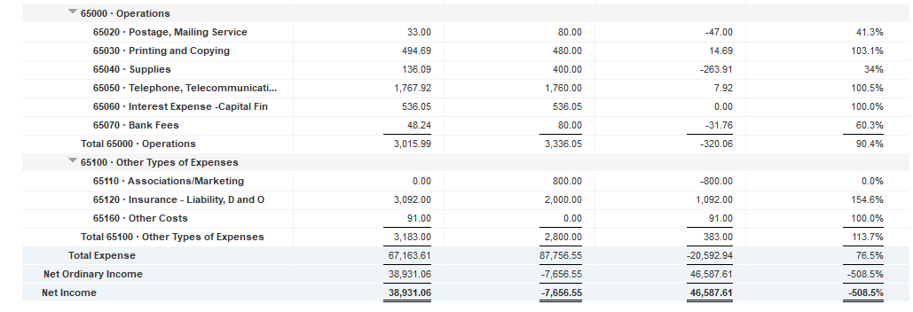

Slide 8
Approved Projects Budgets & Expenditures
Frame shop
12/2019 approved budget | $3,500.00
 |  |  |  |  | Items to be completed
Mar-20 | $628.23 | Home Depot |  |  | insulation
20-Dec | $953.99 | Anthony Lesink |  |  | drywall
21-Jan | $442.87 | Dave Painter |  |  | mud
 | $51.51 | Dave Painter |  |  | mount mini-split interior unit
 | $10.60 | Dave Painter |  |  | paint
 | $276.00 | Dave Painter |  |  | drop ceiling
 |  |  |  |  | interior shelving & tables
Total expenditures | $2,363.20 | 68% | Spent | ?? | Complete
 | $1,136.80
MS-L Basement Buildout |  |  |  |  | Items to be completed
approved budget | $1,000.00 | ?? | Spent | ?? | Complete |  | ??

Slide 9
Approved Projects Budgets & Expenditures
Plasma cutter table | Completed
8/2020 approved budget | $970.62 | actual budget based on 1-1 matching donations
1 to 1 matching donations not to exceed $1500
Total expenditures | $711.47 | 73% | Spent | 100% | Complete
Power Hammer build | Completed
11/2020 approved budget | $700.00
Total expenditures | $576.18 | 82% | Spent | 100% | Complete
Ceramics | Completed
4/2021 approved budget | $1,400.00
Total expenditures | $1,314.43 | 94% | Spent | 100% | Complete
Blacksmith Shop | Completed
Blacksmith Costs | $3,064.82 |  |  | 100% | Complete
Net Income from 2019 & 2020 classes | $2,255.90
Reimbursed to Brad | $2,255.90
Net Income from 2021 classes | $823.32
Reimbursed to Brad | $808.92

Slide 10
Approved Projects Budgets & Expenditures
Leesburg Facility - Repairs and Safety
9/2021 Approved budget | $985.96
Leesburg Facility - Lockers & Web cameras
9/2021 Approved budget | $890.00
Leesburg Facility - Laminator, label machine and french cleats
9/2021 Approved budget | $250.00
Leesburg Facility - Wash station, Mono X Printer, 3 Ender printers
9/2021 Approved budget | $2,001.00
Leesburg Facility - Woodshop misc. tools, saw horses & utility sink
9/2021 Approved budget | $755.00
Leesburg Facility - Arts & Crafts & Sewing equipment
9/2021 Approved budget | $3,597.00
Expenditures | $196.99
Leesburg Facility - Metal Shop
9/2021 Approved budget | $1,200.00

Slide 11
Kickstarter Liability
 | 2021 Kickstarter Liability - September 2021
 | Backer Name | Fullfilled | Liability | Reward Title | Reward Minimum | Pledge Amount
 | Michael Keene |  | $500.00 | Makersmiths Big Class Pass | $500.00 | $650.00
 | George Cummings |  | $500.00 | Makersmiths Big Class Pass | $500.00 | $500.00
 | Jeffrey Stern |  |  | None |  | $25.00
 | Susanne Vasjuta |  |  | None |  | $25.00
 | Kristen |  |  | None |  | $10.00
 | craig shoots |  |  | None |  | $25.00
 | Haig Evans-Kavaldjian |  |  | None |  | $20.00
 | Judy Irelan |  |  | None |  | $20.00
 | Kelli Botelho Grim |  |  | None |  | $50.00
 | Tom Simmons |  |  | None |  | $1,000.00
 | Ann Margaret Russ |  |  | None |  | $100.00
 | Jessica Dubin |  |  | None |  | $100.00
 | Kate Shepet |  |  | None |  | $50.00
 | Thomas Murdock |  |  | None |  | $1,000.00

Slide 12
Kickstarter Liability
 | Gary Cline |  |  | None |  | $25.00
 | Simone Parrish |  |  | None |  | $40.00
 | Matt |  |  | None |  | $100.00
 | Patricia Dubin |  |  | None |  | $100.00
 | rebecca tyler |  | $500.00 | Makersmiths 6 month family membership | $500.00 | $500.00
 | Nancy Gross |  | $250.00 | Makersmiths, Class Pass | $250.00 | $250.00
 | Jennifer Nelson East |  | $250.00 | Makersmiths, Class Pass | $250.00 | $250.00
 | John Raymond |  | $250.00 | Makersmiths, Class Pass | $250.00 | $250.00
 | Dan Schmidt |  | $250.00 | Makersmiths, Class Pass | $250.00 | $250.00
 | Dan Kasun |  | $250.00 | Makersmiths, Class Pass | $250.00 | $250.00
 | Amy Barden |  | $250.00 | Makersmiths, Class Pass | $250.00 | $250.00
 | Ben Rossi |  |  | Makersmiths sign | $100.00 | $100.00
 | Matthew Fistler |  |  | Makersmiths sign | $100.00 | $200.00
 | Mary Litton |  |  | Makersmiths sign | $100.00 | $100.00
 | Dennis Kruse |  |  | Makersmiths sign | $100.00 | $100.00

Slide 13
Kickstarter Liability
 | Chris Bledsoe |  | $100.00 | Founding Member - 1 month | $100.00 | $100.00
 | Andrea Cubelo-McKay |  | $100.00 | Founding Member - 1 month | $100.00 | $100.00
 | Jennifer Noll |  | $100.00 | Founding Member - 1 month | $100.00 | $100.00
 | Michael Raddatz |  | $100.00 | Founding Member - 1 month | $100.00 | $100.00
 | Mark Nichols |  | $100.00 | Founding Member - 1 month | $100.00 | $100.00
 | Stacey Tuman |  | $100.00 | Founding Member - 1 month | $100.00 | $100.00
 | Bruce Lawton |  | $100.00 | Founding Member - 1 month | $100.00 | $100.00
 | Marty Hoffman |  | $100.00 | Founding Member - 1 month | $100.00 | $100.00
 | Aidan |  | $100.00 | Founding Member - 1 month | $100.00 | $120.00
 | Tim Dennison |  | $100.00 | Founding Member - 1 month | $100.00 | $100.00
 | Steve Albers |  | $100.00 | Founding Member - 1 month | $100.00 | $100.00
 | Josh Shields |  | $100.00 | Founding Member - 1 month | $100.00 | $100.00
 | Ryan Dowden |  | $100.00 | Founding Member - 1 month | $100.00 | $100.00

Slide 14
Kickstarter Liability
 | John Dubelko |  |  | Makersmiths Purcellville, T-shirt | $50.00 | $200.00
 | Paul Donohue |  |  | Makersmiths Purcellville, T-shirt | $50.00 | $50.00
 | Rebecca Martin |  |  | Makersmiths Purcellville, T-shirt | $50.00 | $50.00
 | Bryan Boston |  |  | Makersmiths Purcellville, T-shirt | $50.00 | $50.00
 | Vanessa Marie |  |  | Makersmiths Purcellville, T-shirt | $50.00 | $50.00
 | Mary Arden |  | $50.00 | Makersmiths gift month membership | $50.00 | $50.00
 | blindstitch |  | $50.00 | Makersmiths gift month membership | $50.00 | $50.00
 | Bonnie Creech |  | $50.00 | Makersmiths gift month membership | $50.00 | $50.00
 | Alisa Kinney |  | $50.00 | Makersmiths gift month membership | $50.00 | $50.00
 | Ryan Burr |  |  | Makersmiths custom ruler | $25.00 | $100.00
 | Kevin King |  |  | Makersmiths custom ruler | $25.00 | $25.00

Slide 15
Kickstarter Liability

