Slide 1
March 2021
Financials

Slide 2




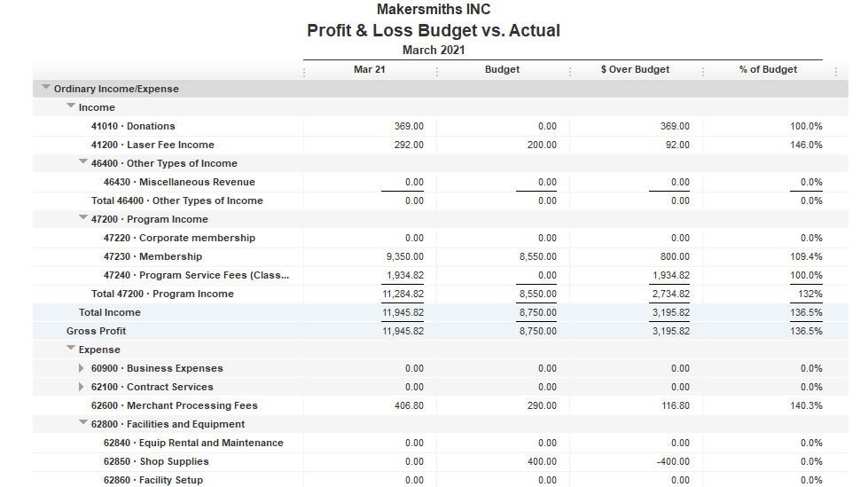

Total Income $11,945.82
Total Expenses $ 8,963.46
Net Income $ 2,982.36
Computer auction
Asset Changes
Power Hammer -$180.05
Bank Account Balance
EOM Mar 2021 $71,029.35
As of Apr 28 $76,673.19

Slide 3


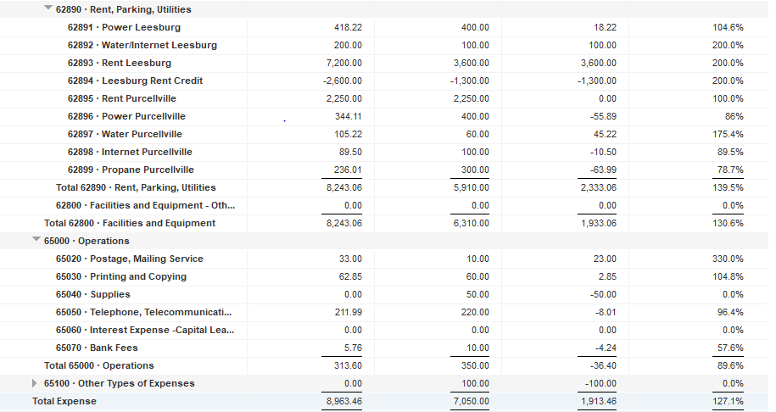

Slide 5
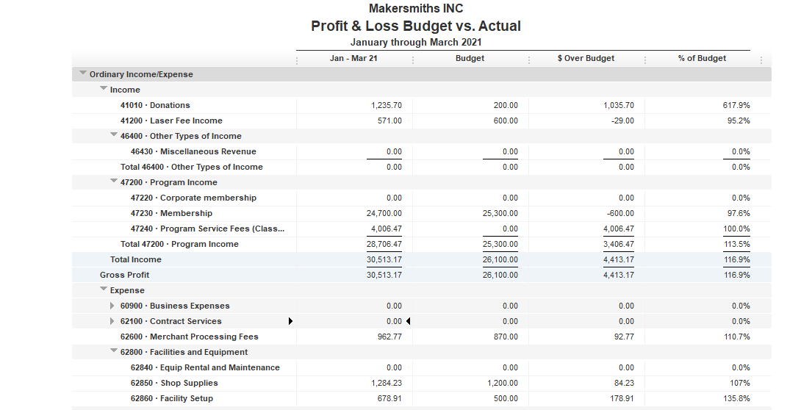

Slide 6
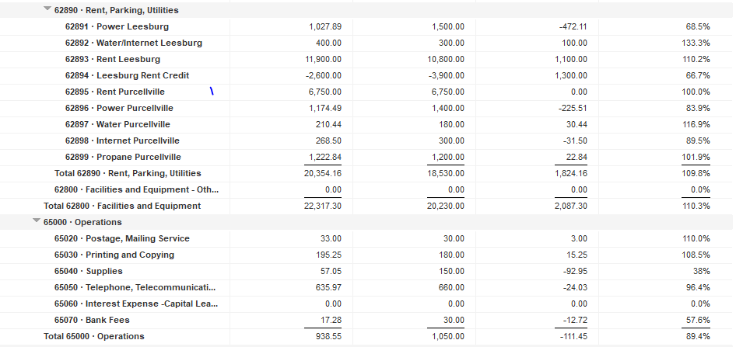

Slide 7
