Slide 1
October 2019
Track to Budget

Slide 2
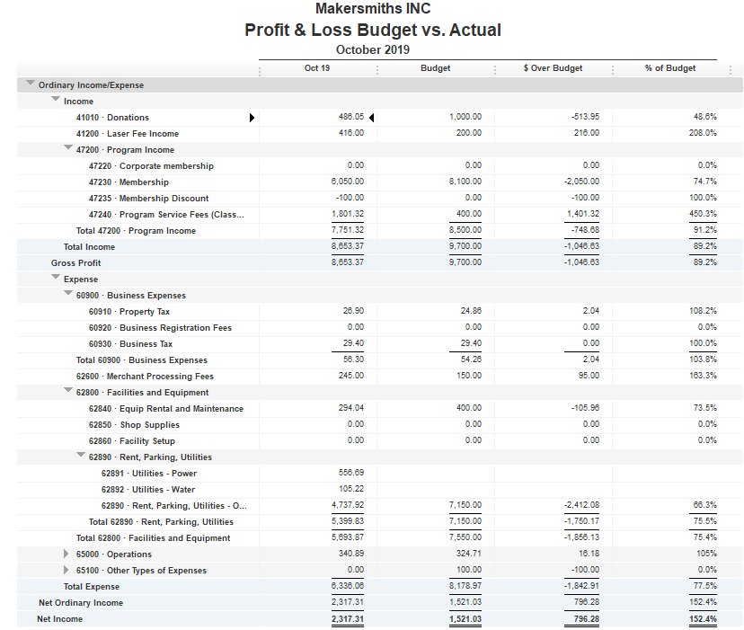


Bank Account | Balance
EOM Oct | $48,618.12
As of Nov 25, 2019 | $49,625.28
Behind on Membership

Slide 3
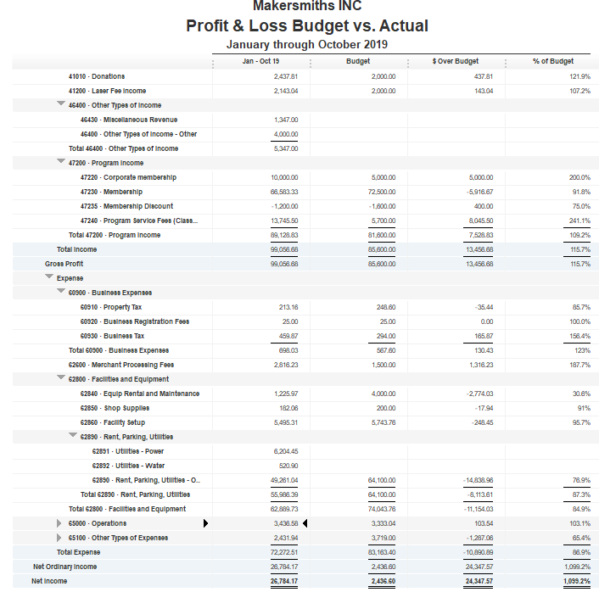
Earlier Membership Surplus is Eroding
Facility Build out surplus is $248.45

Slide 4
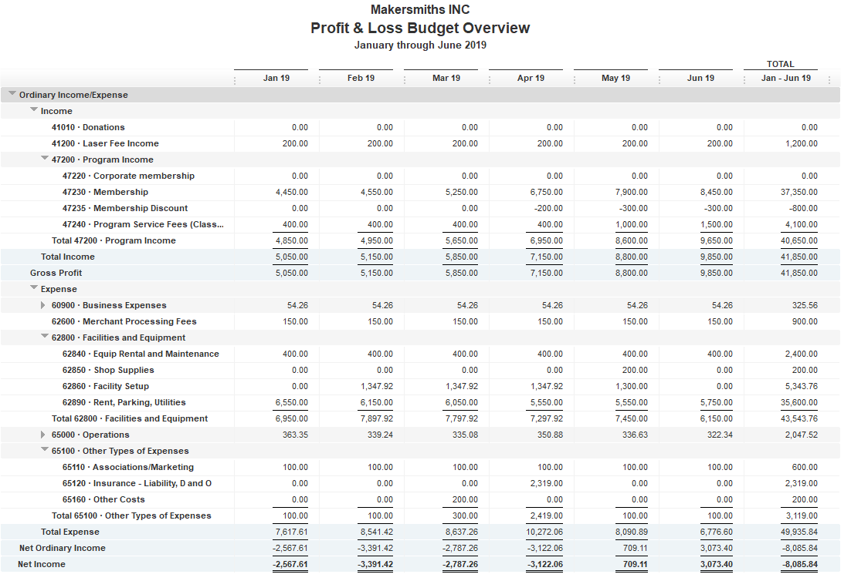
Jan - Jun Monthly Budget
Jan Beckstrom check cleared in Dec 2018
Ceramics
Cameras

Slide 5
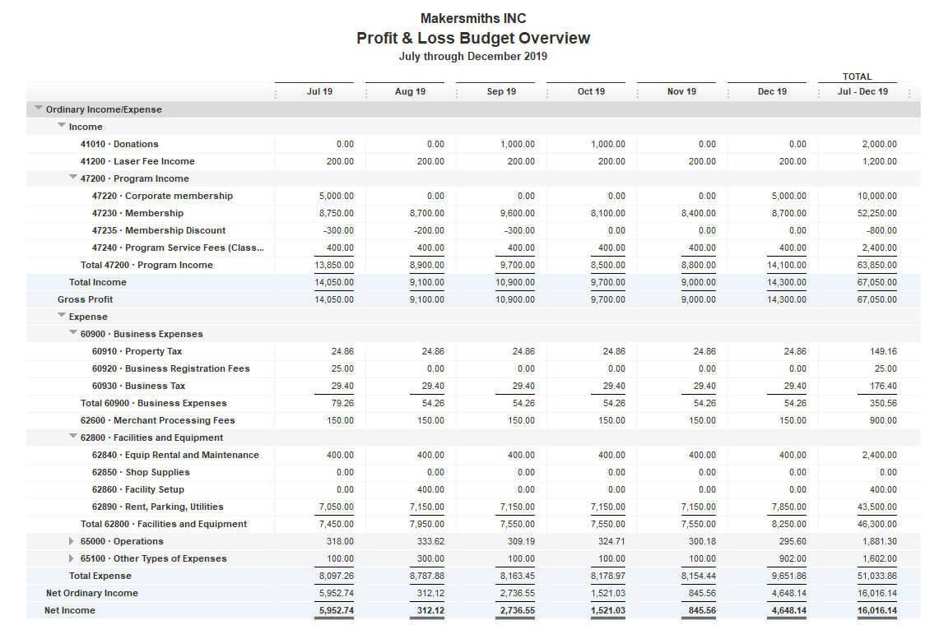
July – Dec Monthly Budget
Note: Sep 2019 BOD approved $450 for a lathe
$400 Fire Extinguisher
$200 T-shirts

