Slide 1
August 2019
Track to Budget

Slide 2
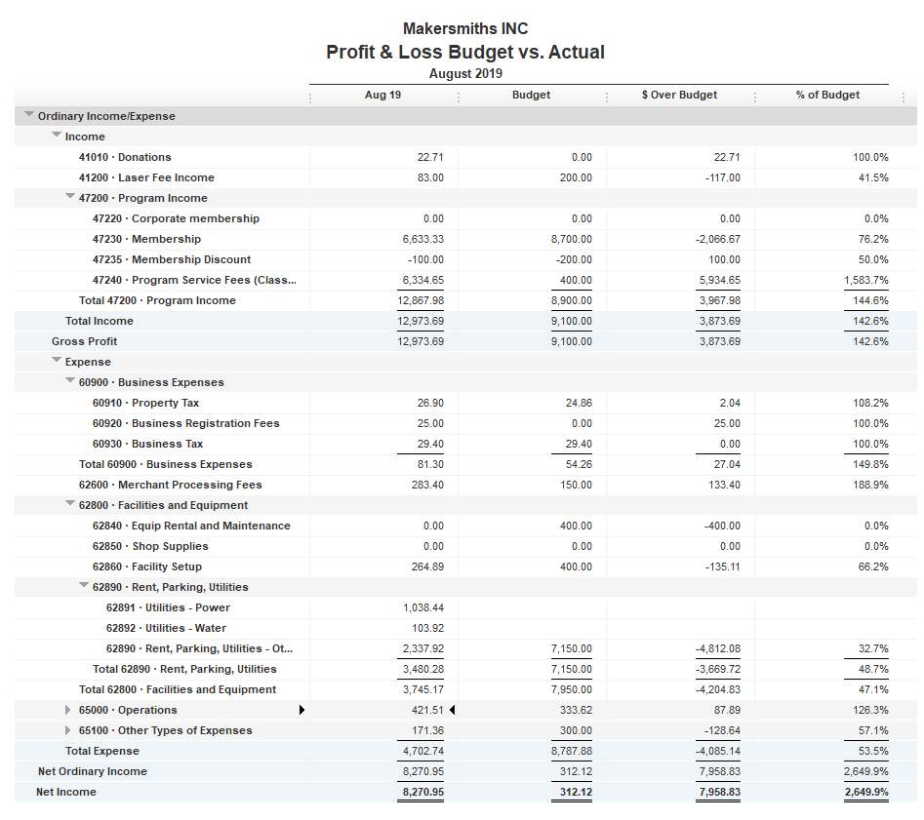


Bank Account | Balance
EOM August | $47,005.58
As of Aug 25, 2019 | $45,785.56
Waiting for K2M Membership Payment
Leesburg Rent Check cleared in Sep

Slide 3
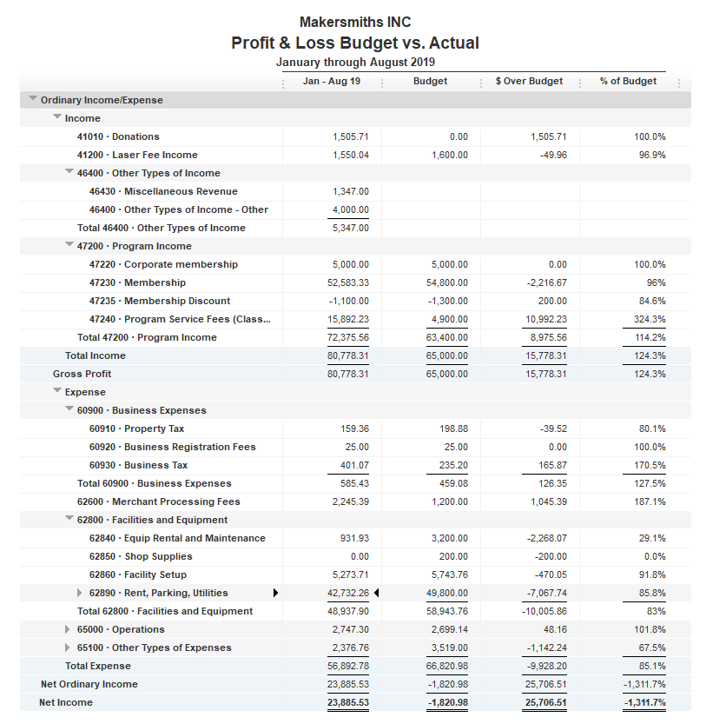
Earlier Membership Surplus is Eroding
Facility Build out surplus is $470.05

Slide 4
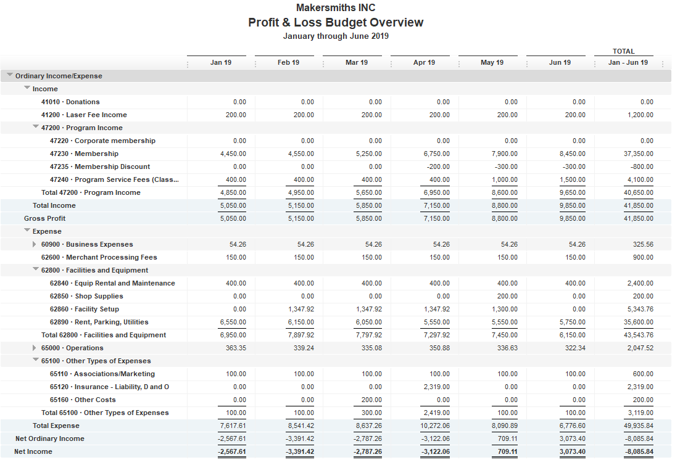
Jan - Jun Monthly Budget
Jan Beckstrom check cleared in Dec 2018
Ceramics
Cameras

Slide 5
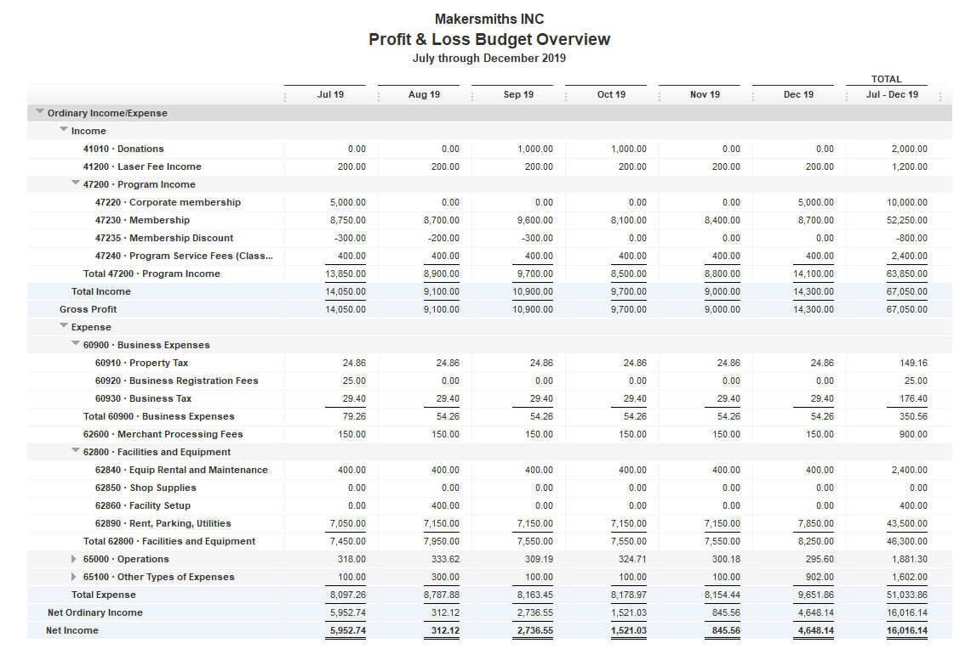
July – Dec Monthly Budget
$400 Fire Extinguisher
$200 T-shirts

