Slide 1
June 2019
Track to Budget

Slide 2
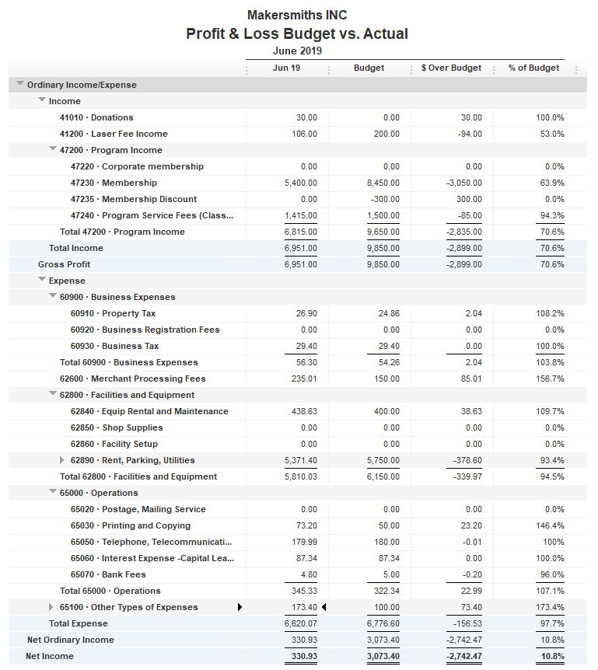


Bank Account | Balance
EOM June | $41,838.51
As of July 24, 2019 | $42,412.14
Planned
3 Annual Memberships
T-Shirts

Slide 3
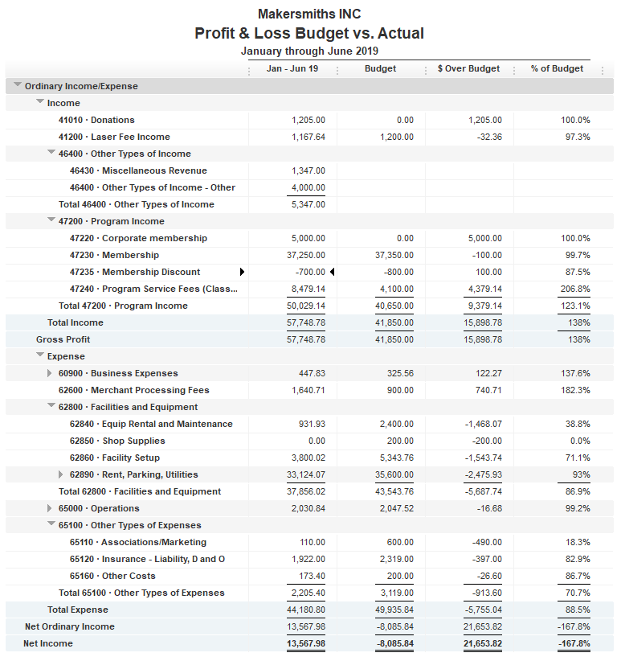

Slide 4
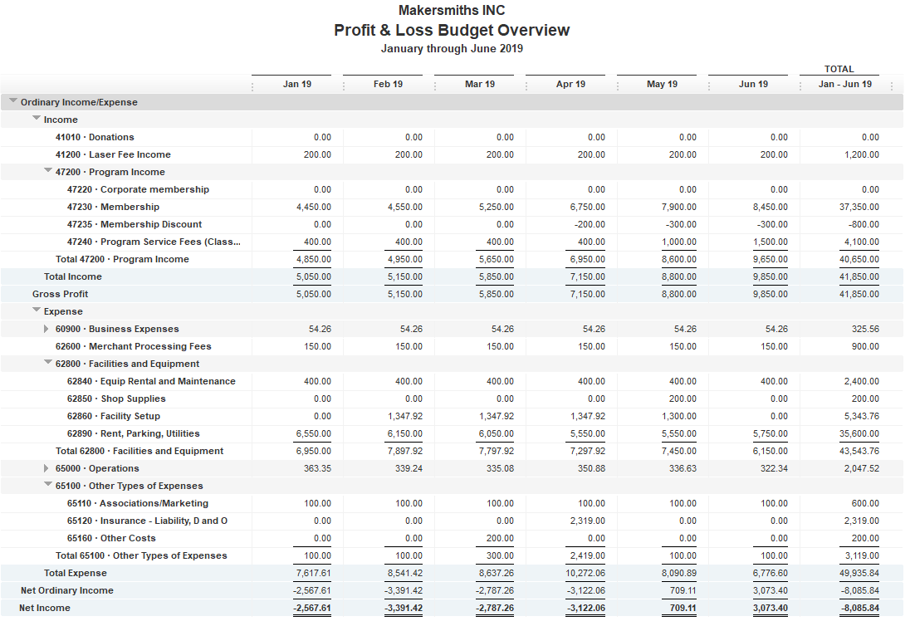
Jan - Jun Monthly Budget
Jan Beckstrom check cleared in Dec 2018
Ceramics
Cameras

Slide 5
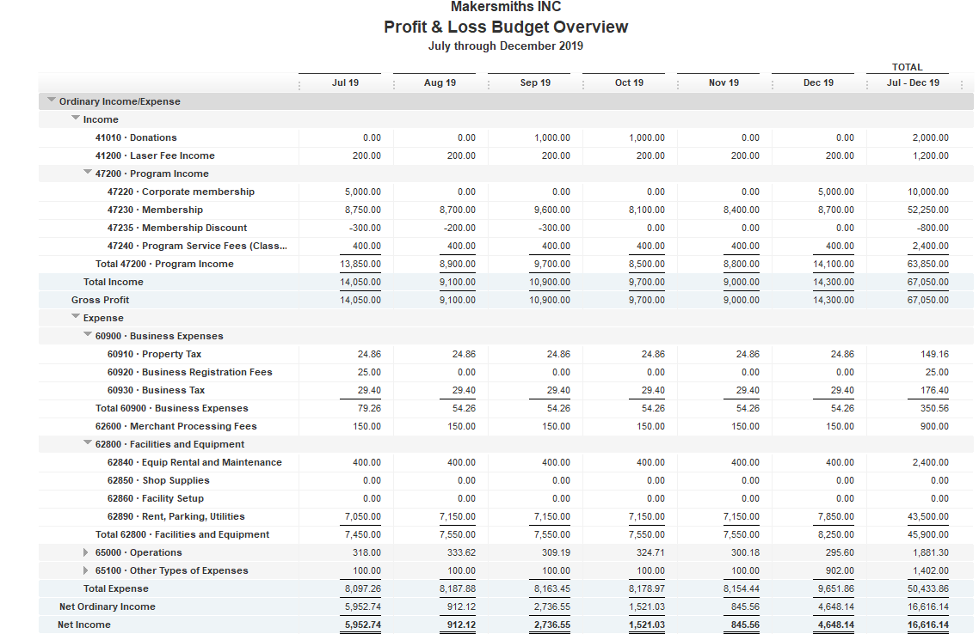
July – Dec Monthly Budget

