Slide 1
May 2019
Track to Budget

Slide 2
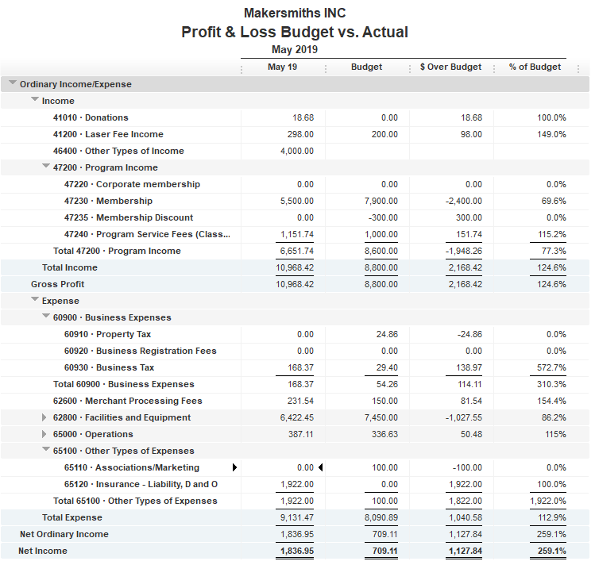


Bank Account | Balance
EOM May | $41,910.24
As of Jun 23, 2019 | $40,698.03
Grant
Budgeted for last month

Slide 3
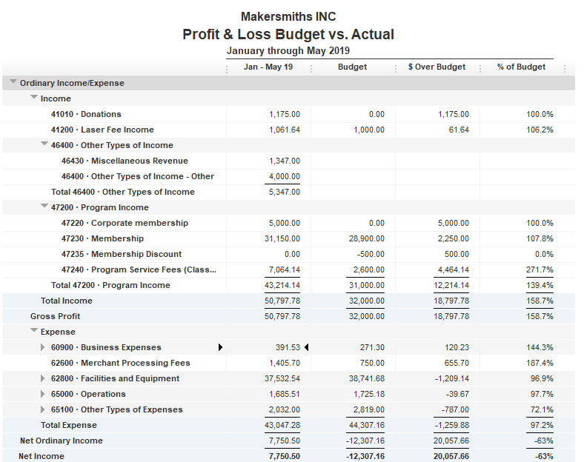

Slide 4
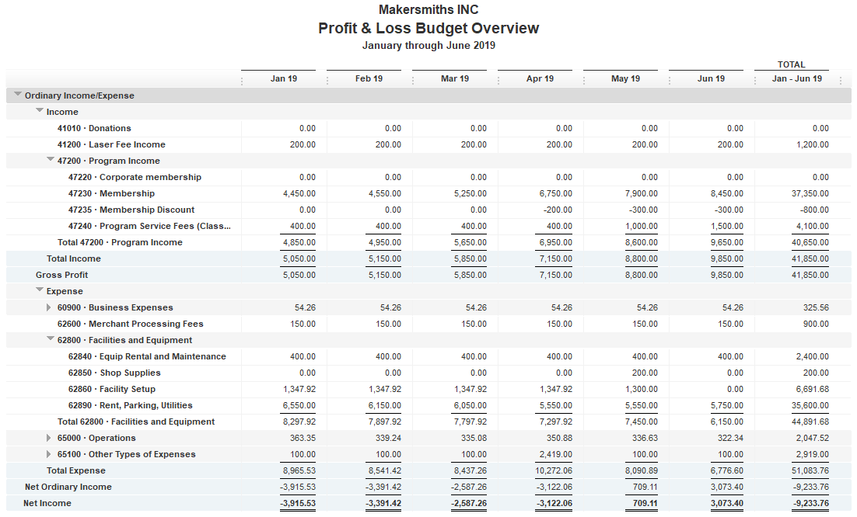
6 Month Budget
Ceramics
Cameras

