Slide 1
April 2019
Track to Budget

Slide 2
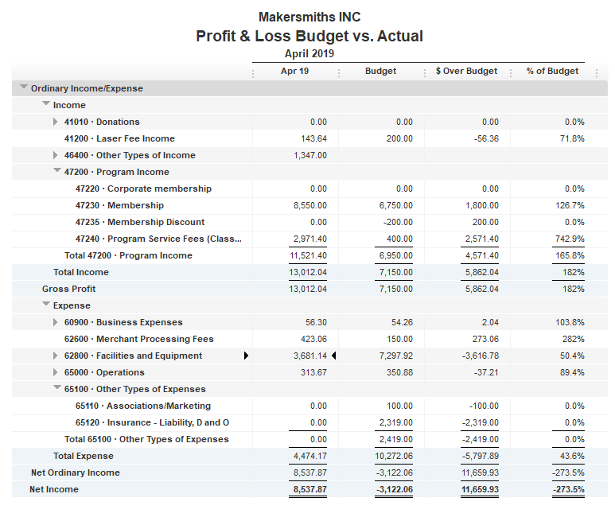


Bank Account | Balance
EOM April | $40,471.66
As of May 29, 2019 | $41,898.57

Slide 3
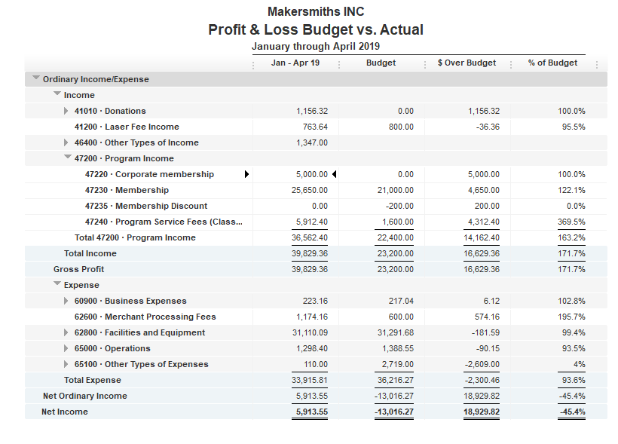

Slide 4
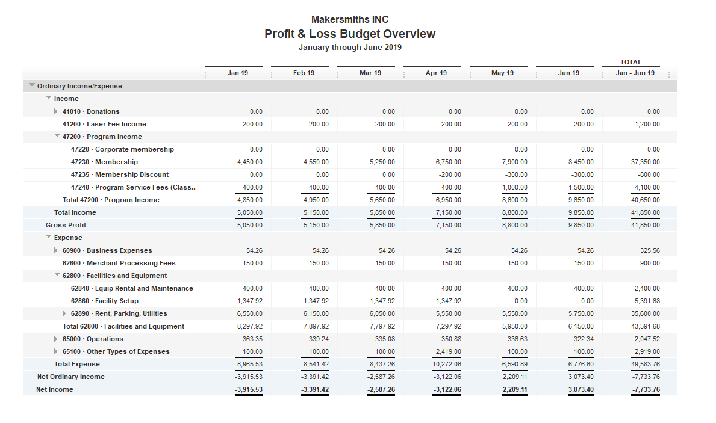
6 Month Budget

