Slide 1
Feb2019
Track to Budget

Slide 2
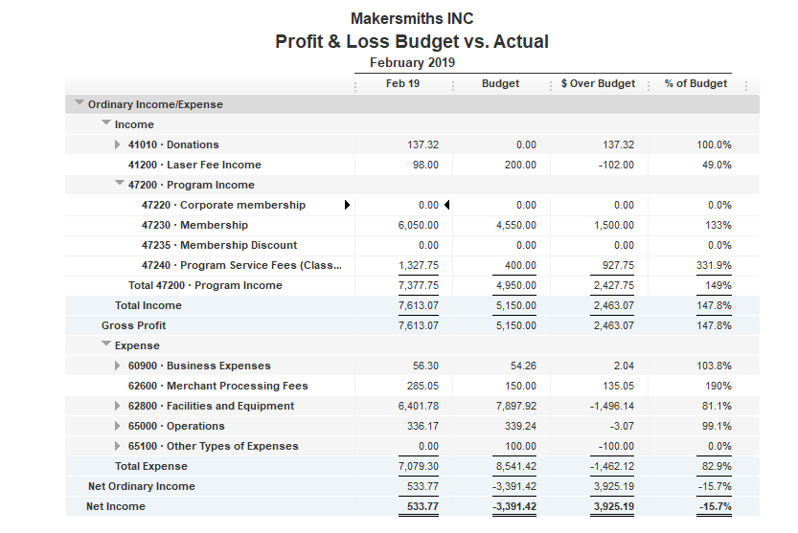


Bank Account | Balance
EOM Feb | $35,525.17
As of Mar 27, 2019 | $32,588.18

Slide 3
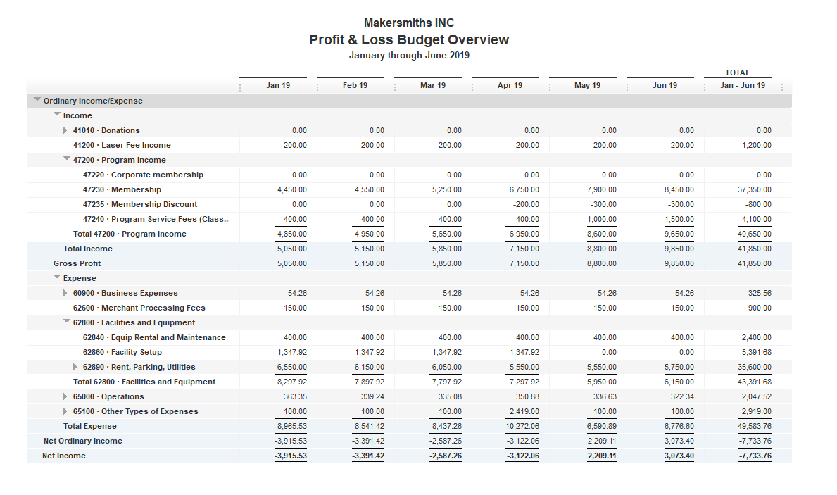
6 Month Budget

