Slide 1
Jan2019
Track to Budget

Slide 2
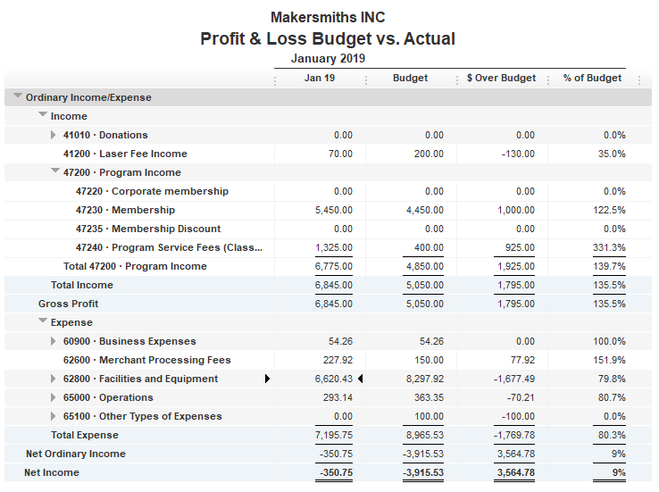



Slide 3
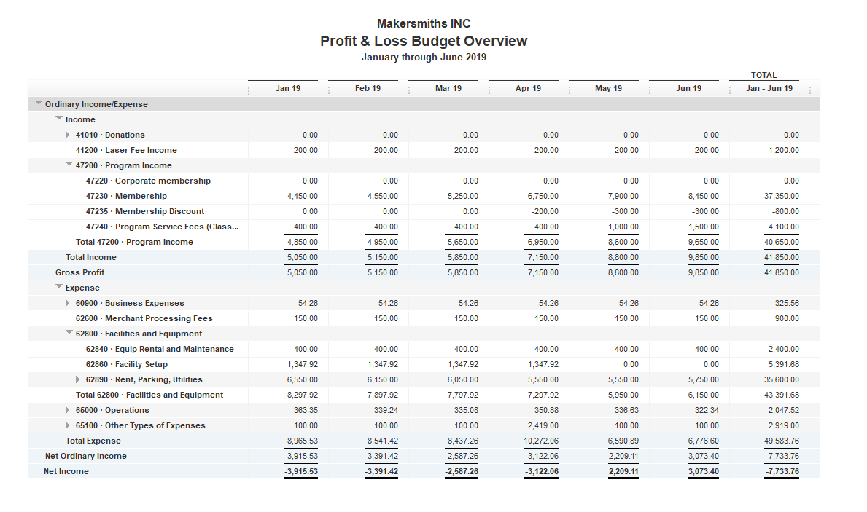
6 Month Budget

