Slide 2
Color Palette Information
Red = #E31837
Black = #000000
Silver = #999999
Gold = #B9AB97

Slide 3







Logos For Use in Presentations

Slide 4
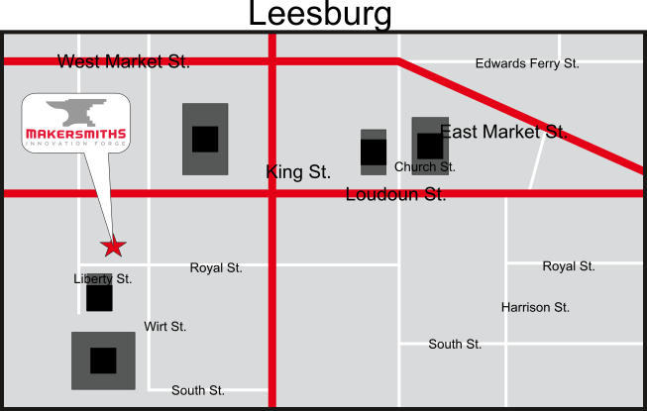

Maps For Use in Presentations

