Slide 1
Laser Cutter
Beginner Class
Thunder Nova 24 & Nova 51
REVISED 2/10/24

Slide 2
Laser Training Outline
Introduction to Laser Equipment in Leesburg & Purcellville
Guidelines and Policies
Laser Safety Review
Getting to Know the Machine
Laser Cutting & Engraving Process
Introduction to Laser Software: LightBurn
Tips, Hints, and having FUN
Hands on Training and Use

Slide 3
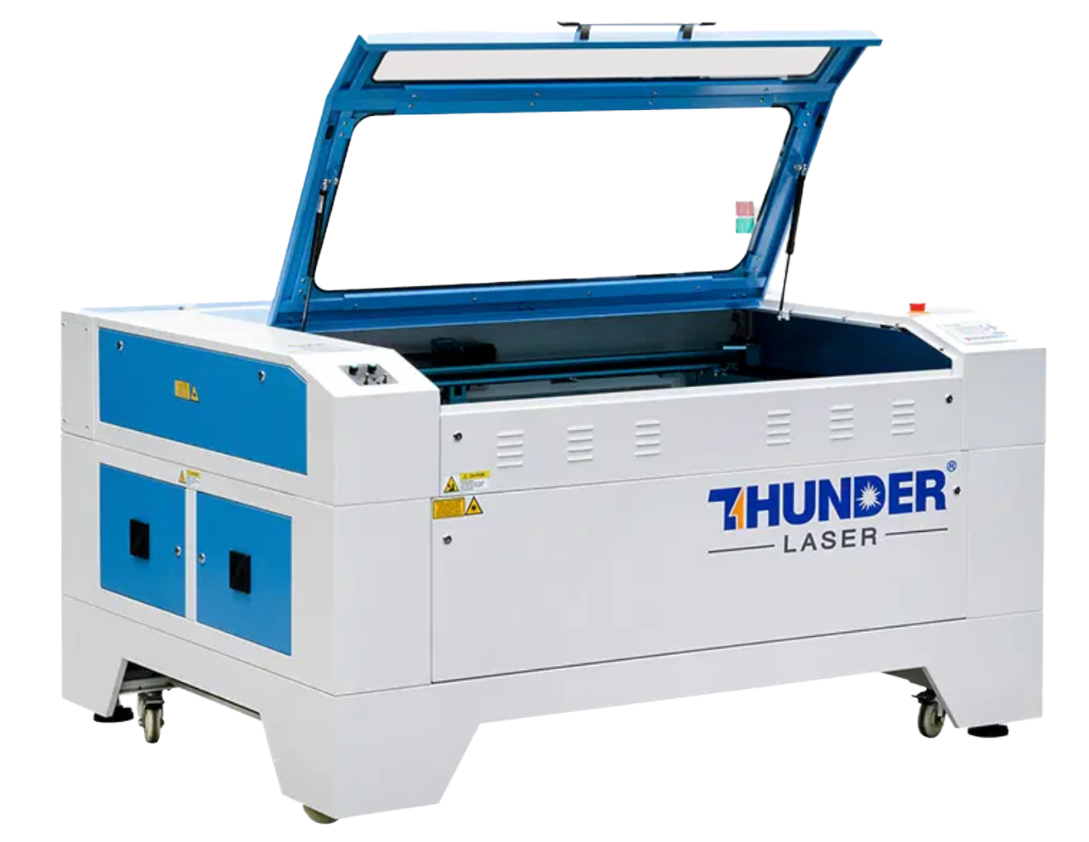
Laser Equipment: Leesburg
Nova 51: https://www.thunderlaserusa.com/machine/nova-51/
Uses one 100 watt sealed glass CO2 cartridge
Cutting area is 51.2" x 35.4" - with a max thickness of 9.1”
Pass through closed: 55.1" x 40.6" x 9.1"
Pass through open: 55.1" x ∞" x .8"
Rotary attachment available
(separate training session)

Slide 4
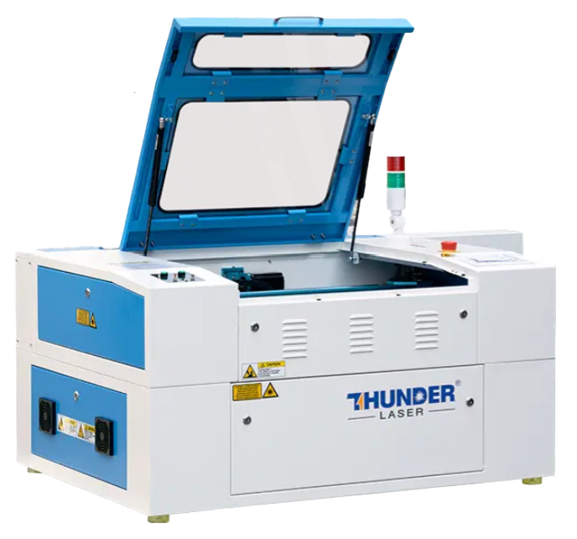
Laser Equipment: Purcellville
Nova 24: https://www.thunderlaserusa.com/machine/nova-24/
Uses one 60 watt sealed glass CO2 cartridge
Cutting area is 23.6" x 15.7" - with a max thickness of 6.1”
Pass through closed: 27.6" x 20.9" x 6.1"
Pass through open: 27.6" x ∞" x .8"
Rotary attachment available
(separate training session)

Slide 5
Differences Between Locations
The NOVA 51 is larger than the NOVA 24 so you can do larger projects.
The NOVA 51 has a 100 watt laser and the NOVA 24 has a 60 watt laser. Do not use the same speed and power settings between laser cutters.
The compressors are different units so turning them on/off is slightly different.
The extractor fan is turned on manually in both locations but in different places.

Slide 6
Policies, Safety & Materials

Slide 7
Guidelines and Policies
Sign the Makersmiths Waiver Form - This can be done at the iPad in the Leesburg classroom or the Purcellville Green Room
The Laser is a Red Tool – Red tools require safety training on a specific machine to operate unsupervised for safety and to prevent damage to the machine.
Schedule Your Time on the Laser – Login to Makersmith.org. Go to Members Only Content > Tool Reservations > Lasercutter Reservations and fill out the reservation form
  Which laser, start and end times, your name
  Limits:
    <= 2 hours per day. You can schedule 4 hours with permission from a laser steward.
    8 hours/week if time is open
  Priority of scheduling given to Members over Non-Members
Pay Your Usage Fees – collected to cover consumables (cleaning supplies, upgrades etc.)
  Members – first hour free (per month), $10 an hour after that
  Non-Members - $55 an hour
  Billable time is based on using the machine or schedule on the Google calendar (not print time)
  Payment: Cash Box, iPad, QR Code or on the Tool Reservation Page
Record Time in the Log Book - Keep track of print time /cut time and material cut in the logbook next to the laser computer. This is used to determine maintenance/cleaning routines.

Slide 8
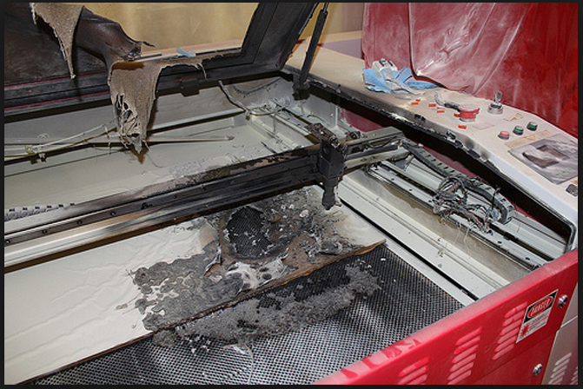
Laser Safety Review
Personal Safety
Don't stare at the cutting point: it is very bright. The window shields harmful light but prolonged exposure can give you headaches and more.
Don't cut or engrave materials that will create fires or produce toxic gases: a list of these is in this presentation and at wiki.makersmiths.org.
Pause after project completion: allow air inside the chamber to fully vent outside.
Engrave mirrors from the backing side: not the front side. If double sided, please cover all sides with an opaque film.
Device Safety
Always be sure the External Exhaust Fan is in operation before cutting/engraving.
Be sure the bed is clean and has no debris from previous uses. Always clean it when you are done.
Make sure you have focused the Laser Optics to the top of your material.
NEVER Leave the Laser Running Unattended!
If material catches fire, Don't Panic. Try blowing it out, remove it from the device, cover fire blanket, and as a last resort use the fire extinguisher.
Opening any door will stop the laser from firing. Use pause button to resume.
Make sure that the material is supported outside the machine (front and back) if using the passthrough. There are stand up rollers nearby each machine.

Slide 9
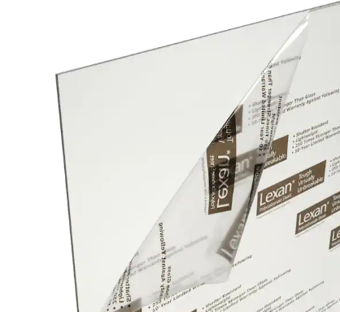


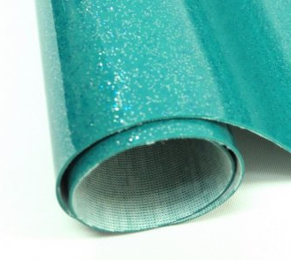
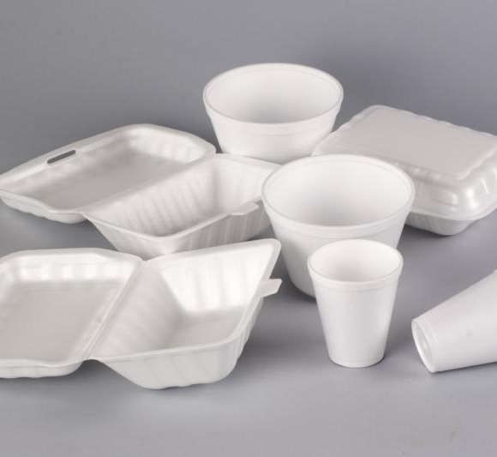
Laser Safety Review: DO NOT LASER
DO NOT LASER List
Any material that won't cut well or emits gasses
PVC: produces hydrochloric acid and toxic fumes
ABS: emits cyanide gas and tends to melt
Polycarbonate/Lexan: cuts very poorly, discolors, catches fire, may contain chloride which is bad, might look like acrylic but is not the same thing
Artificial leathers, Pleather: contains PVC and produces toxic gasses when lasercut
High Density Polyethylene (HDPE): milk bottle plastic, melts and creates fires
Foams like PolyStyrene or PolyPropylene: they catch fire
Fiberglass: emits fumes
Cellulose: combustible

Slide 10

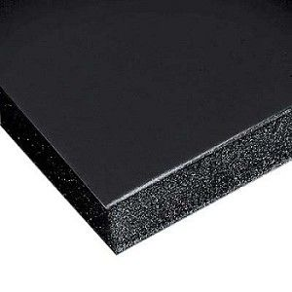



Laser Safety Review: OK Materials
OK to Cut or Engrave:
Wood: hardwood, softwood, plywood, cork
Plastics: acrylic, lucite, plexiglass
Paper
Cardboard
Fabric: most kinds
Leather: real animal hide, not pleather
Foam: Gator Foam, Depron foam, plastics (without Chlorine), dry celluloid sponges (always double check what they are made from), Craft Foam/EVA
Felt: wool felt, acrylic felt (may melt down a bit)
Foamcore/Foam board (the inside melts away faster than the outside),
Laserable Rubber (low odor or red)
OK to Engrave Only Only:
All materials above plus metal with coating, glass, ceramic tile glaze, stone, painted or powder coated tumblers

Slide 11
Getting to Know the Thunder Laser

Slide 12
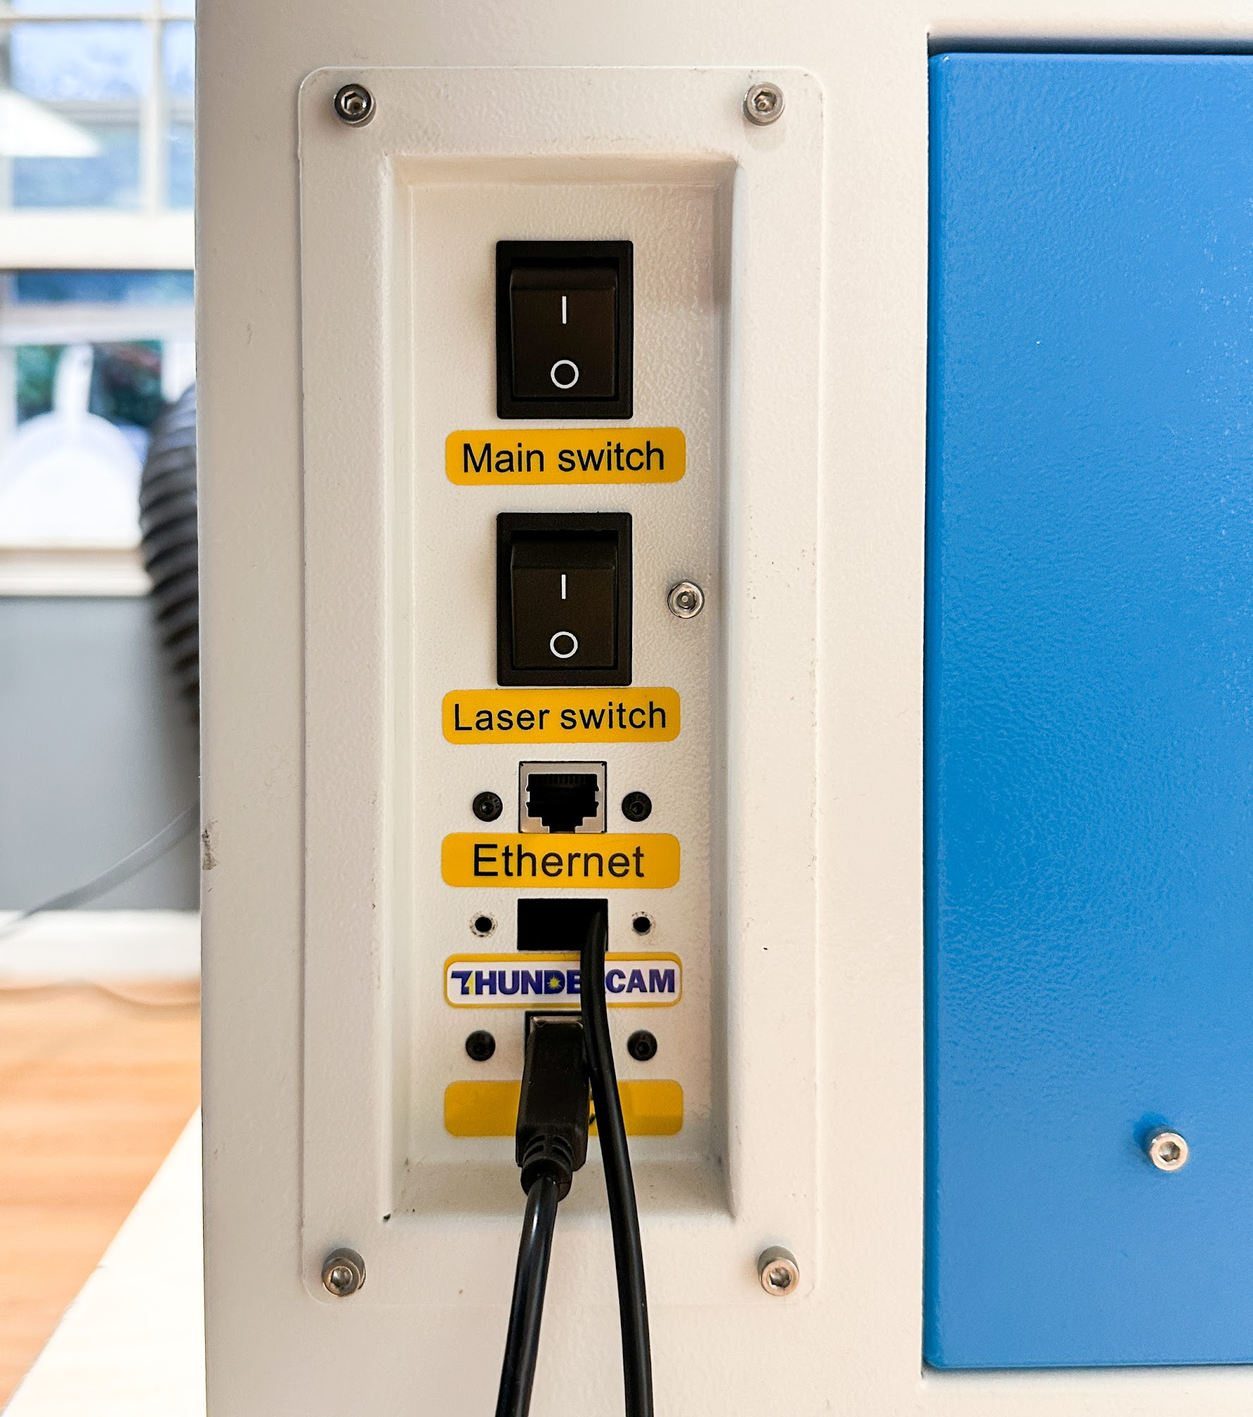
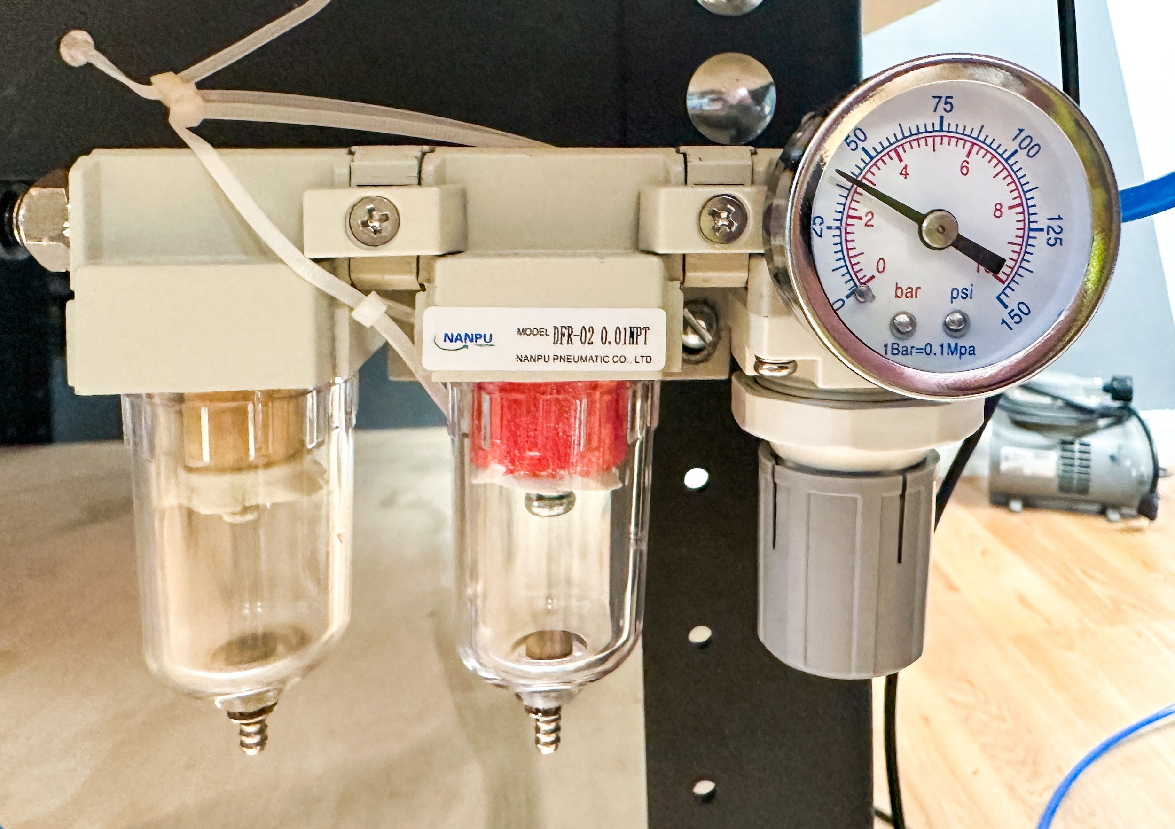
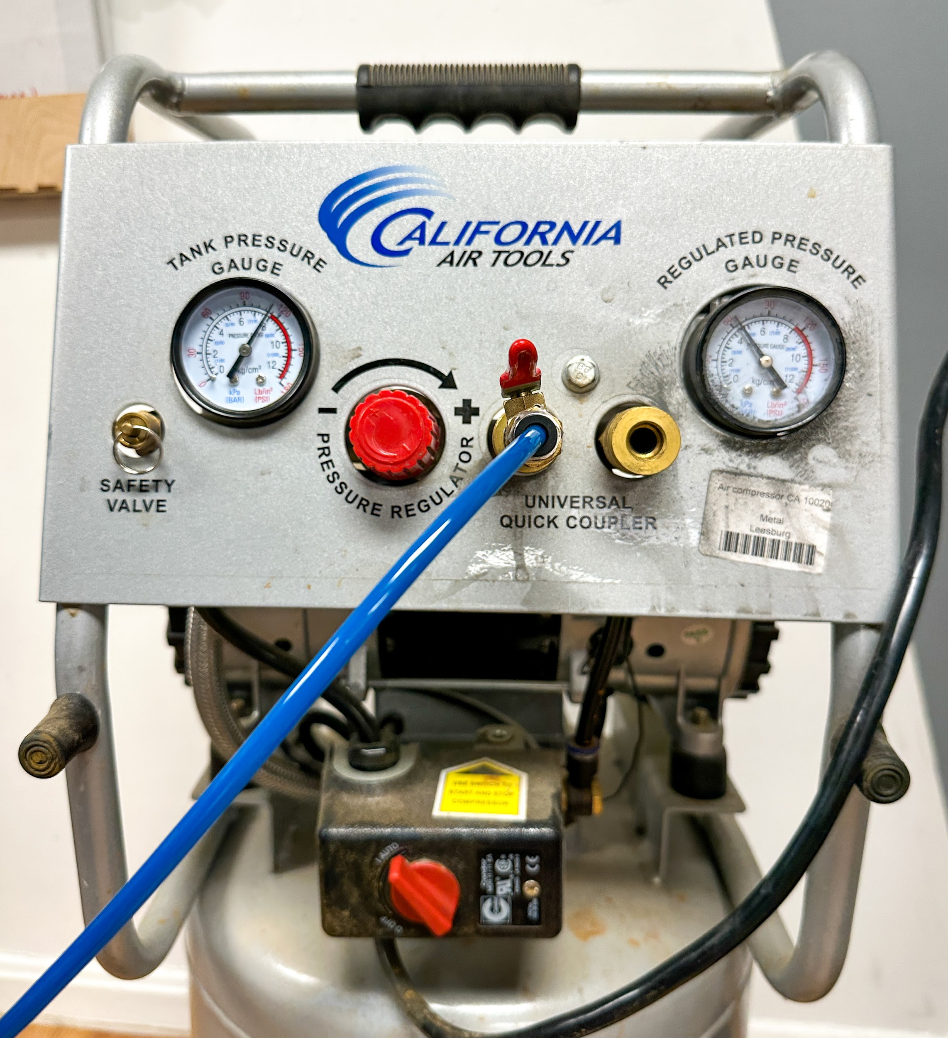
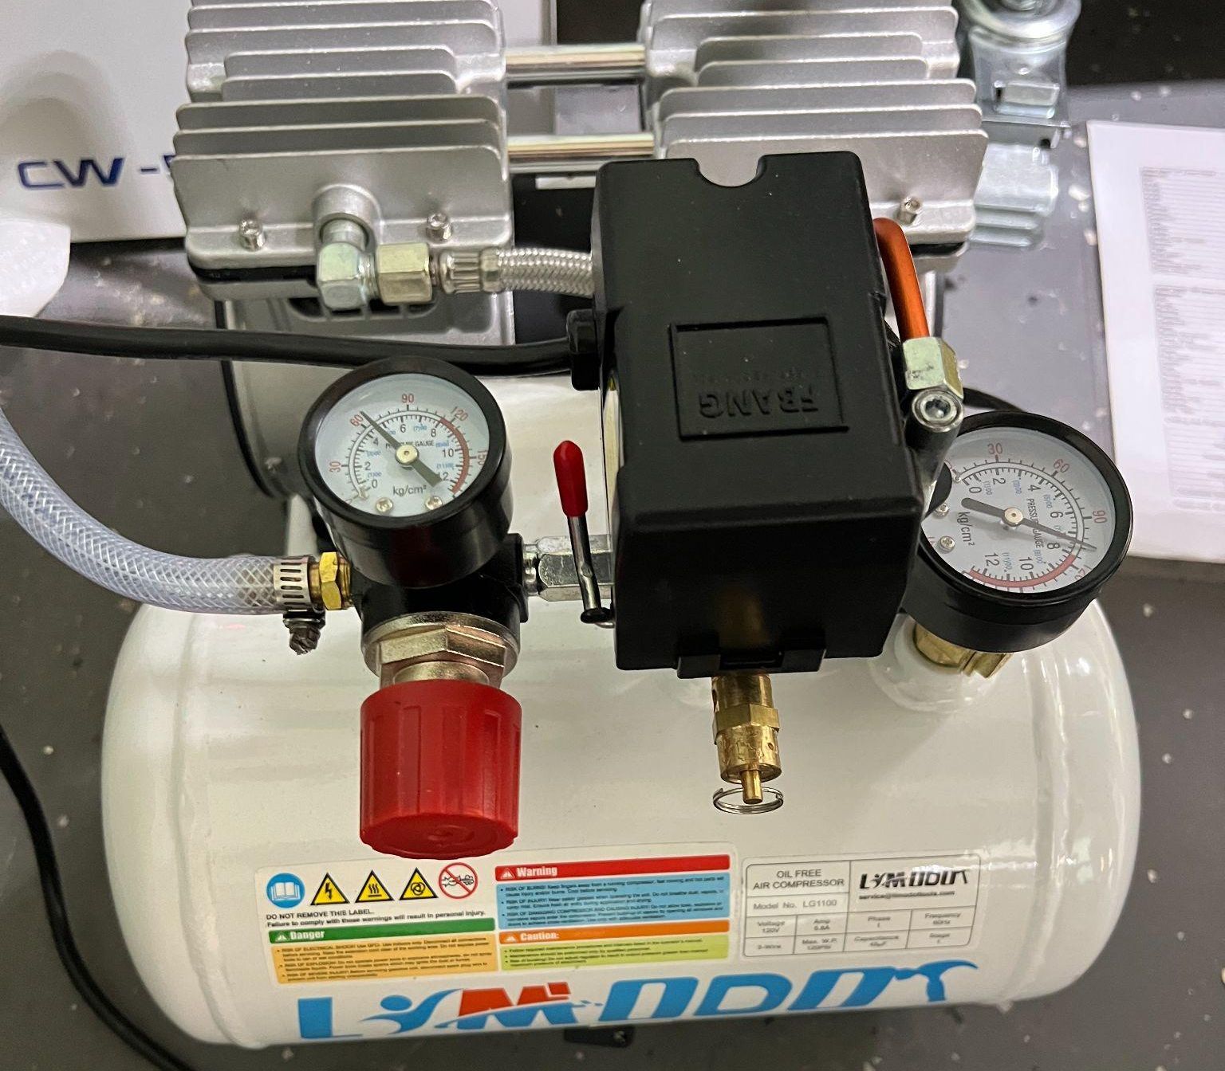
Getting to Know the Machine: Switches & Air
The air compressor at each location has both a tank pressure and a regulated/supply pressure rating.
The regulated/supply pressure from the air compressor should be ~90psi and is adjusted with the red knob.
Compressed air goes from the compressor into the regulator. The regulator can be adjusted by pulling down and turning the grey dial. The regulator should be set to 50psi and no higher.
Make sure that the water cooler, fume extractor, compressor, and both the Main and Laser switches are on before starting your job.
The “Main switch” turns on the power to the control panel
The “Laser switch” provides power to the Laser and the water cooler. The fume extractor and compressor must be turned on individually.

Slide 13
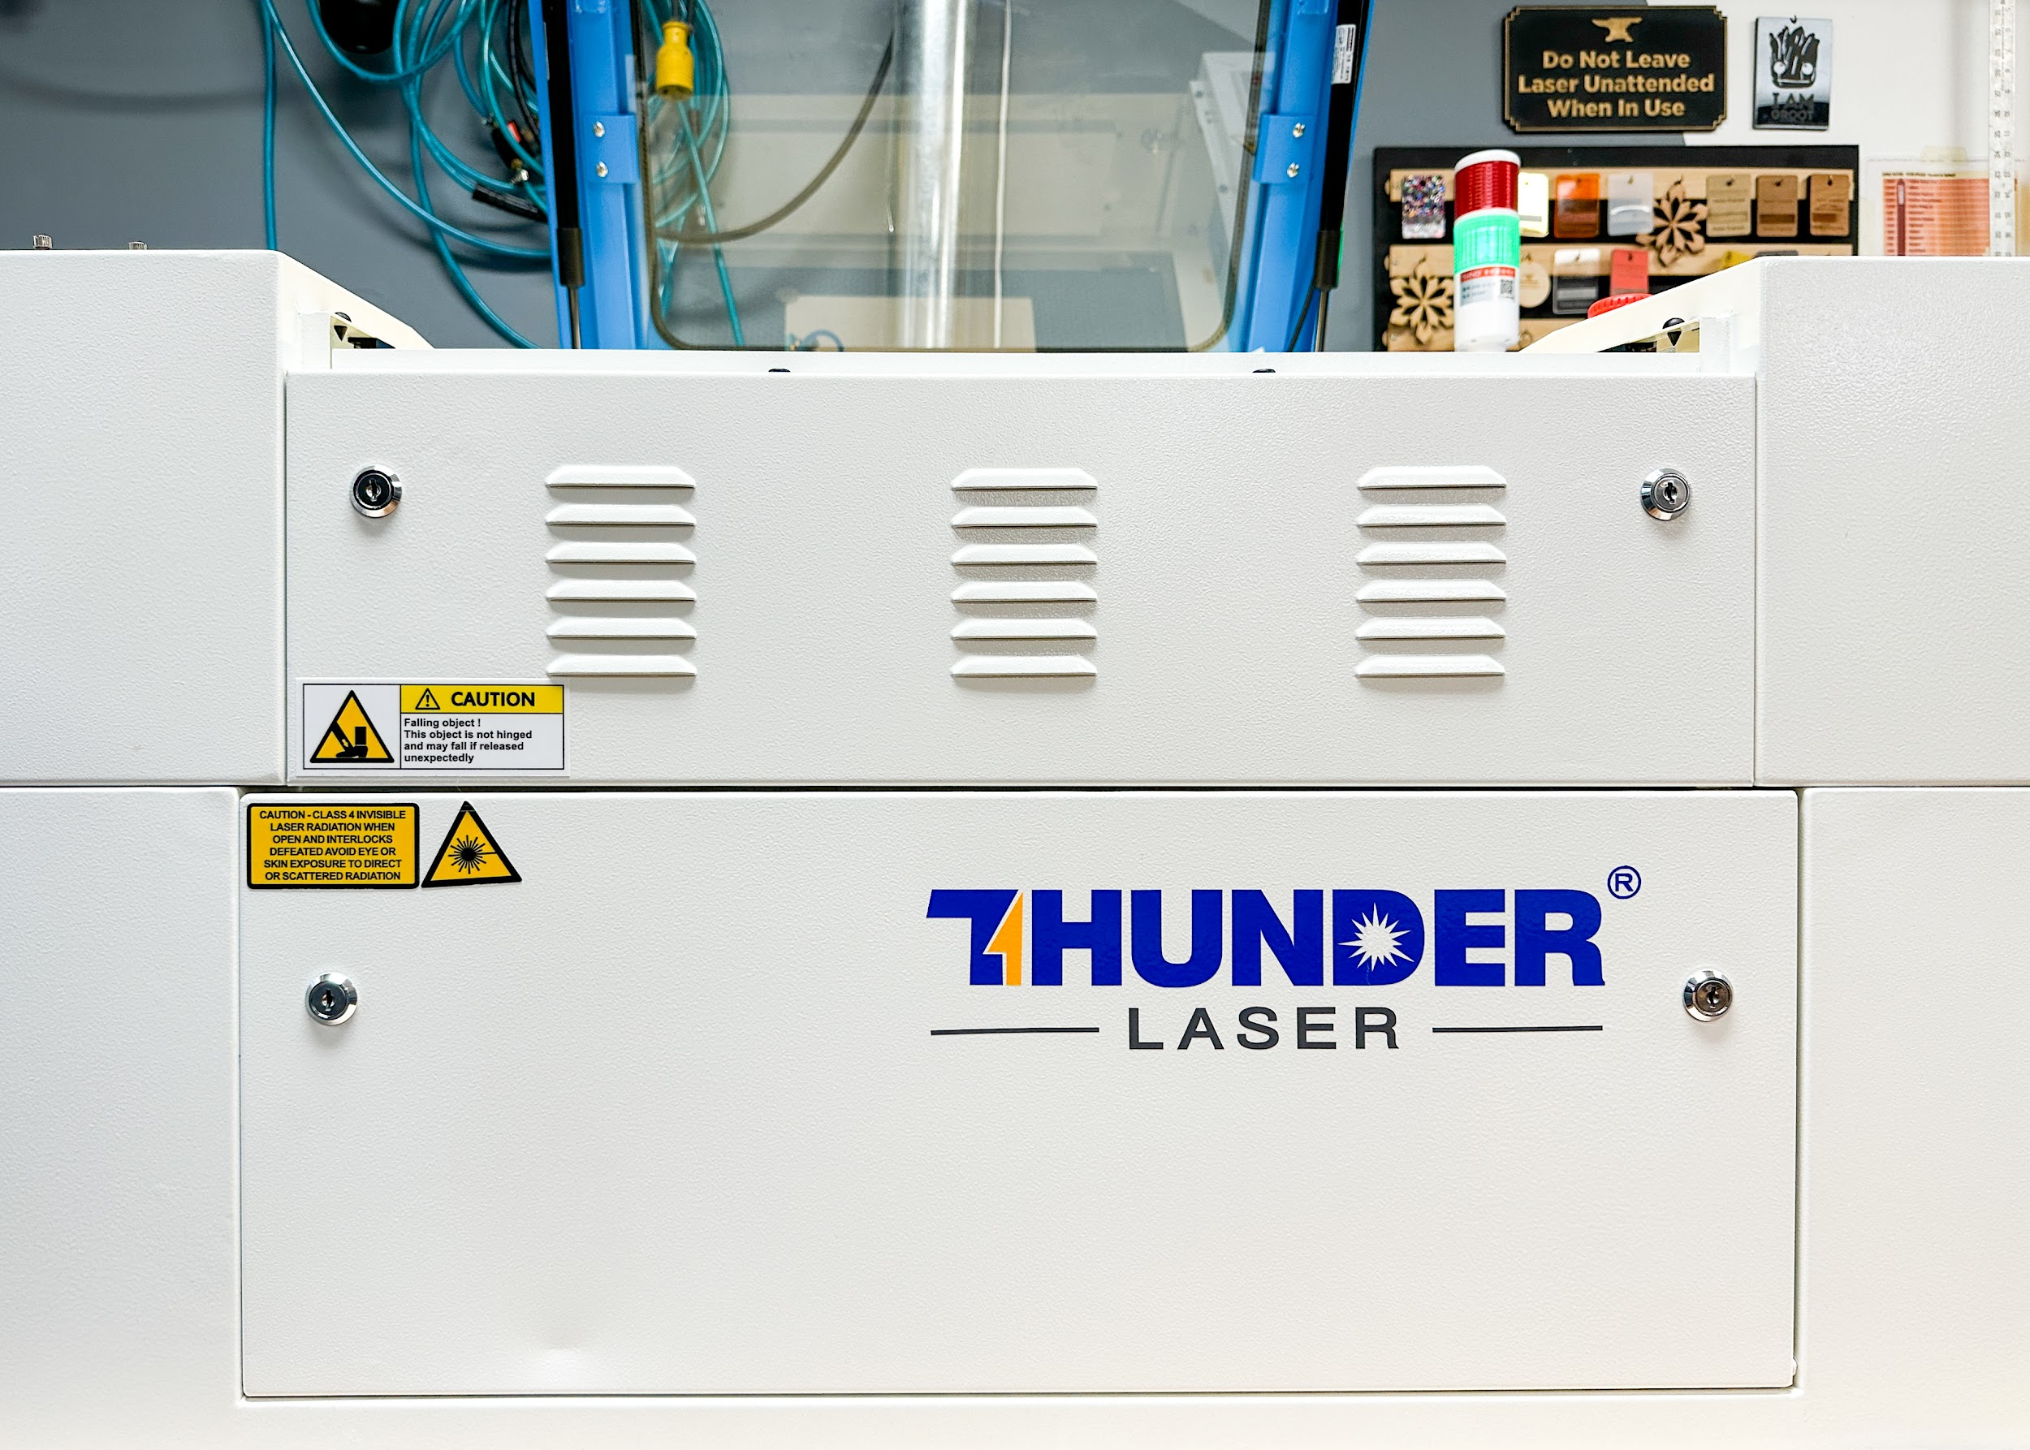
Getting to Know the Machine: Doors
This is the door for the passthrough. It is held on ONLY with two key latches. Once you unlock them, it will fall, so make sure to hold on!!
When the passthrough is open, you will be exposed to the laser. So please take caution, and alert those around you.
We are working on a new door that will cover the area, but still let material through.
This is the door for the crumb tray, and where you would remove the honeycomb. Unlike the passthrough door, it’s held on with a spring hinge. Please still be careful and don’t let it drop against the machine

Slide 14
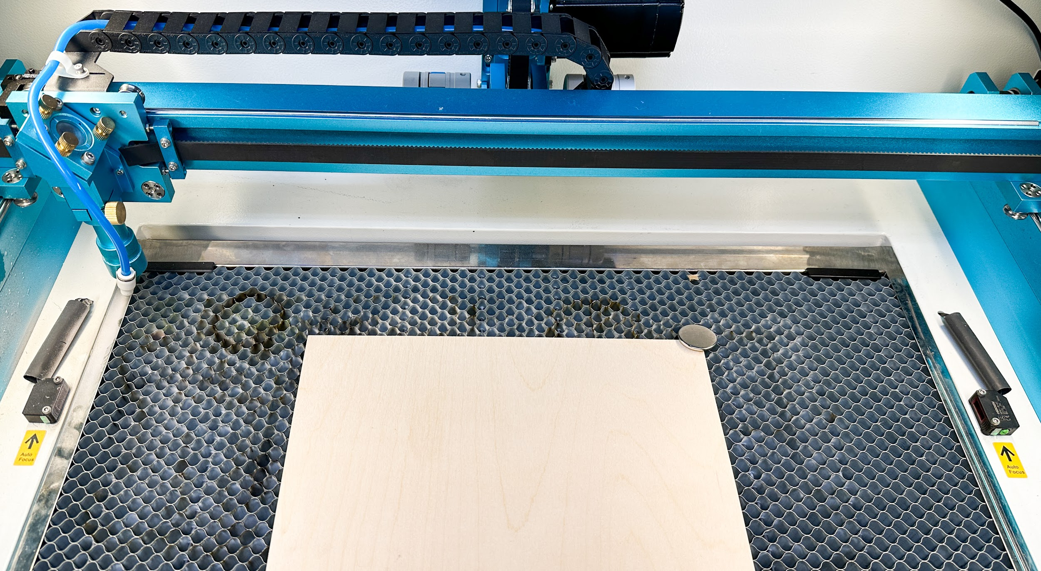
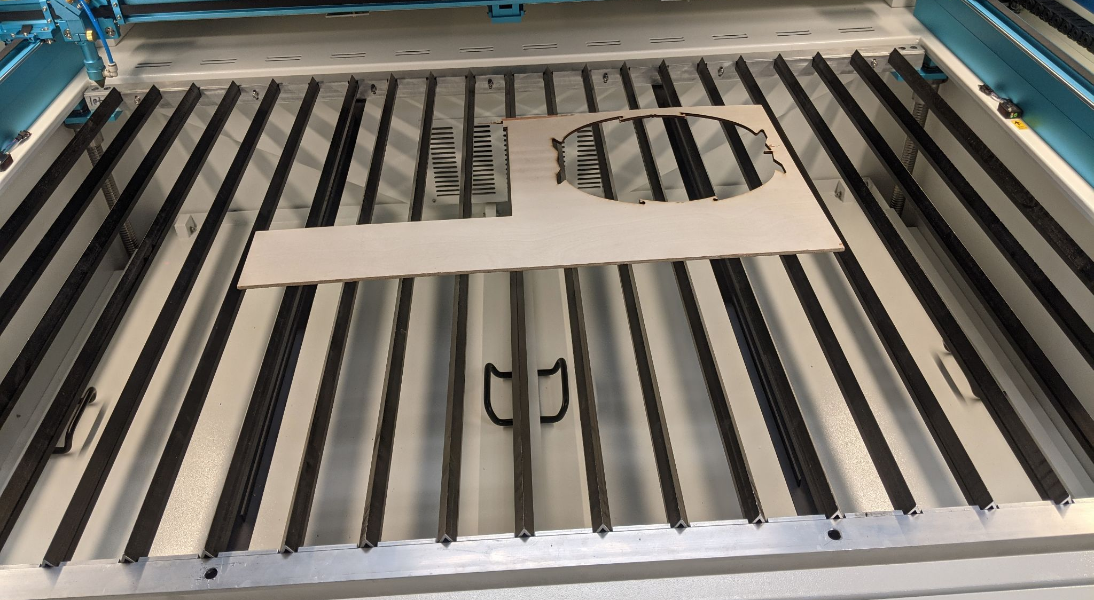
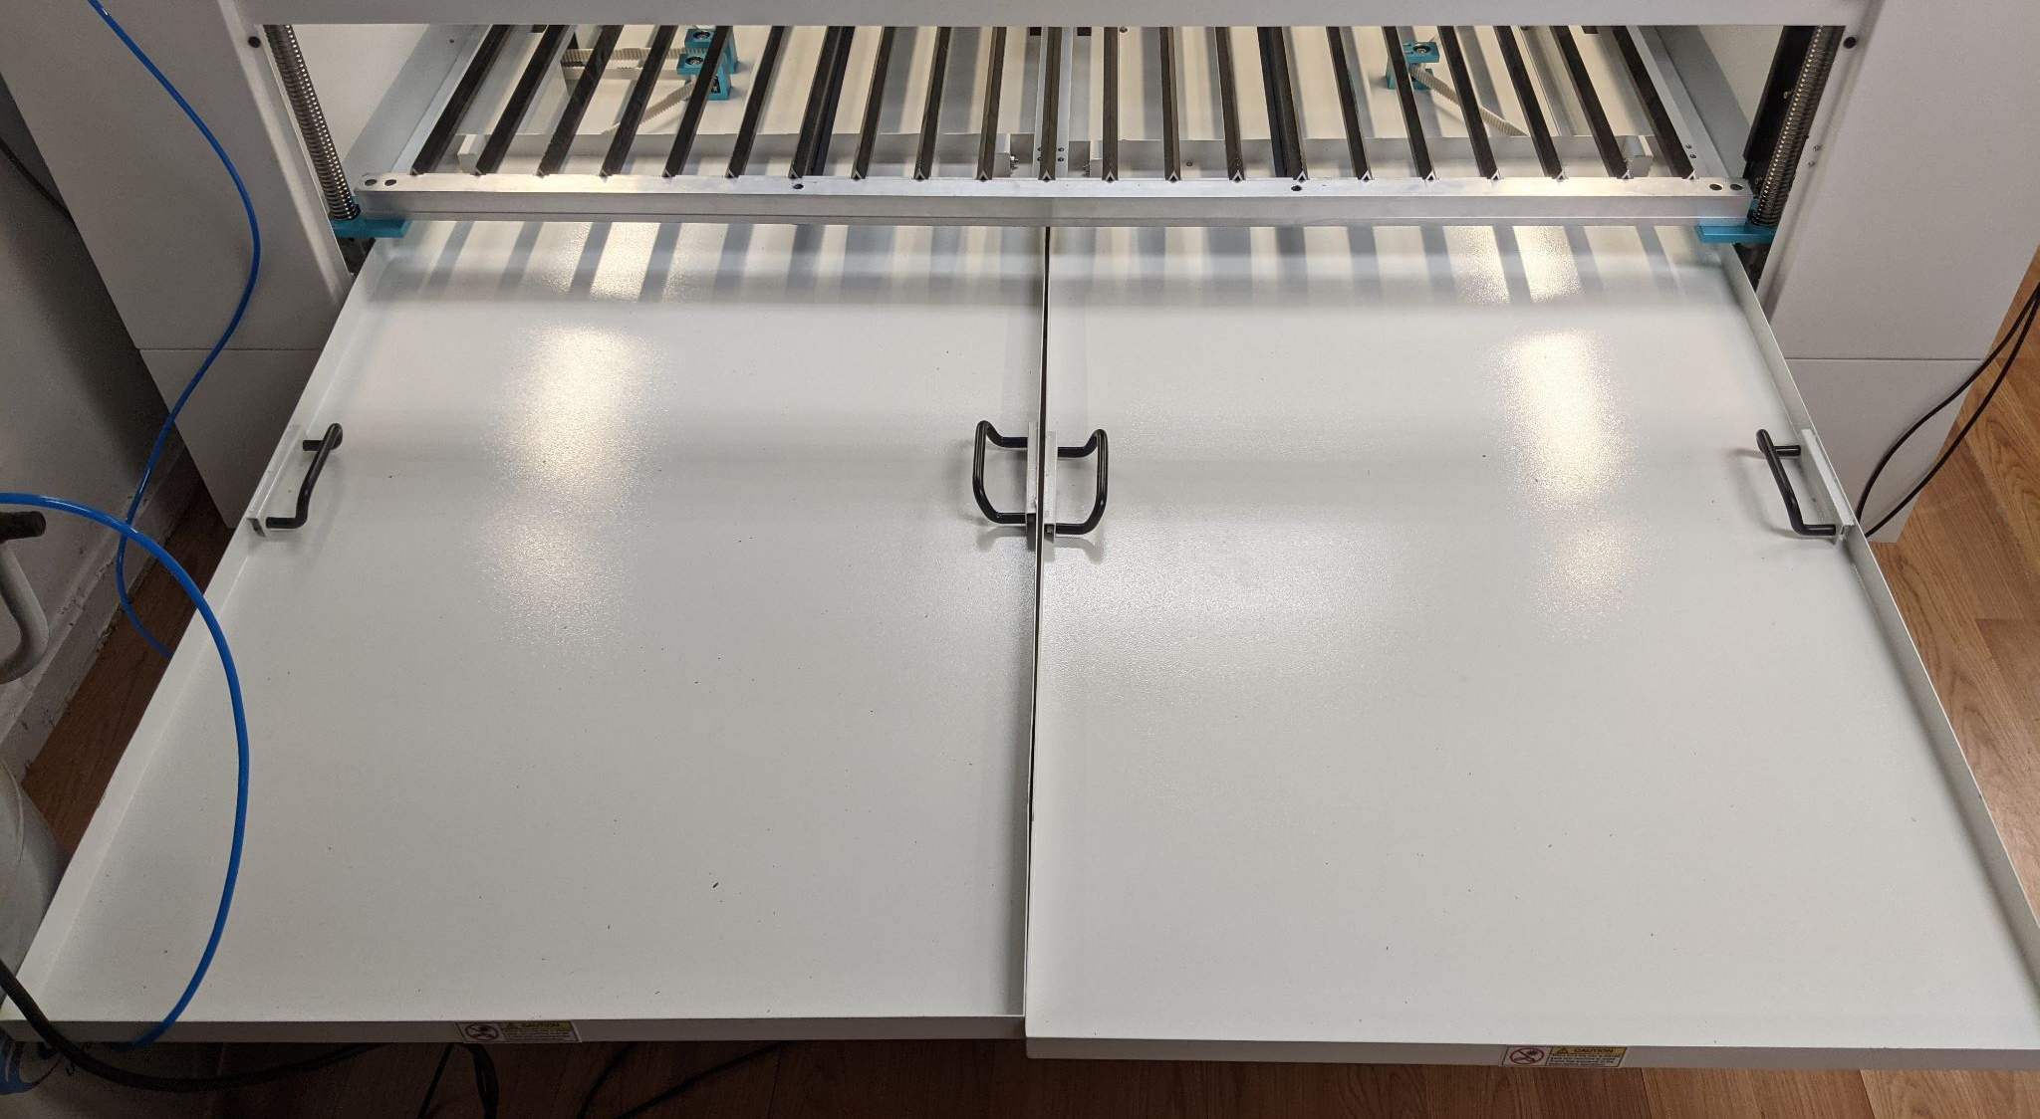
Getting to Know the Machine: Beds
Magnetic Honeycomb Bed
Blades
Crumb Trays (pulled out for cleaning)

Slide 15
Getting to Know the Machine: Beds
You have the choice between using the honeycomb or the blades as your bed.
The honeycomb is magnetic and the blades are not. This means you can use magnets to hold down your material on the honeycomb! Your hold downs shouldn’t extend above your material far enough that the laser nozzle hits them as it moves around.
If your piece is too tall to fit under the nozzle on either the honeycomb or the blades, you can place your work directly onto the crumb tray.
You don’t have to put your workpiece in any particular place on the bed. You can change the X & Y origin so that your project begins anywhere on the bed.
Be aware that the X/Y origin is not the same as the edges of the honeycomb, and putting your work material too close to the edges of the honeycomb can result in your engraving failing and a “Frame Slop” error warning on the laser control panel.

Slide 16
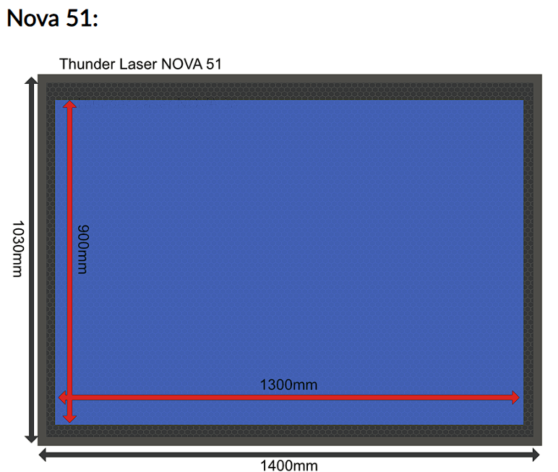
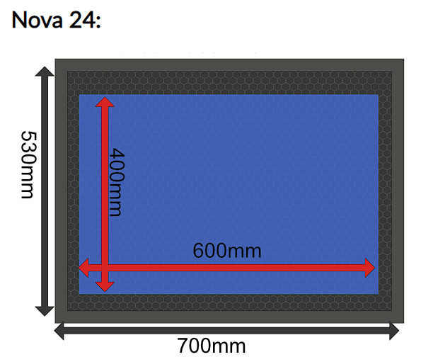
Honeycomb Size vs Cutting Area
The working space is smaller than the honeycomb. Smaller machines will have a proportionally larger honeycomb since the amount of space required for the machine gantry components to be able to move the laser head is the same no matter the size of the machine.
Users may get a "Not enough Extend Space" Error when they feel their artwork and material is far enough from the edge of the honeycomb when it is not far enough from the edge of the working space of the laser.
The illustrations below are a representation of the workspace size. Note that the workspace is not necessarily centered on the honeycomb. This is a visualization, not an exact representation. More explanation can be found here.

Slide 17
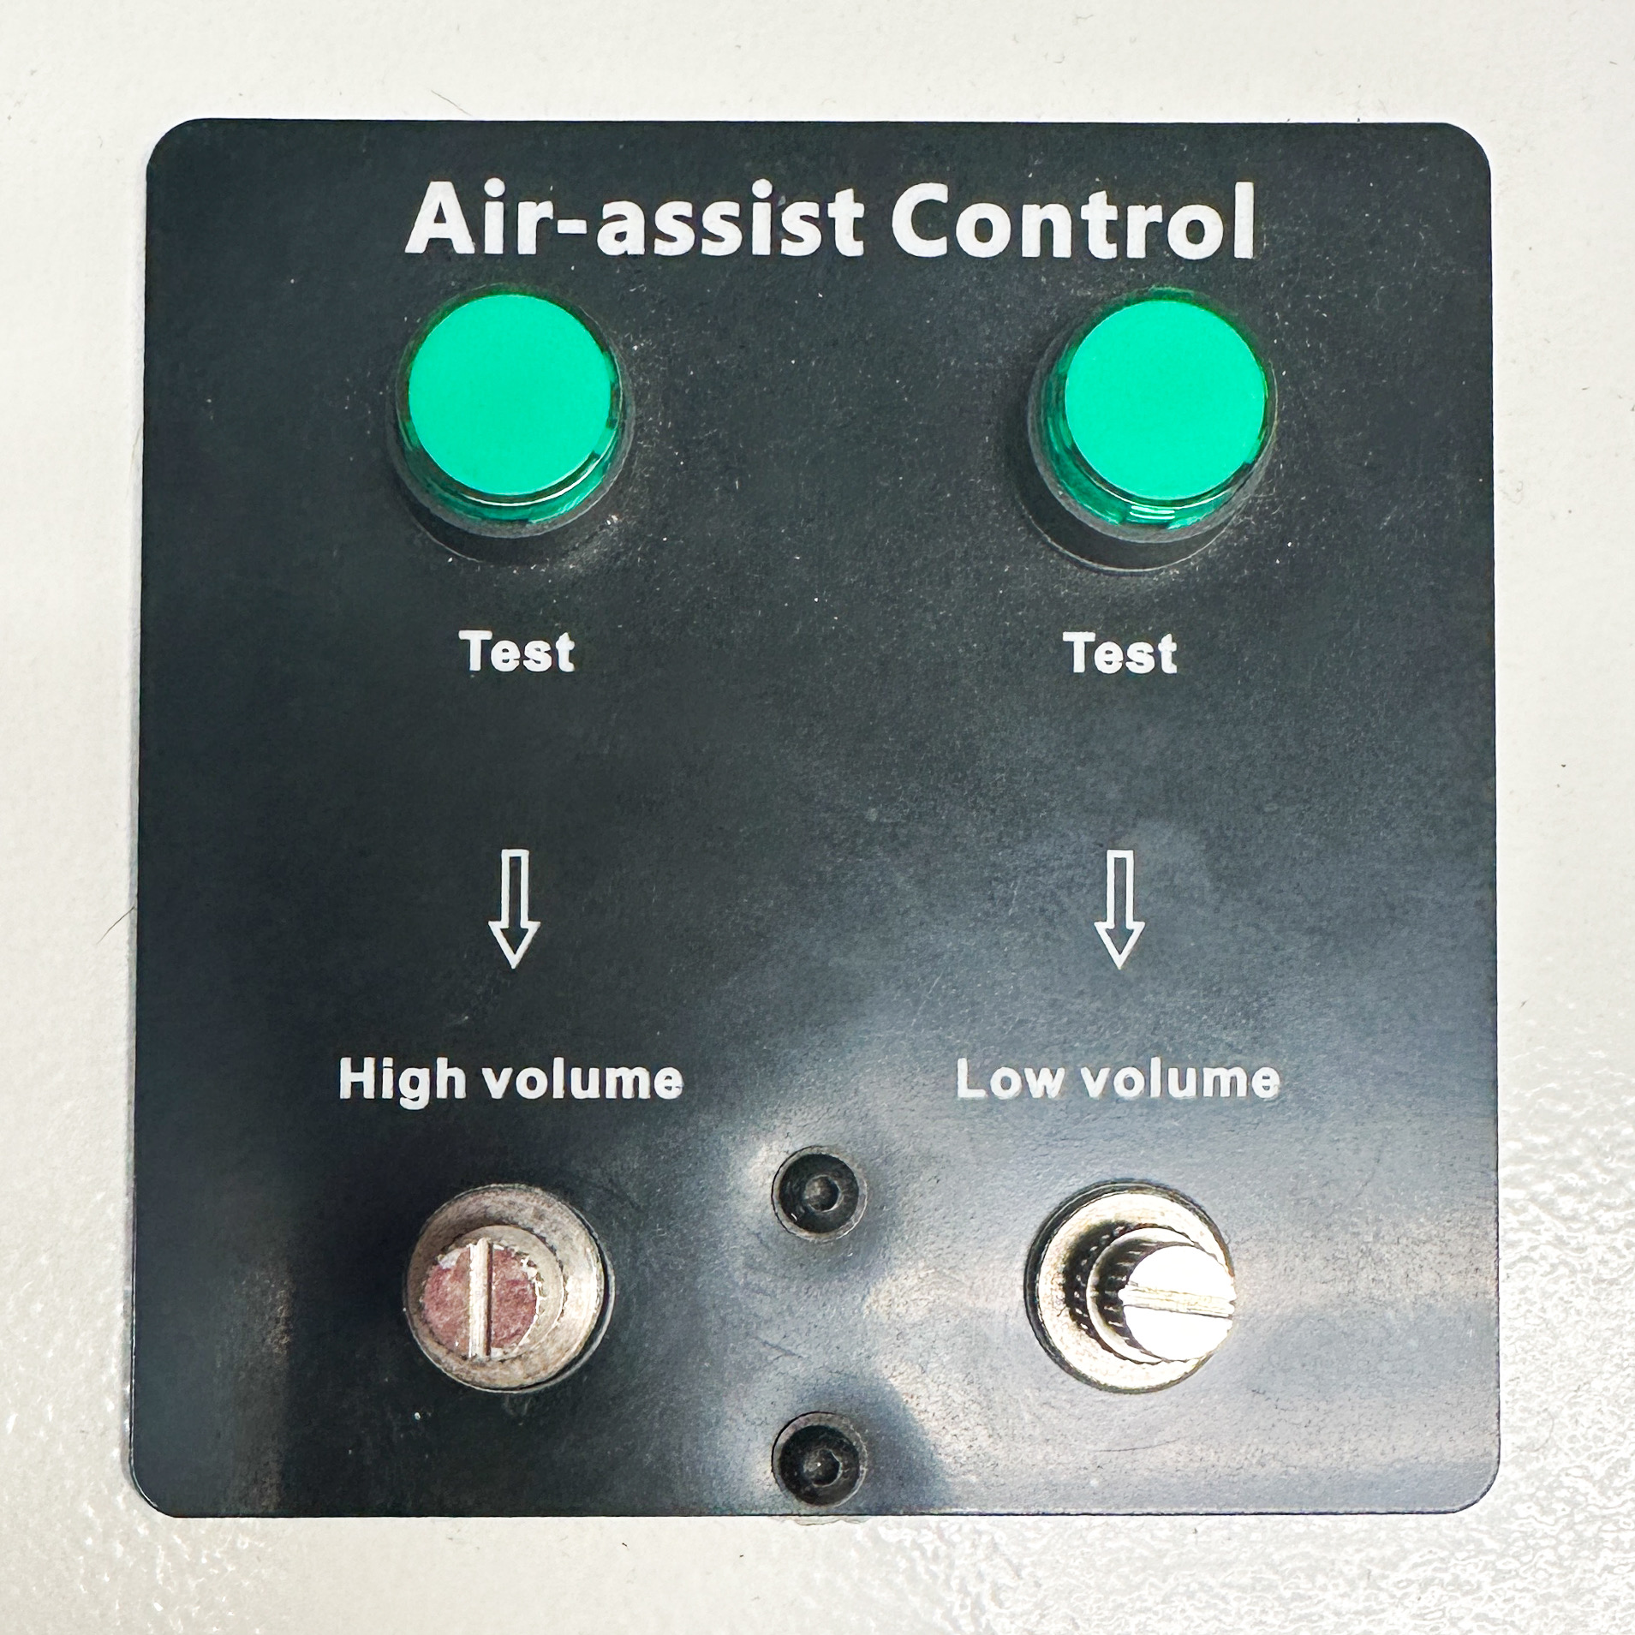
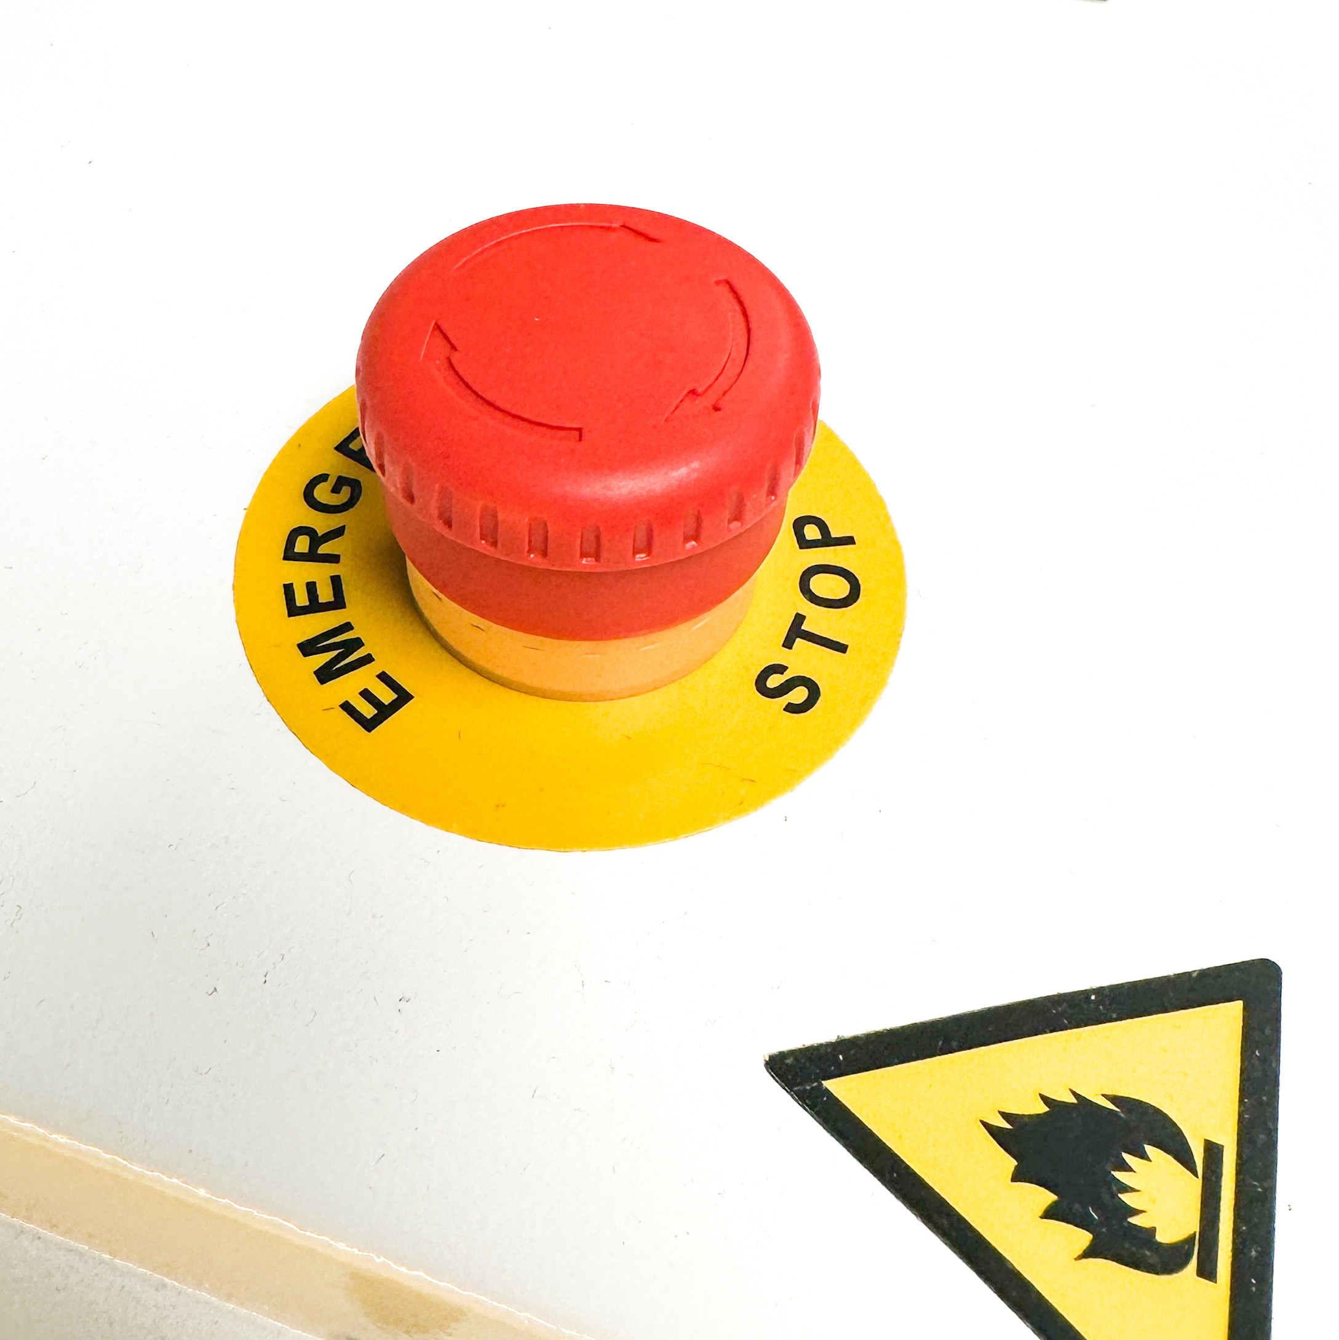
Getting to Know the Machine: Important Buttons
Both machines have Air Assist!
The dials aren’t marked with numbers/gauges/etc, so the stewards have manually set them the to optimal levels. Please do not re-adjust them without permission from the Laser Stewards.
We will be installing digital gauges in the future.
You can press the “Test” button to help set the PSI on the compressor or regulator if you need to do so.
There is an emergency stop button on each machine!
This is the quickest way to stop the machine in case of a fire, the nozzle hitting something, etc.
You can pause the machine from the control panel by pressing the “Start-Pause” button.
You can also stop the machine by pressing “Stop” in LightBurn. If need be, opening the top door will also stop the laser.

Slide 18
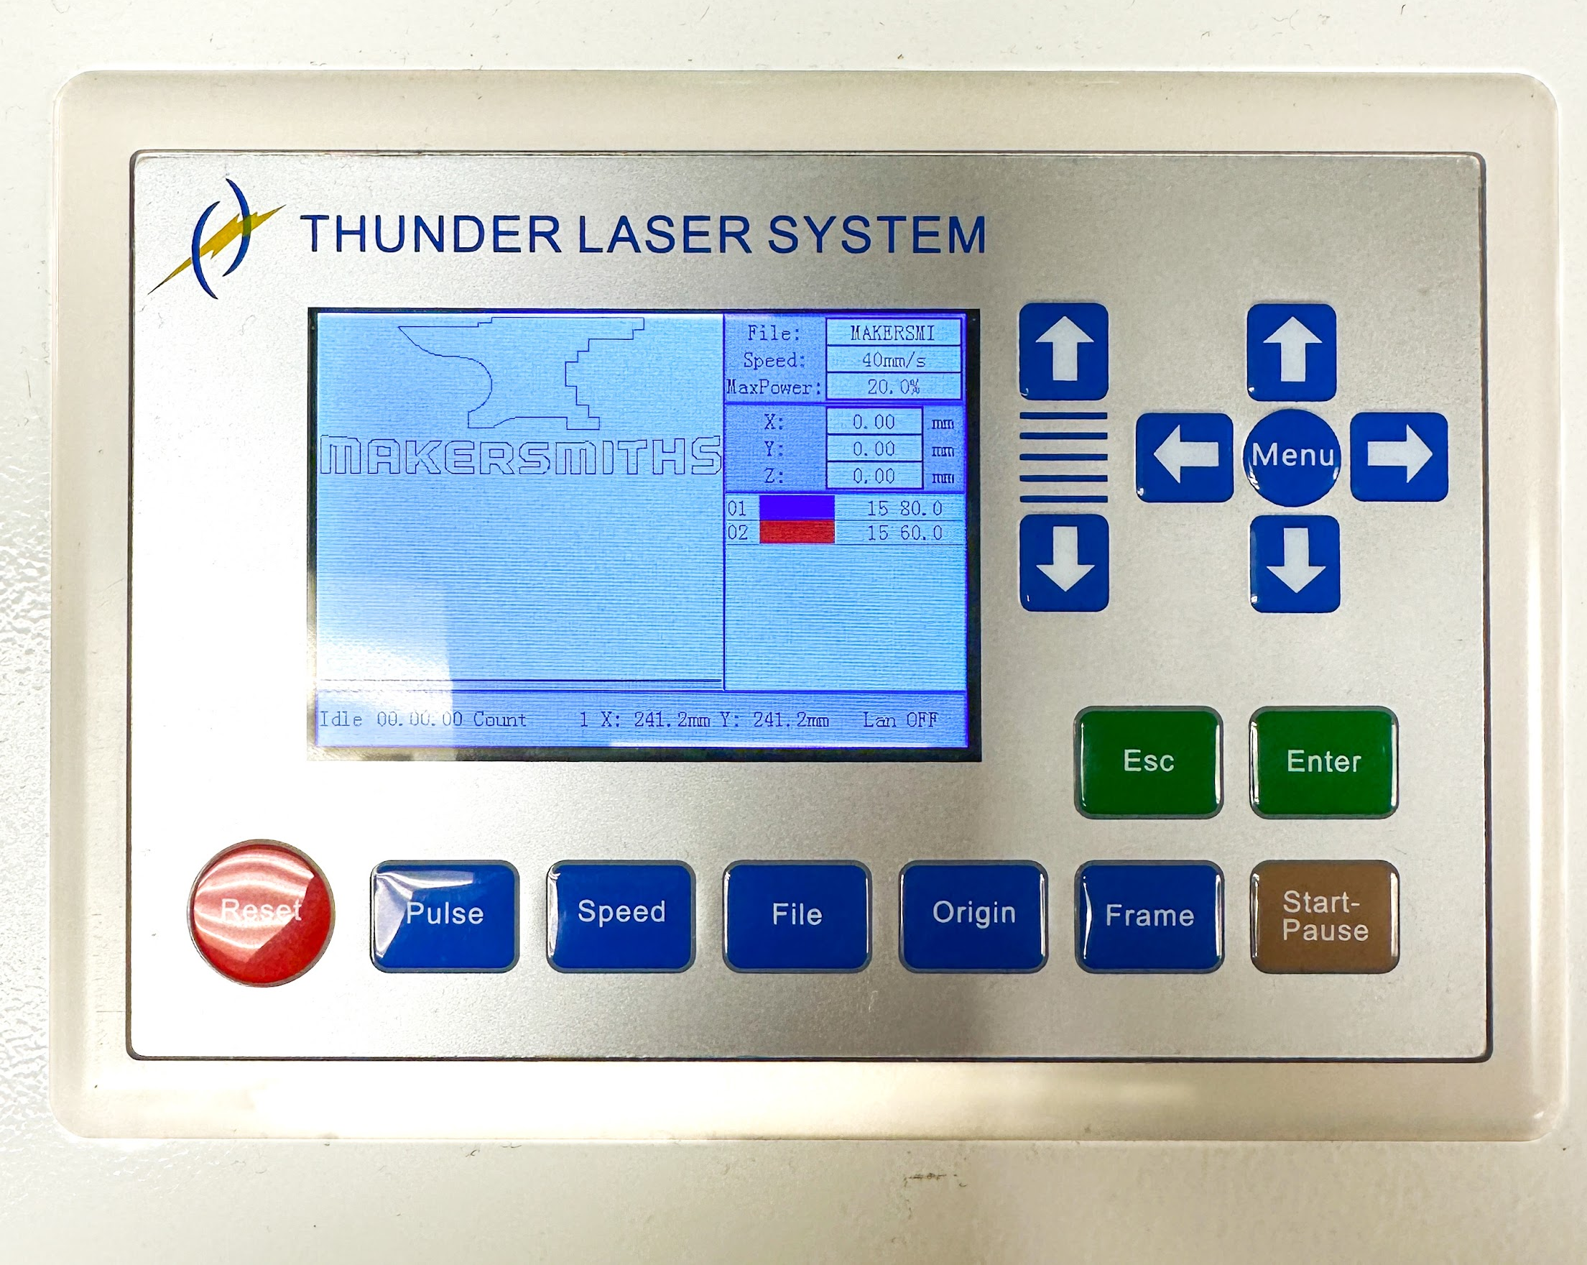
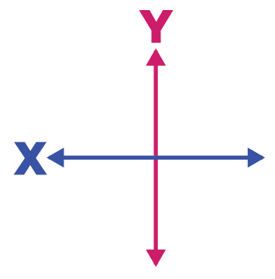
Getting to Know the Machine: Control Panel
Z Axis Controls
This moves the bed up and down.
Please keep an eye on the laser head when moving the Z, so you don’t hit it.
Menu Includes
Auto Level / Auto Z
X & Y Axis Controls
Speed Control
Controls the mm/s speed that the X and Y move when you manually move the machine.
Faster speed is good for setting your origin, and lower speed is good for pinpointing registration marks or the center of an object.
Start - Pause
You can pause your job here, and restart it by pressing start.
If it’s an emergency stop, please hit the big red button

Slide 19
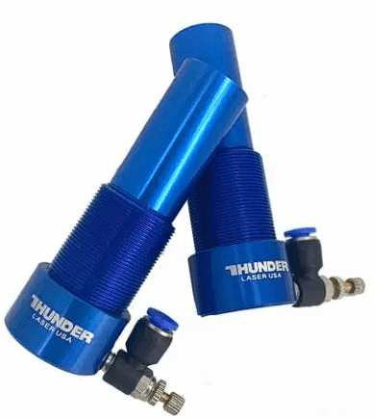
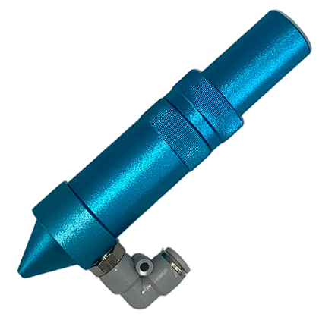
Getting to Know the Machine: Laser Head
The entire component that includes the metal housing, lens, nozzle and air attachment is called the head.
The lens is inside the head and should not be touched, cleaned or changed except by a laser steward. Care should be taken when removing the nozzle from the head and exposing the lens.
The nozzle is at the end of the head that is closest to the bed when installed and is where the air assist flows through. This can be unscrewed for cleaning, or to change between sizes. Always unscrew/remove the nozzle before cleaning it.
The compressed air attachment is connected to the nozzle and is the connection point between compressed air and the nozzle. The air hose must be removed prior to changing heads or removing the head and nozzle for cleaning.

Slide 20
Setting Up to Laser Cut/Engrave

Slide 21
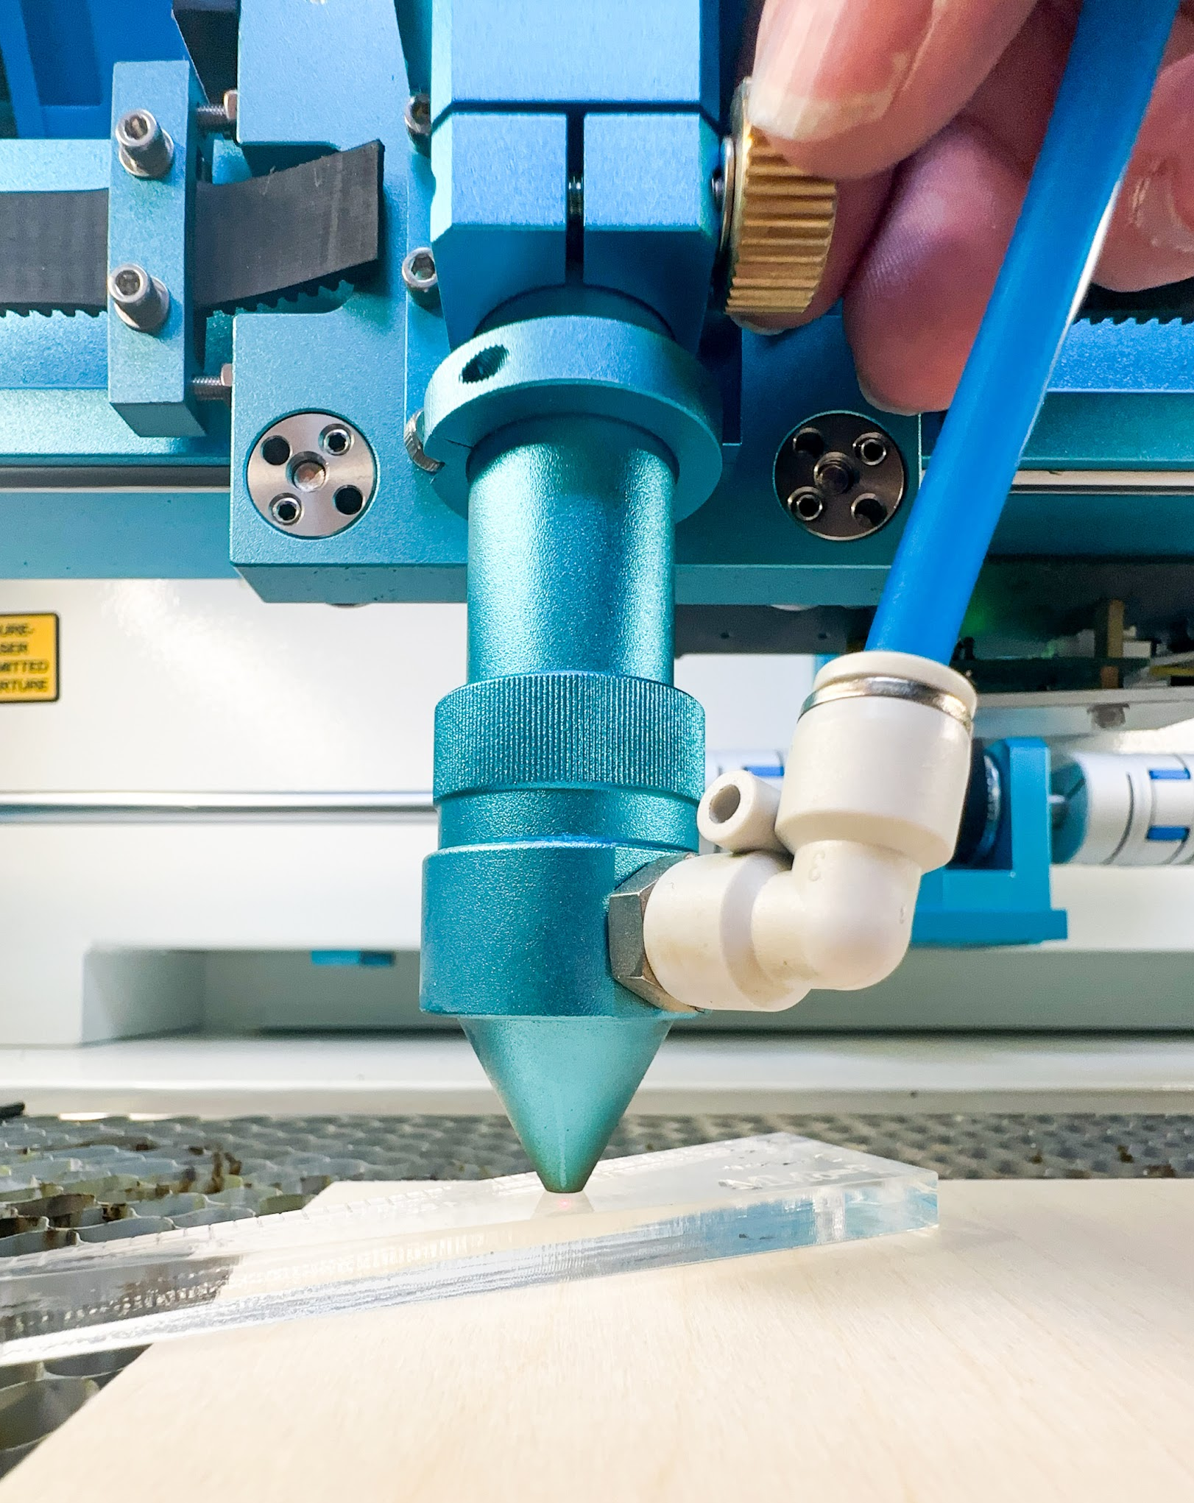
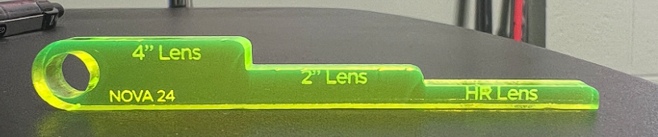
Laser Setup: Focusing the Laser
The laser lens must be adjusted to the correct focus on your material every time. Don’t assume that because you are using the same material each time, that it doesn’t need to be checked.
For the beginner class we will focus on the 2” / Standard Lens. It requires a 7mm distance between the end of the nozzle and your work material. Use the acrylic focus tool to correctly focus the lens.
To Focus:
Loosen the gold nut and raise the head as far up as it will go. Tighten. This will minimize the risk of material hitting the nozzle and damaging the head, nozzle, material or gantry.
Move the laser head so that it is over your workpiece.
Place the acrylic focus tool on top of your workpiece, directly between the nozzle and your workpiece. Raise the bed so that your material is around 10mm from the nozzle. Leave some wiggle room.
Loosen the gold knob while holding the head. Slowly lower the nozzle to the 2” Lens position on the focus tool. Tighten the gold knob.
The laser/lens is now focused.
Do not use tools to tighten or loosen the knob, but do make sure it is firmly hand-tightened.
You can find a
great article about focusing here:
The Basics of Focus
Acrylic Focus Tool

Slide 22
Laser Setup: Cleaning and Nozzle Sizes
Before starting your project, make sure the nozzle is clean, and always clean the nozzle after you have finished your session on the laser. This requires removing the entire head, then removing the nozzle from the head.
To Clean:
To remove the head, first press down on the white fitting around the blue air hose, and after feeling/hearing a click, gently pull the blue air hose up to remove it.
Lower the bed far enough so that when you loosen the gold nut, you can remove the entire head.
Loosen the gold nut while holding the head. Lower the head so that the entire head is removed from the machine.
Unscrew the nozzle from the head and clean the nozzle with alcohol and a paper towel and/or swabs. Clean the inside and outside of the nozzle.
Reverse instructions above to replace the nozzle and head.
After taking the Advanced Laser class which includes using the HR and 4” lenses, use the same procedure for focusing the lens and cleaning the nozzle, but be sure to use the relevant height on the acrylic focus tool for the lens you are using to focus.
You can find a
great article about focusing here:
The Basics of Focus

Slide 23
Getting to Know LightBurn

Slide 24
Laser Software - LightBurn
LightBurn Software
In Lightburn you can preview, edit or create artwork. It also controls the laser cutters.
We have a limited number of Makersmiths licenses available. There is one for each computer attached to a laser, and one for the Leesburg Classroom.
You can download a 30 day trial and/or purchase your own copy. If purchasing you will need to buy the Lightburn DSP License Key.
Design Software
If you want to design outside of Lightburn, you can use a vector drawing program such as CorelDraw, Adobe Illustrator, Canva, Inkscape, Fusion 360 or any software that will export vector graphics in the file types shown later in these slides.

Slide 25
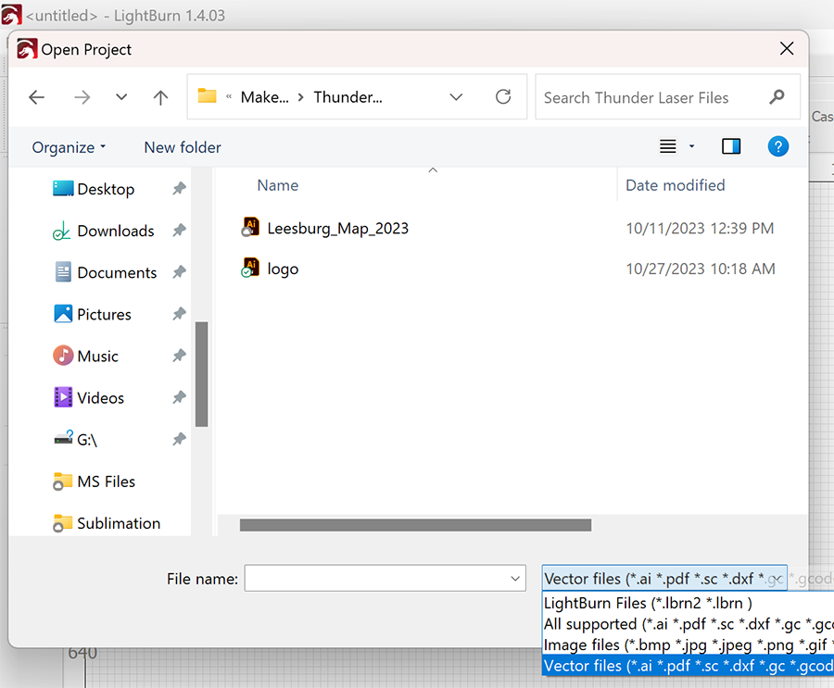
LightBurn: Opening/Importing Your File
To get the most of out of a laser cutter, your files will primarily be vector files. The laser uses the vector pathways as a guide when cutting. Raster files can also be used, but are not as vector files. You can find more info here: Raster vs Vector Files
Most Commonly Used Vector Drawing Programs:
Adobe Illustrator: Subscription based, around $50 a month, with discounts for students. We have a license available at each location.
CorelDraw: One time cost. We have a license available at each location.
InkScape: Free, with some small limitations relative to the paid options. A copy can be found on most of our computers.
Fusion360: Free “Hobbyist” version, sketches can be exported as .DXF files for import to Lightburn. Useful for very precise drawing.
Others: Other vector/CAD drawing programs are available, but may take some more work to get the file ready.
Open LightBurn and go to File > Open and choose your file. You may not see it right away, since LightBurn defaults to its own file format. To get to your file go down to the bottom right corner, next to the “File name” bar and click the extension box to see other file options.

Slide 26
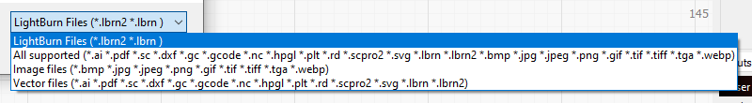
LightBurn: File Types
LightBurn can accept many file types!
We have tested many of them, and most open perfectly fine with the exception of .svg’s. When imported, the object in the .svg file can be smaller than the original design. Always double check that ANY file you import is the correct size!
With past laser cutters, you were required to have specified line weights and colors.
LightBurn does not require that! It just needs vector lines, or fills and you get to choose what each line does before you begin cutting/engraving.
If you know ahead of time that you want all of the lines to cut with the same power/mms, then group them together. Same with your fill lines. This will save you time later on.
If you use Inkscape, make each type of cut you want to do a different color in your drawing and LightBurn will import them as separate layers/cut profiles and assign them the closest color. This can save time.

Slide 27
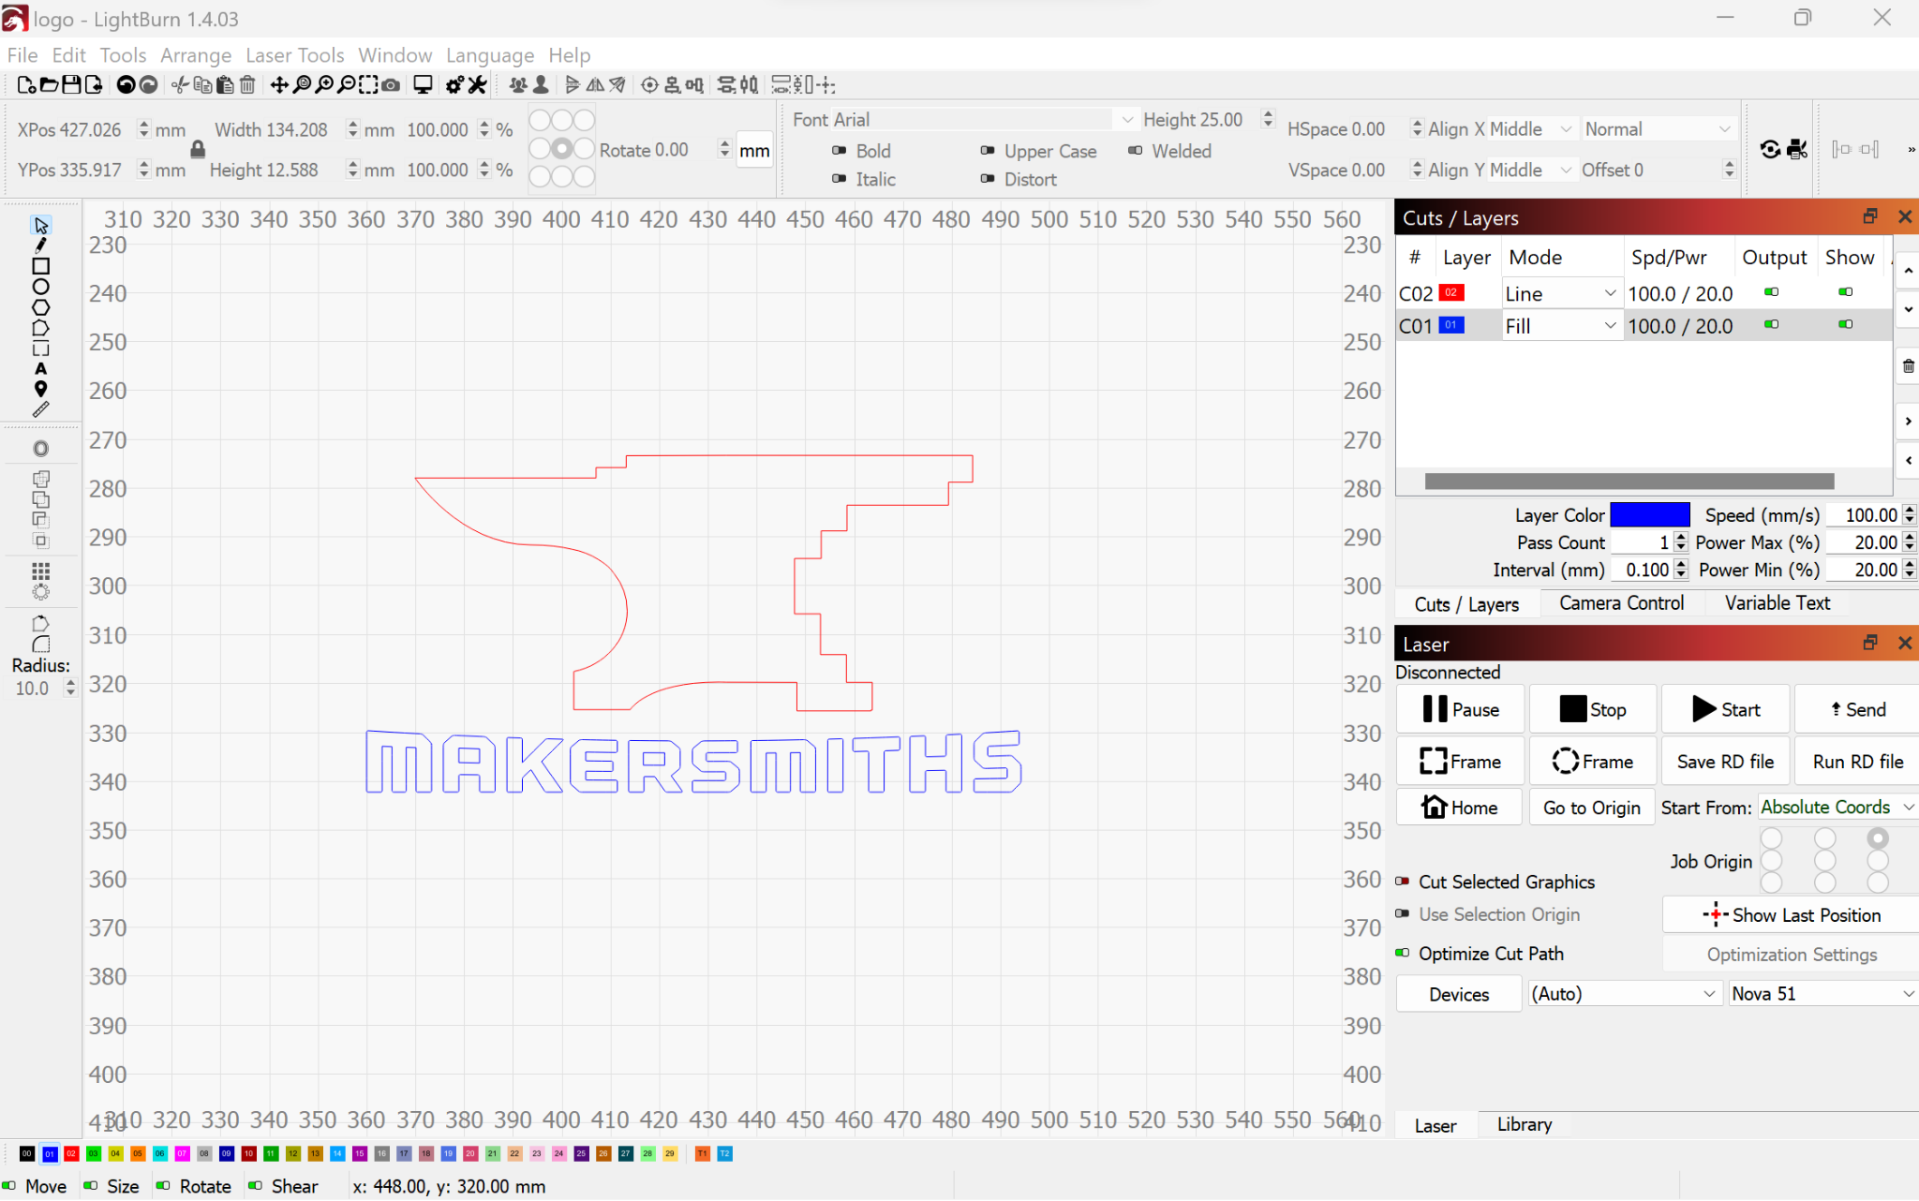
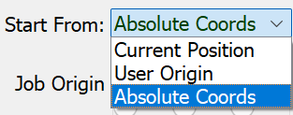
LightBurn: File Setup
Let’s get to know this screen…
Preview Button: see the lasers path and time
Order of
Operations
Start Job
Boundaries Check
Layer Color Options
(you get to choose!)
Laser Controls tab
Materials Library tab
Notes:
Talk about the difference between “current position” “user origin” “absolute control”

Slide 28
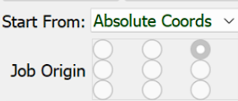
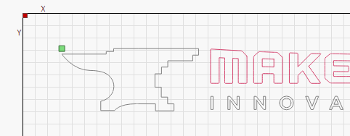
LightBurn: Origin
LightBurn gives you multiple options to set the origin (X & Y) for your project.
Start From: Absolute Coordinates: means that the project origin is the same as the machine’s absolute X-Zero & Y-Zero position, which is the top left of the work area. If you select Absolute Coords, the “Job Origin” option will be greyed out because the software assumes the Job Origin as Top Left.
Start From: User Origin: lets the user set their project to start from anywhere inside the cutting area. Move the laser to where you want your project to start from, set the “Job Origin” accordingly, then press the Origin button on the laser control panel to communicate the “User Origin” to LightBurn.
Start From: Current Position: means that the project will start from wherever the laser is positioned when you press Start.
Job Origin: If you use either User Origin or Current Position, you can select whether the origin is in the upper left, upper middle, upper right, etc.of your design.
The absolute X & Y origin of the machine is indicated by a red square. The Start From position is indicated by a green square.

Slide 29
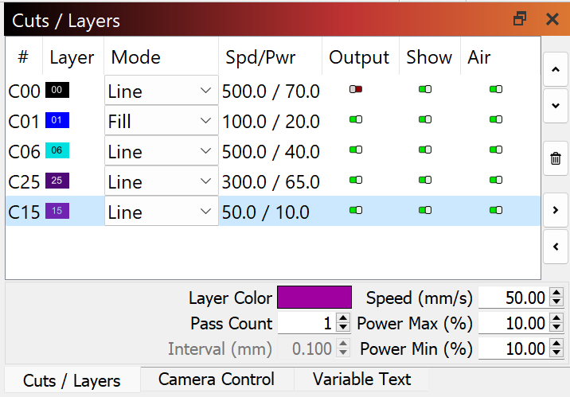
LightBurn: Speed & Power
The ratio of Speed (how fast the head moves) to Power (the intensity/power of the laser) makes a substantial difference in the quality of the final result of your engraving, whether you cut all the way through, and well as how long it takes you to complete your project.
There is a sheet with Thunder Laser’s recommended base settings relevant to the location’s lasercutter attached to the laser computer. It is strongly recommended that you use LightBurn’s built in Material Test Card each time you have new project materials.
TEST TEST TEST. Always test your material with different fill and line settings before doing your final project.
Once you find a Power/Speed profile that works for your material, save that information (Google sheet, notebook, OneNote etc.) so you can use those settings again in the future.
Remember that the Nova 24 and the Nova 51 are different wattages. Settings that worked on one will NOT work on the other.
You can choose the order in which the laser cuts and engraves by pressing the arrows on the far right of the “Cuts / Layers” window.
If the Output in the Cuts/Layer window is green, it will cut/engrave, if it’s red the laser will skip it.
Power Min (%) is the setting used when the laser changes direction. It can help avoid scorching. The minimum power threshold for the Nova 51 is 3%, and for the Nova 24, 7%.

Slide 30
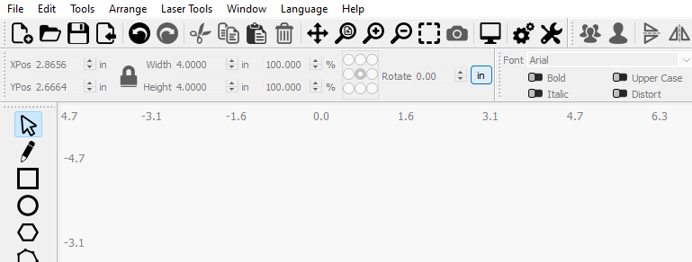
LightBurn: Other Tips & Tricks
Air Assist can be turned on and off for each layer/color. High Air is for cutting through materials, especially acrylics. It helps cool it so it doesn’t melt back together.
When the Air Assist is turned on it will activate the "High Power" air. When turned off the "Low Power" air will be used.
Both machines have a top engraving speed of 1000mm/s. At that high rate of speed, the gantry and even sometimes the entire machine can shimmy a bit. This is why it’s important to firmly tighten the gold thumbscrew holding the laser head and often helpful to secure your material to the honeycomb, especially on the smaller Nova 24.
The “Preview” button at the top of the screen is useful to find out how long your project will take as well as make sure your cut/fill/layer settings are correct before you get started.
If you want to change between metric and imperial, you can do so by clicking on the button here.

Slide 31
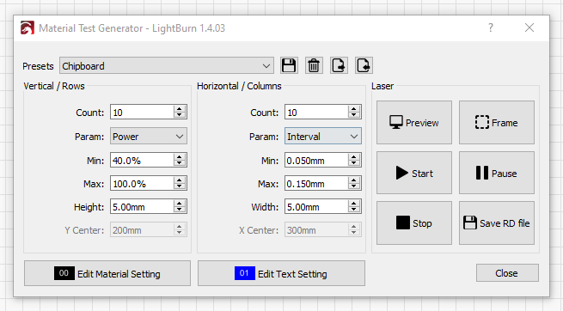
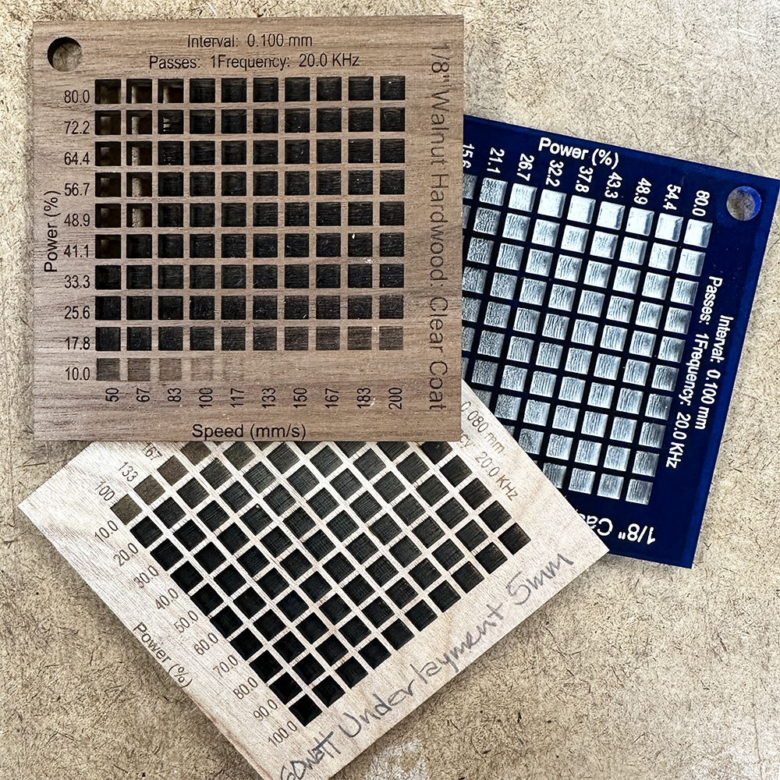
LightBurn: Material Test Cards
Thunder Lasers provides a limited library of materials with preset speed/power, but these are only starting points and not necessarily the best settings. You should do a test on your material before starting your full project. This will allow you to see what the engraving will look like with different speed/power combinations AND if your speed/power settings are correct to cut all the way through.
LightBurn has made it super simple to make one with different settings for your material. The widget can be found in the top left menu > Laser Tools > Material Test.
LightBurn tutorial: https://docs.lightburnsoftware.com/Tools/MaterialTest.html or other YouTube videos.

Slide 32
Additional Resources &
Advanced Classes

Slide 33
Hands on Topics
Walk around machine
Compressor turn on/off
Ventilation turn on/off
Power switches
Emergency stopping the machine
Restarting machine
Adjusting power speed
Focusing Auto/manual
Setting up software
Setting up material
Camera
Trash location
Fire extinguisher and blanket
Vacuum locate
Cleanup of machine and area
Logging time
Paying for use

Slide 34
Laser Hands On
Practice and Test! A LOT!
Hands on use of the Laser
Calendar Link: https://makersmiths.org/LaserReservations
or go to Makersmiths Wiki look for calendar under tool resources/laser cutter

Slide 35
Useful Videos:
Computer Creationz: https://www.youtube.com/channel/UCB3-k4fmkVqTTjAhb0Cdd_g
LightBurn Official YouTube Channel: https://www.youtube.com/@lightburnsoftware7189
The Louisiana Hobby Guy: https://www.youtube.com/@TheLouisianaHobbyGuy

Slide 36
Tips, Hints, & Have Fun
10 Tips and Tricks for Laser Engraving and Cutting
http://www.instructables.com/id/10-Tips-and-Tricks-for-Laser-Engraving-and-Cutting/?ALLSTEPS
Material Safety and your Laser
http://support.epiloglaser.com/article/8205/30188/material-safety-and-your-laser
How to test if a material is safe to laser cut!
https://www.reddit.com/r/glowforge/comments/3no1vj/how_to_test_if_a_material_is_safe_to_laser_cut/
Visit the Engravers forum at: http://www.sawmillcreek.org/
Laser Engraving Tips: http://www.inoplas.com/techtips/laserengrave.asp
Maker Case: a super easy to use website that will design box files for you! You just input the demensions https://www.makercase.com/

Slide 37

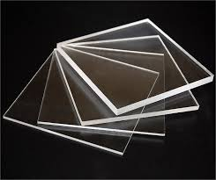
Tips, Hints, & Have Fun (cont)
Where to buy Acrylic
Canal Plastic (closest to us) https://www.canalplastic.com/collections/acrylic-sheets
Johnson Plastics https://www.jpplus.com/engraving/sheet/laser/plastic
Tap Plastics (furthest, longer shipping) https://www.tapplastics.com/product/plastics/cut_to_size_plastic
Inventables (great place to buy small sheets of ⅛” wood too. Just double check it is laser safe) https://www.inventables.com/categories/materials

Slide 38
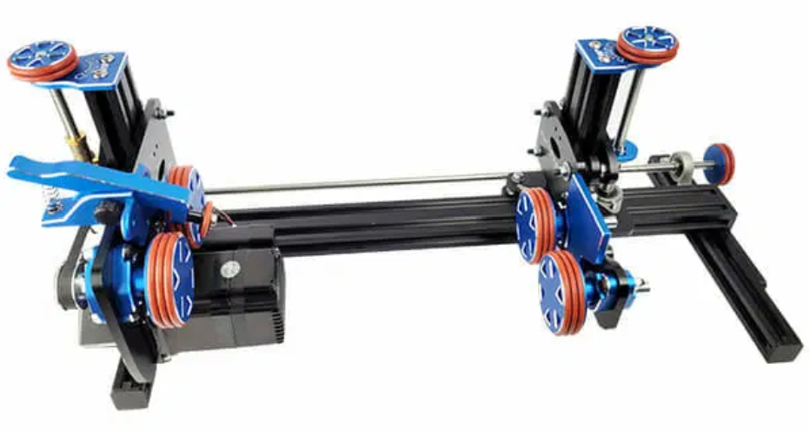

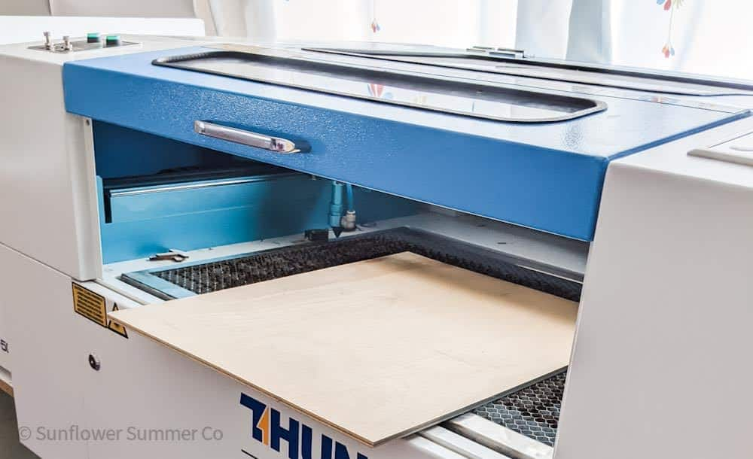
Advanced Classes
Laser Rotary: This class will go over how to use the rotary tool on both the Nova 24 & 51.
Advanced Laser Cutter: This class will go over how to safely use the many advanced options the Thunder Lasers offer. These include: :
Passthrough
Print and cut wizard
HR & 4” lenses
Nozzle Sizes
Camera Calibration

Slide 39
Passthrough: Safely Moving the Machines
The Nova 24 & Nova 51 both have a passthrough option. This means you can cut and/or engrave items larger than the bed size. The width will be the same, but the length is only limited by the space around each machine.
How to use the pass through, as well as print & cut options will be covered in our Advanced Laser Class. DO NOT attempt to use it without training.
Please keep in mind that the Nova 24 in Purcellville has VERY limited space around it. We would prefer to not use the passthrough in that space and ask that you just use the Nova 51 in Leesburg instead.
Keep all cords clear of the wheels.
Make sure the exhaust hose has enough slack, as well as the power cords.
Please move the computer along with the machine.
If you know you will need help, please let a steward or site manager know ahead of your reservation and we will try to get everything ready for you. Otherwise put a call out on SLACK. We have a handful of members who live very close to each location and have been known to run over and help out.
Each location has a limited amount of space around their laser cutter, so please account for this when choosing your materials and which machine you’ll be using.
  Leesburg can handle up to a 4’x8’ board
  Purcellville can’t handle much, so we would prefer to not use the passthrough in that space and ask that you just use the Nova 51 in Leesburg instead.

Slide 40
Differences from ULS Laser
Your power, speed, interval, etc. settings save within your Lightburn save file. If you do multiples of the same project on the same material, this should reduce your setup time.
You can change the direction that the laser does raster engraving to any direction which could speed up projects where there is a lot of tall but narrow text. You can also use Offset Fill to engrave more like a CNC.
On the ULS, if it fit on the honeycomb bed, you could cut/engrave it. The honeycomb bed of the Thunder Laser is not equal to the area you can cut on. It’s easy to hit the limits of the machine and this can happen even if the “Frame” preview looked fine.
On the Thunder Laser, you have to make sure that the engrave/cut order is right. The software won’t do it for you.
Print and Cut is a great feature if you want to print and cut, or to line up jigs for repeated use.
You have two air assist levels with the Thunder Lasers.

Slide 41
Pre-Cut Checklist
Turn on the computer and monitor.
Turn on the “Main” switch on the laser.
Turn on the “Laser” switch on the laser.
  This turns on the watercooler in Leesburg and Purcellville. Check it is on.
Turn on the compressor. This is required in both locations but the on/off is different.
  Check that the regulated supply on the compressor is 90psi and that the psi on the secondary regulator is at 50. Press the Test button on the Air-assist Control High to verify that both regulators are correct.
Add/remove the honeycomb and knives as needed for your project. Most projects will use the honeycomb bed.
Check that the correct lens head is installed. The standard lens head is the 2” lens. The HR and 4” lenses/heads are covered in the advanced class.
Holding the head, loosen the gold knob and raise head all the way up.
Place your work material on the bed. Place the acrylic focus tool on top of your material. Raise the bed until it is about 10mm from the focus tool. Hold the head, loosen the gold knob, and lower the nozzle until it touches the acrylic focus tool. Re-tighten the knob and remove the focus tool.
Open LightBurn on the computer.
File - Import Prefs - goto Thunder Laser Default Preferences folder on the Desktop choose the default settings file based on whether you will be importing SVGs from Inkscape or Illustrator. These files are also on the wiki.
Import/open/create your art as appropriate
Check or set all speed/power/passes/interval layer settings. Check that your origin in LightBurn is correct.
Move the laser/set your origin location as appropriate.
In LightBurn, press the “Frame” button which will move the machine around the outside edges of the area to be cut, to make sure your project will be cut in the correct location.
Turn on the fume extractor fan: Leesburg: Turn on the power strip next to the ductwork. Purcellville: Press the black button on top of the laser. Each press is 10% power so press at least 5 times, more if you need more extraction.
Press Start.

Slide 42
Post-Cut Checklist
Wait 10-15 seconds for the laser bed to exhaust before opening top.
Retrieve object(s) from laser bed.
NOVA-24: Turn exhaust fan off by pressing button so all lights are on, then press one more time and the lights will go out.
NOVA-51: Turn off the power strip where the exhaust is plugged in.
Turn off compressor. Bleed the compressor tank. Turn the red knob on the regulated/supply pressure all the way to the left until the pressure is zero. Turn the valve on the output to the left so that the handle is parallel to the dials. Press the Test button on the Air-assist Control High to bleed any remaining air from the system.
Turn off “Laser” switch.
Turn off “Main” switch.
Replace the front and rear panels if they were removed to use the pass through function.
Replace the stop collar on the 2” lens/head if it was removed for your project.
Replace the 2mm nozzle on the 2” lens/head if it was changed for your project.
Clean all nozzles that were used with alcohol, paper towels and swabs.
If the HR or 4” lens/head was used, replace it with the 2” lens/head in the machine.
Vacuum top of bed. Remove all little pieces that you can vacuum or find.
Open tray door and vacuum out all little pieces in tray.
Save your file and exit Lightburn.
Purcellville: Turn off the monitor but leave the computer on.
Leesburg: Leave the computer and monitor on.

