Slide 1


Slide 2
Makersmiths
Green New Member Orientation Class

Slide 3
Outline
History and Why We’re Here
Membership
Rules & Policies
Safety
Tool Access Levels
Accounts and Platforms
Getting Started
Make Something

Slide 4
History
2014
September – Incorporated as a non-stock, non-profit in VA, with an all volunteer staff
October – held first annual Loudoun County Maker Fair, launched website, successfully funded our first Kickstarter campaign
November – First members joined, November & December: Hosted showing of “Maker, the Movie” in Sterling and Leesburg
2015
First half, 2015: planning, fund-raising, tool-gathering, building membership, negotiating lease
June 15th: Completed lease, begin space prep, Aug 1: Ribbon Cutting ceremony!
Makerspace open! Location: 71 Lawson Rd in Leesburg VA:
Member hours 24/7/365. Non-members “drop-in” hours 6-9M on Tuesdays & Thursdays.
2017
Moving from Lawson Rd into larger space at 106 Royal St SW Leesburg, VA 20175. To be known as Makersmiths Leesburg
Setting up new location leased from Town of Purcellville. Location has 7,500 sf of buildings on little over 13 acres.
Makersmiths Purcellville it is at 17760 Telegraph Springs Rd, Purcellville, VA 20132.
July: won the Purcellville 4th of July parade Liberty Cup! Wooo Hooo!
October: Lots of activity with etching pumpkins and pumpkin pies at Makersmiths-Leesburg.
Open Houses on First Fridays.
Bee Hive of activity at Makersmiths-Purcellville with transforming upper building into a makerspace upper building into a makerspace
with multi-purpose meeting room, wood shop, and metal shop. Also transforming lower building with hot shop (kilns, forge) and frame shop.

Slide 5
Why we exist
Adult Enthusiasts
Prototyping Entrepreneurs
STEM/STEAM Education
Community Organizations
Enable and inspire people to make things and learn things

Slide 6
Membership
Associate Member
All of the Guest Member benefits noted above.
Special Discounts on classes, workshops, materials and tool use time like discounts on use of laser cutter.
Can bring along friends and other guests (1 guest).
Mentorship by a Full Member who can answer most all of your questions and concerns.
Use of space anytime a Full Member is present
Use of all our tools (subject to safety and training requirements)
The Associate Monthly Membership fee is $50 per month

Slide 7
Membership
Full Member
Must be voted in at a Member Meeting after a trial period as an Associate Member
All of the Associate Member benefits noted above
Key Holder with 24/7 access to the space
Can bring along friends and other guest (3 guests)
The Full Monthly Membership fee is $100 per month

Slide 8
Membership Process
Attend an Open House tour of the space
Complete Associates Join-Us process at:
https://makersmiths.org/Join-Us
Attend a “Green” New Member orientation (this class)
Find a Full Member to act as a Sponsor
Attend a Monthly Membership meeting

Slide 9
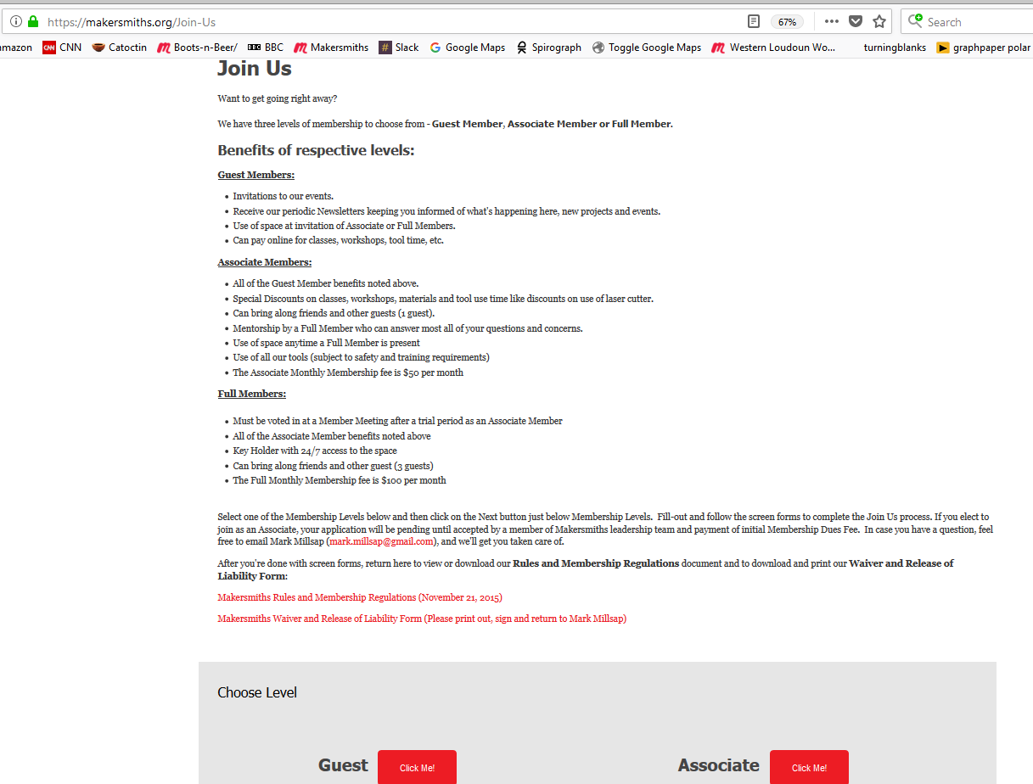
Membership Page

Slide 10
Rules
Be Excellent To One Another
Pay It Forward
Clean It Up, Put It Back, Leave It Better
Pay Attention to Your Children
Put Your Name and Phone Number On It
Don’t make us make another rule

Slide 11
Rules
Read the Rules:
  Wiki --> Rules and Guidelines Home -->
  New Standing Rules and New Bylaws
Sign Waiver of Liability
Have Fun !

Slide 12
Safety
Use Safety Glasses to Protect Eyes
Use Ear Plugs / Ear Muffs to Protect Ears
Tie Back Hair
Roll Up Sleeves
Wear Closed-Toe Shoes
Don’t know - ASK & Get Trained

Slide 13
Safety
Wear Eye Protection (always!)
Wear Ear Protection
Wear Gloves As Needed
Keep Workplace & Aisleways Clear & Clean
Mind Your Eyes, Fingers and Dangly Bits

Slide 14
Tool Access Levels
Bench Top Tools with GREEN tape marking
Hand-Held Bench Tools
  files, tap sets, hacksaw, pliers, hammers, etc.
Hand-Held Power Tools
  jig saw, sanders, grinders, etc.

Slide 15
Tool Access Levels
Prior to using YELLOW or RED tape tools you need sign-off from a Shop Steward.
Shop Stewards are:
Brad Hess - Wood Shop
Dave Painter - Metal Shop
John Dubelko - Laser Cutter

Slide 16
Tool Access Levels
Wood Shop YELLOW RED Tools:
Table Saw
Band Saw(s)
Router(s)
Joiner / Planer
Drum, Belt, Spindle and Disk Sander

Slide 17
Tool Access Levels
Metal Shop YELLOW Tools:
Grinder(s) / Horizontal Mill
Drill Press / Vertical Mill
Corner Cutter / Metal Break
Vertical Press / Horizontal Bandsaw

Slide 18
Tool Access Levels
Red Tools Require Instruction Prior to Use:
Laser Cutter - John Dubelko
Red Tool Training Wood Shop - Brad Hess
Table Saw / Router Table / Band Saw(s)
Joiner / Planer / Lathe(s) / Chop Saw

Slide 19
Orientation for New Members
Platforms and Accounts
Meetup – show webpage and discuss – mention that this platform is going away.
Used to signup for classes and meetings at Makersmiths – show process.
Describe account setup.
Slack – show webpage and discuss Channels and Direct Messages.
Set up this on cell phone during the meeting, and demo features.
Send email to Slack@Makersmiths.org, Join by email invitation back from Mark Millsap.
What is slack – message with team, share files, get updates on activities on your area of interest (channels), Make announcements, Door Status.
More info at https://slack.com/features
Hands on learning at :-
https://get.slack.help/hc/en-us/articles/115005333523-Study-Guide-Fundamentals-for-End-Users
Wild Apricot - https://www.makersmiths.org/ this is main platform once Meetup goes.
Used to signup for classes and meetings at Makersmiths – show process.
Join by invitation from Mark Millsap via email.
Use projector to show webpage and the info on the website.

Slide 20
Orientation for New Members
Wiki - http://wiki.makersmiths.org/display/MAK/Makersmiths
Describe features on this website using projector.
Wifi - Once you become a member, go to this page to set up wifi
http://wiki.makersmiths.org/display/MAK/WiFi
August – Once you become a full member, this Cell Phone App will allow you to
unlock and lock the front door.
Also discuss how to use platforms to manage your membership.
Getting Started – after joining
What do you want to learn or make – both short and long term goals?
Discuss with each new member
Give new member a person to contact who would act as a Mentor for their area of interest.
What is possible – get inspired !
- describe with photos some of the things members have made recently covering CNC, Woodwork, Raspberry Pi, 3D Printing, Handicraft.

Slide 21
Orientation for New Members
Joined, Oriented, Red Class done, Inspired - Now what !
Ask other members for help, Attend Open Woodshop for help with your project.
It is hoped that members can give a Show and Tell where they describe the steps used to make something.
Take Makersmith Classes – show list of past and present classes.
The Laser and Red Tool classes will teach machine safety and the machine operation,
but not operational skill.
The below YouTube channel will help you learn to use CorelDraw to make a simple Laser cut bowl - https://www.youtube.com/watch?v=dOUfEiRts38
Join a Group e.g. https://catoctinareaturners.org/v5/wp-content/uploads/2017-3-newsletter.pdf
this woodturning group has Thursday night turning sessions’, where guidance is freely given.
Online classes:
          https://www.inventables.com/projects
                https://www.craftsy.com/woodworking/shop/woodworking-classes
Hands- on classes
      https://www.woodcraft.com/stores/northern-virginia/classes

Slide 22
F.A.Q.
Questions?
Web:
http://www.makersmiths.org
Email:
Info@makersmiths.org

Slide 23
V1.0 Green Orientation Class - September 2015

