Slide 1
New Member Orientation
Feb 2019

Slide 2
Outline
Who we are
    History
    Corporate Structure
    Business Model
    Membership Stats
    Policies
    Safety
Where we are
    Leesburg
    Purcellville
How we communicate
    Wild Apricot
    Slack
    Makersmiths Wiki
    Meetup
    Door tweets
    Wifi
Membership Levels
Training
    Discounts
    Instructor pay
    Tool Signoff
  How to help
    Membership meetings
    Volunteer Opportunities
  How to get started Making
    Hours
    Resources

Slide 3
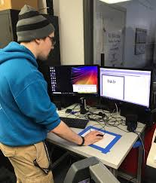
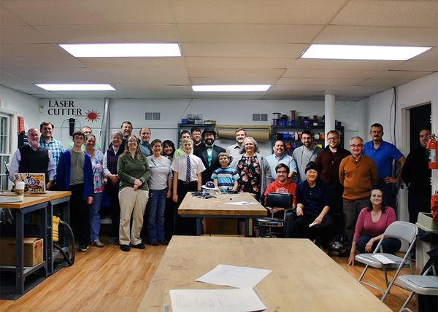
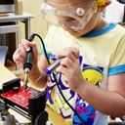
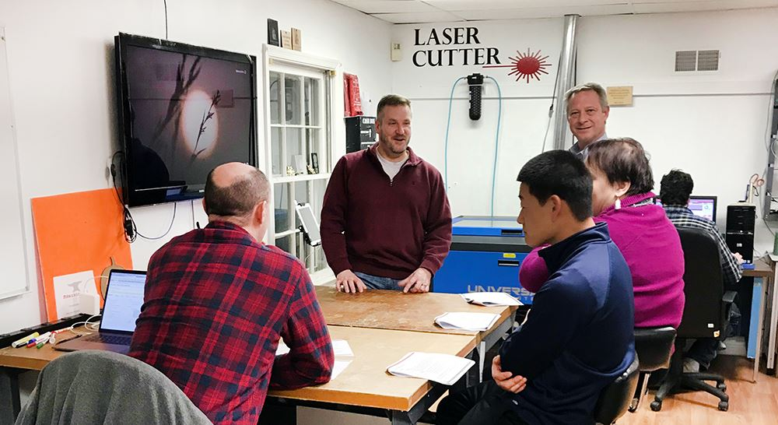
Who we are
Prototyping Entrepreneurs
Adult Enthusiasts
Mission Statement:
To provide a community workshop where people can learn, teach and collaborate on creative and technical works, and to promote the usefulness of competence in the technical arts to the public; and by serving as a center of information about the technical arts for members, schools, other interested groups and the general public.
Community Organizations
STEM/STEAM Education

Slide 4
History
2014
September – Incorporated as a non-stock, non-profit in VA, with an all volunteer staff
October – held first annual Loudoun County Maker Fair, launched website, successfully funded our first Kickstarter campaign
November – First members joined, November & December: Hosted showing of “Maker, the Movie” in Sterling and Leesburg
2015
First half, 2015: planning, fund-raising, tool-gathering, building membership, negotiating lease
June 15th: Completed lease, begin space prep, Aug 1: Ribbon Cutting ceremony!
Makerspace open! Location: 71 Lawson Rd in Leesburg VA:
2017
Moving from Lawson Rd into larger space at 106 Royal St SW, Leesburg, VA.
  Setting up new location leased from Town of Purcellville. Location has 7,500 sf of buildings on little over 13 acres.
  July: won the Purcellville 4th of July parade Liberty Cup! Wooo Hooo!
  Purcellville - Start the transformation of the upper building into a makerspace upper building.
  2018
  Large format CNC added to Leesburg
  Larger format CNC added to Purcellville
  Tormach Metal CNC added to Leesburg
  Purcellville upper building goes online (power, water and internet)

Slide 5
Corporate Stuff
Leadership
Board of Directors:
Brad Hess (Chairman)
Brandon Bullis
Julia Rivera
Dave Painter
Mark Millsap
Michael James
Erin Werling
The Board is the official voice of Makersmiths Inc. All contracts and other legal matters must be approved by the board of directors
President: Mark Millsap
Treasurer: John Dubelko
Bookkeeper: Christa Stern
Structure
IRS designated Nonprofit 501(c)3
    $$$$ Donations are tax deductible $$$
Incorporated in Virginia under the name “Makersmiths Inc.”
Information on Wiki
Bylaws
Board of Directors Meeting Agenda/Minutes
Board Resolution Process
Yearly Budgets

Slide 6
Business Model
2019 Budget
Revenue
Expenses

Slide 7
Membership Stats (as of May 2019)
Cost | Levels | Members | Memberships | FTE
$50 | Associate Monthly | 58 | 52 | 26.0
In-kind | Complimentary | 6 | 0 | 0.0
$5,000 | Corporate Annual | 9 | 2 | N/A
$1000* | Full Annual | 12 | 9 | 7.5
$100 | Full Monthly | 66 | 40 | 40.0
$500* | Full Semiannual | 7 | 4 | 3.3
 | Total | 158 | 107 | 76.8
Projecting about 100 Full Time Equivalent (FTE) members by year end.
*Discount for Annual and Semiannual memberships. FTEs based on $100 a month, with discount this equates to .83 per membership for these levels.

Slide 8
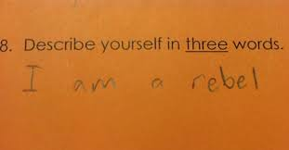
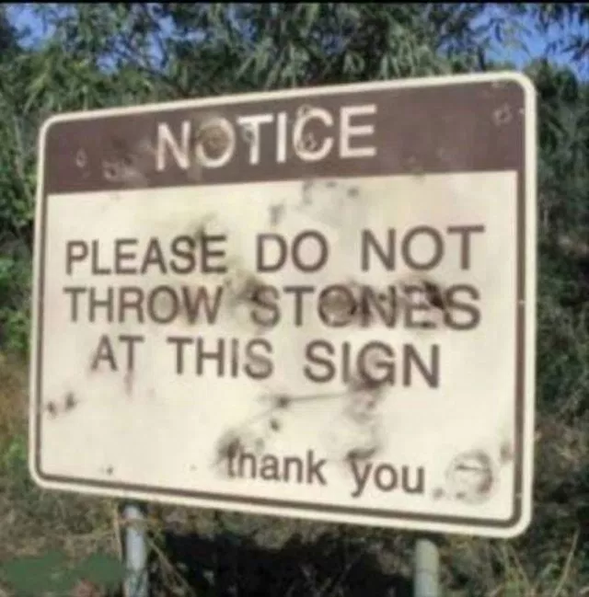
Policies
Be excellent to each other.
Don’t do anything that would require us to write a new rule.
When in doubt-ask.
Nobody shall use hazardous equipment while alone in the space or without sufficient training. If you do not know how to use a tool you must ask for the assistance of someone who does. If you do not know if something is hazardous you must ask someone who does.
Please keep the space in a pleasant, clean and tidy state. Wash up any kitchenware and sweep up any sawdust etc. Pack away your projects when you're not working on them and put tools back where they belong. Items left on desk surfaces may be moved or disposed. Hot food/drink etc is allowed however please be considerate of others when consuming strong smelling foods.
Don't use the space for illegal or immoral purposes.
Restore makerspace to its default state, putting all materials, projects and tools away and leave it as good as or better than the state in which you found it, turn off all lights and tools, and lock the space before you leave.
Under 18s may not enter the space without a responsible adult; they can only use equipment that they have been certified on, and then must follow any and all minor supervision rules required for that equipment. The responsible adult can be a parent/guardian, or any adult member with permission from a trustee and a parent/guardian in advance. Said responsible adult assumes all responsibility for the actions and safety of said minor.
Both Faculties have Cameras so we can rewind the

Slide 9
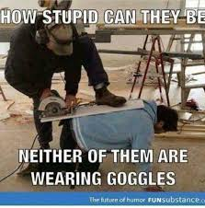



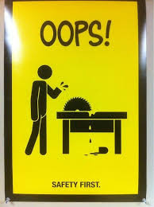
Safety
Wear the Gear
Know the Machine
Know your Ability
Take the Safety Class
Cameras in Both Facilities
See Something Say Something

Slide 10
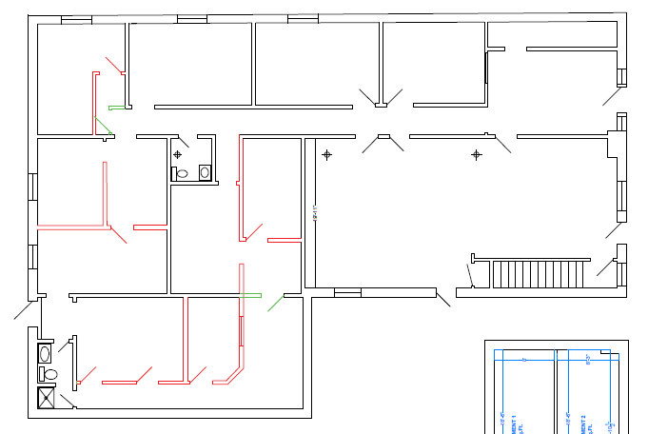
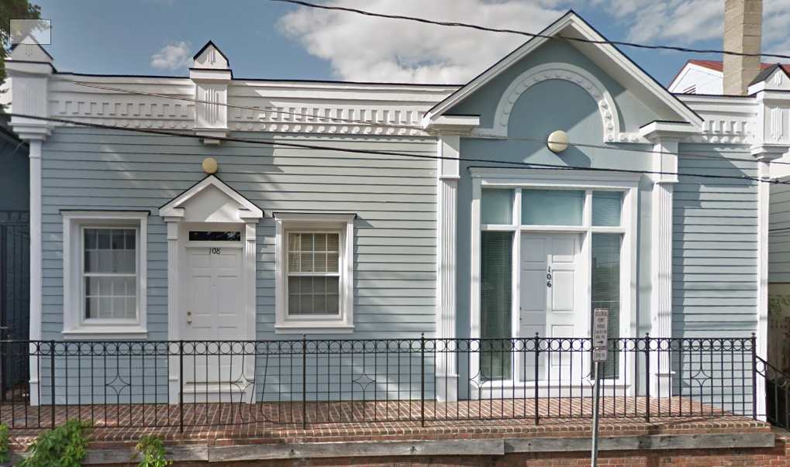
Where we are
Leesburg
    106 Royal St SW, Leesburg, VA 20175 (official mailing address)
Full Format
CNC
Classroom
3-d Printers
Reception
Metal Shop
Small CNCs
General/Crafts
Electronics
Laser Cutter
Vinyl Cutter
3d printers
Tormach Metal CNC
“Big Red” CNC
Electronics
Wood shop
Wood Shop
Park in the Liberty St lot South West of facility

Slide 11
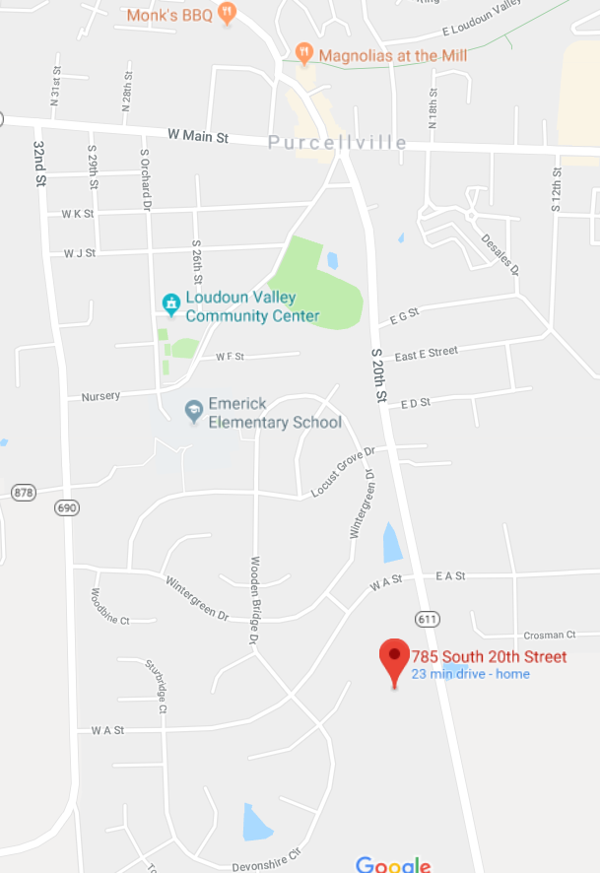
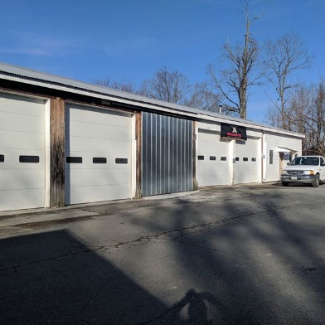
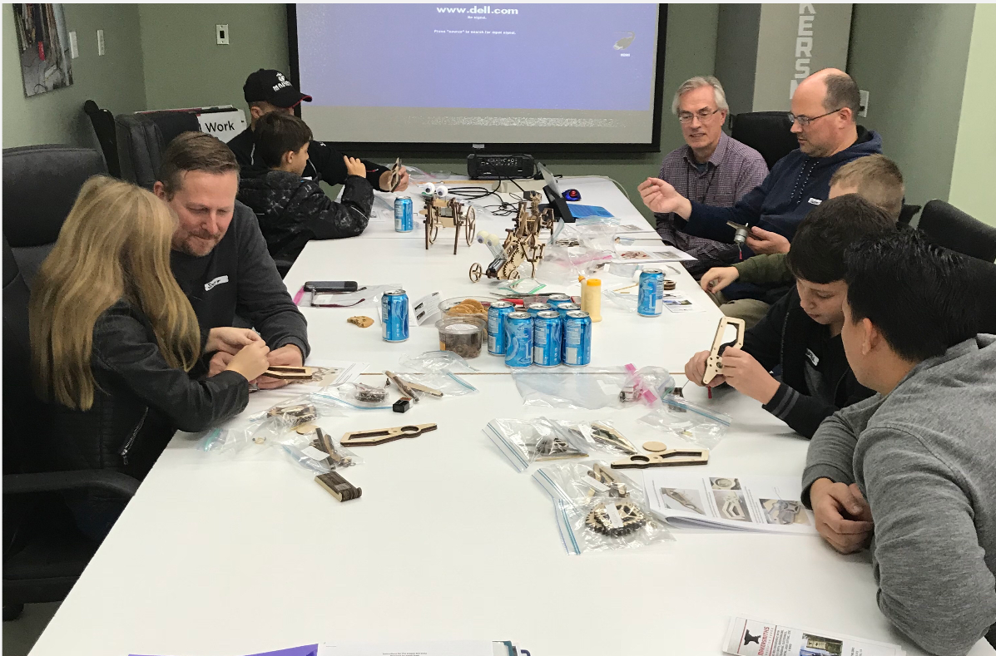
Where we are
Purcellville
    785 S. 20th St, Purcellville, VA 20132
Classroom
Wood Panel Shop
Metal Shop
Welding
Paint Booth
Ceramics
Drone Park
Hot shop
Large CNC
3d printers
Noise limits start at 9PM
Upper and lower gates, use the lower and drive up the hill

Slide 12

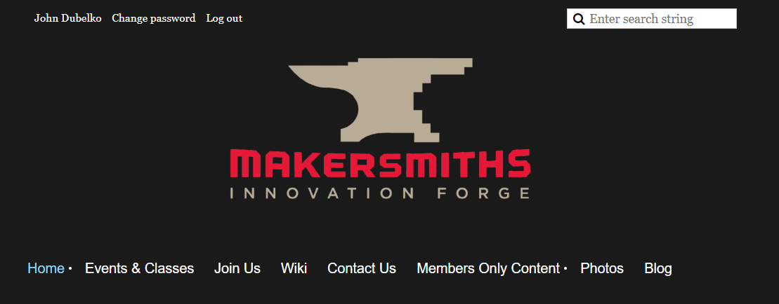

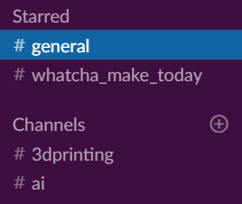
How we communicate
  Makersmiths.org
    Holds all the membership info
    Runs membership billing
    Backend is a membership management system called “Wild Apricot”
    How you signup and pay for events
    Members Only Content
    Edit your account
  Slack
    Collaboration area for Makersmiths
    Several channels or topic areas
    Running blog
    Can call and direct message members

Slide 13




How we communicate (cont.)
  Makersmiths Wiki
    Place to hold “longer term” information
    Corporate archive (Standing Rules, Bylaws, Board Meeting Agendas)
    Tool information
    Official files
  Door tweets (https://twitter.com/makersmithsdoor)
    Leesburg stop light status
    Track when the door is open or closed
    Slack Channel
    Working setup for Purcellville; see purcellvillestatus channel on slack
  Facebook
    Events
    News
    Direct message
  Wifi
    Leesburg
    Guest (low data rate)
    Members (full throttle) – setup your password on your account profile (makersmiths.org)
    Purcellville
    Password is near main door upper building

Slide 14




Membership
Guest Members:
Invitations to our events.
Use of space at invitation of Associate or Full Members.
Can pay online for classes, workshops, tool time, etc.
Associate Members $50 a month:
All of the Guest Member benefits noted above.
Special Discounts on classes, workshops, materials and tool use time like discounts on use of laser cutter.
Can bring along 1 guest.
Mentorship by a Full Member who can answer most all of your questions and concerns.
Use of space anytime a Full Member is present
Use of all our tools (subject to safety and training requirements)
Full Members $100 a month:
Voted in at Board Meeting see members only section of makersmiths.org for request form
All of the Associate Member benefits noted above
Key Holder with 24/7 access to both spaces
Can bring along up to 3 guests.
Family members (same household) included, add under membership profile
Corporate $5,000 a year:
Up to 10 Members with Full member benefits
Complimentary
Three month Full membership in exchange for service to the organization
Application required and approved by the board of directors

Slide 15





Training
Discounts
    Members get discounts, look for them!
  Instructor pay guidelines:
    Must be a full member in good standing and current on dues.
    Notify the board of directors and treasurer before classes are scheduled
    Instructors will split the class fees (after class supplies and other charges) with Makersmiths 50/50.
    Makersmiths will follow the IRS rules on compensation. An IRS 1099 will be issued at the end of the year for those that meet the minimum requirements. Instructors are not employees of Makersmiths and no taxes will be withheld. The payment of the next month’s dues is considered compensation.
    The board of directors can modify this policy on a case by case basis.
  Holding a class or event
    Go to makersmiths.org and look under members only content for request forms and an instructor guide
Tool Signoff
    Several machines require safety training before they can be operated
    Wood shop tools, Metal shop tools, Laser Cutter are examples

Slide 16
How to help/get involved
Members are ask to give back 2 hours a month
Getting involved
    Attend Membership Meetings (first Wednesday night of the month)
    Watch for opportunities on Slack
    Post to the makersmiths.org blog
    Show us what you’re making on Slack
Volunteer Opportunities
    Several community out reach events are planned through out the year that need support
    Scouting, parades, Leesburg flower shop, science fair judges, county fairs
Tool/room stewards
    Badly need to get both facilities organized
    No prior experience required
    You are ask to be the advocate for the tool or room, meaning doing light maintenance, coordinated repair if broken, letting members know of the status of the tool or room
Donations
    We are a 501(c)3 organization so donations are tax deductible
    Before donating equipment or items check with the Treasurer or room steward
    Monetary donations are easy to make via credit card on makersmith.org
    You will ger a tax receipt for you donation
  Be on a Committee
    See the Makersmiths Wiki for more information

Slide 17
Getting Started - Making
Hours - The space is open 24/7 for Full Members. Associates need Full Member present to enter.
    Leesburg
    Open Woodshop Hours on Mondays
    Fridays Craft Nights
    Thursday Open house
    First Friday
    Purcellville (Working out Full Member access)
    Brag Thursdays
    Open Shop Saturdays
    Tuesday Open house
Go to the Makersmiths Meetup page for a listing of events
https://www.meetup.com/Makersmiths/events/

Slide 18





Getting Started - Making
Mentorships -
    There are stewards allocated to each room.
    A Full Member can mentor an Associate Member
    The best way to find a mentor is to turn up at the meetings and network with the people.
    Talk to the folks about what you want to do, or where you need help.
    Below is a small sample of the type of MS meetings available :
                Open Woodshop,
                3D Printing - Level 1,
                Arduino Introduction 101 Class,
                MS-P Brag Thursday
                MS-P Open Shop/Work Day,
                Block of the Month Quilting Party
                MS-P Fix-it First Thursday
                Leesburg Makersmiths Craft Night
                Laser Cutter Introduction

Slide 19
Getting Started - Making
Resources
    In addition to the Makersmith support and classes, there are numerous local and online classes
    Below are just a few options:
    YouTube – Slack Video Guides,
    CorelDraw guides for Laser Cutting,
    Fusion 360 with Lars Christensen.
    Leesburg Woodcraft classes –
    Others
    https://get.slack.help/hc/en-us/articles/115002990986
    https://www.youtube.com/watch?v=dOUfEiRts38 https://www.inventables.com/projects
    https://www.craftsyles.com/projects.com/woodworking/shop/woodworking-classes
    The plan is to use the Makerspace Wiki page, to list learning and reference links
    http://wiki.makersmiths.org/display/MAK/Makerspace+Resources

