Slide 1
New Member Orientation
April 2018

Slide 2
Outline
Who we are
    History
    Corporate Structure
    Business Model
    Membership Stats
    Policies
    Safety
Where we are
    Leesburg
    Purcellville
How we communicate
    Wild Apricot
    Slack
    Makersmiths Wiki
    Meetup
    Door tweets
    Wifi
Membership Levels
Training
    Discounts
    Instructor pay
    Tool Signoff
  How to help
    Membership meetings
    Volunteer Opportunities
  How to get started Making
    Hours
    Resources

Slide 3
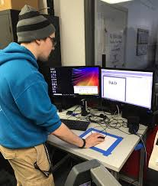
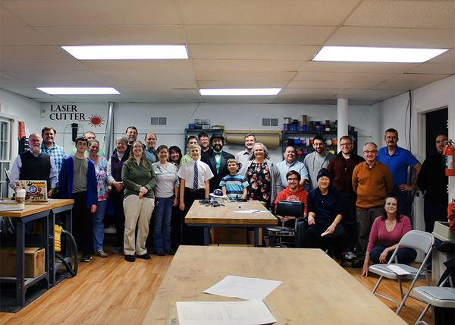
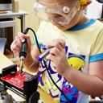
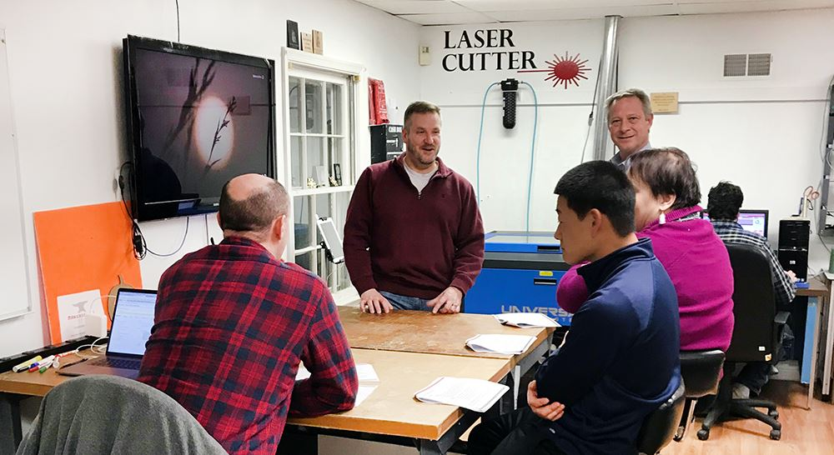
Who we are
Prototyping Entrepreneurs
Adult Enthusiasts
Mission Statement:
To provide a community workshop where people can learn, teach and collaborate on creative and technical works, and to promote the usefulness of competence in the technical arts to the public; and by serving as a center of information about the technical arts for members, schools, other interested groups and the general public.
Community Organizations
STEM/STEAM Education

Slide 4
History
2014
September – Incorporated as a non-stock, non-profit in VA, with an all volunteer staff
October – held first annual Loudoun County Maker Fair, launched website, successfully funded our first Kickstarter campaign
November – First members joined, November & December: Hosted showing of “Maker, the Movie” in Sterling and Leesburg
2015
First half, 2015: planning, fund-raising, tool-gathering, building membership, negotiating lease
June 15th: Completed lease, begin space prep, Aug 1: Ribbon Cutting ceremony!
Makerspace open! Location: 71 Lawson Rd in Leesburg VA:
2017
Moving from Lawson Rd into larger space at 106 Royal St SW, Leesburg, VA. To be known as Makersmiths Leesburg
  Setting up new location leased from Town of Purcellville. Location has 7,500 sf of buildings on little over 13 acres.
  July: won the Purcellville 4th of July parade Liberty Cup! Wooo Hooo!
  October: Lots of activity with etching pumpkins and pumpkin pies at Makersmiths-Leesburg.
  Open Houses on First Fridays.
  Bee Hive of activity at Makersmiths-Purcellville with transforming upper building into a makerspace upper building into a makerspace with multi-purpose meeting room, wood shop, and metal shop. Also transforming lower building with hot shop (kilns, forge) and frame shop.

Slide 5
Corporate Stuff
Leadership
Board of Directors:
Brad Hess (Chairman)
Brandon Bullis
Julia Rivera
Dave Painter
Mark Millsap
(The Board is the official voice of Makersmiths Inc. All contracts and other legal matters must be approved by the board of directors)
President: Mark Millsap
Treasure: John Dubelko
Bookkeeper: Christa Stern
Structure
IRS designated Nonprofit 501(c)3 ***donations are tax deductible***
Incorporated in Virginia under the name “Makersmiths Inc.”
Information on Wiki
Bylaws
Board of Directors Meeting Agenda/Minutes
Board Resolution Process
Yearly Budgets

Slide 6
Business Model
2018 Budget

Slide 7
Membership Stats (as of May 2018)
We are growing and projecting about 100 FME by year end.

Slide 8
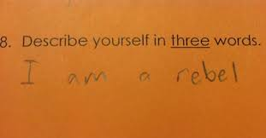
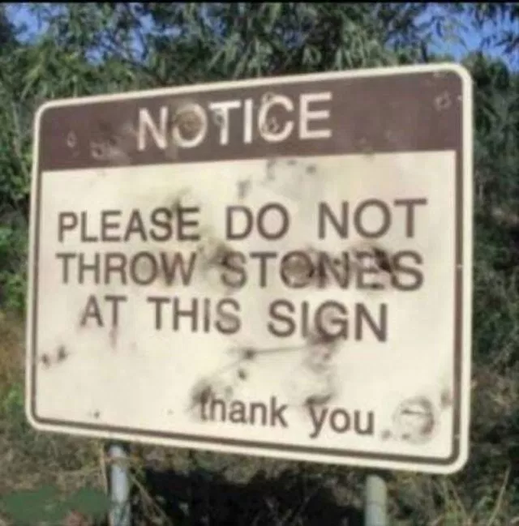
Policies
Be excellent to each other.
Don’t do anything that would require us to write a new rule.
When in doubt-ask.
Nobody shall use hazardous equipment while alone in the space or without sufficient training. If you do not know how to use a tool you must ask for the assistance of someone who does. If you do not know if something is hazardous you must ask someone who does.
Please keep the space in a pleasant, clean and tidy state. Wash up any kitchenware and sweep up any sawdust etc. Pack away your projects when you're not working on them and put tools back where they belong. Items left on desk surfaces may be moved or disposed. Hot food/drink etc is allowed however please be considerate of others when consuming strong smelling foods.
Don't use the space for illegal or immoral purposes.
Avoid doing harm to the Makersmiths reputation. Do not bring illegal drugs, drug paraphernalia or evidence of drug use to the space.
Restore makerspace to its default state, putting all materials, projects and tools away and leave it as good as or better than the state in which you found it, turn off all lights and tools, and lock the space before you leave.
Keep entry and walkways clear of materials and debris.
Respect private and shared property. Don’t borrow something unless it’s understood it’s something you can use. If you do use something, replace it (Pay it forward!). If you break it, it is your responsibility to get it fixed. (Ask for help if needed).
…and on, and on, see the rest at the Makersmiths Wiki under “Rules and Guidelines Home”

Slide 9
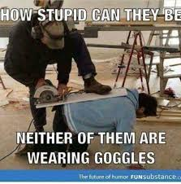





Safety
Wear the Gear
Know the Machine
Know your Ability
Take the Safety Class

Slide 10
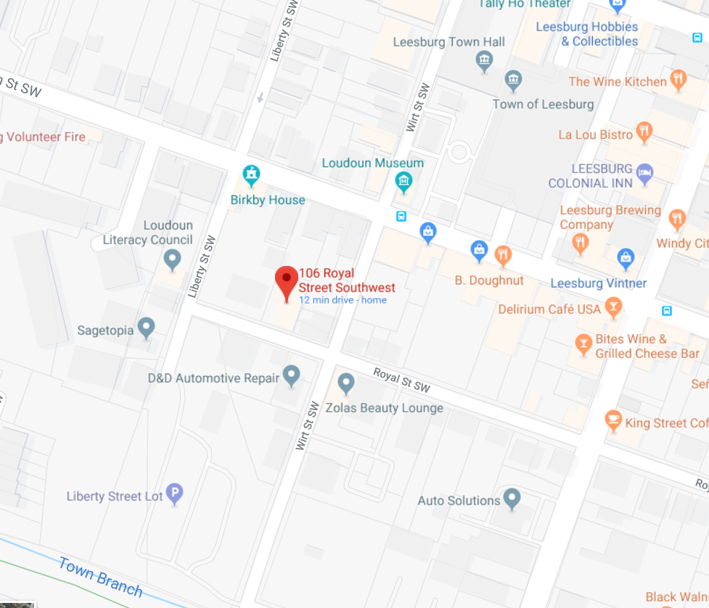
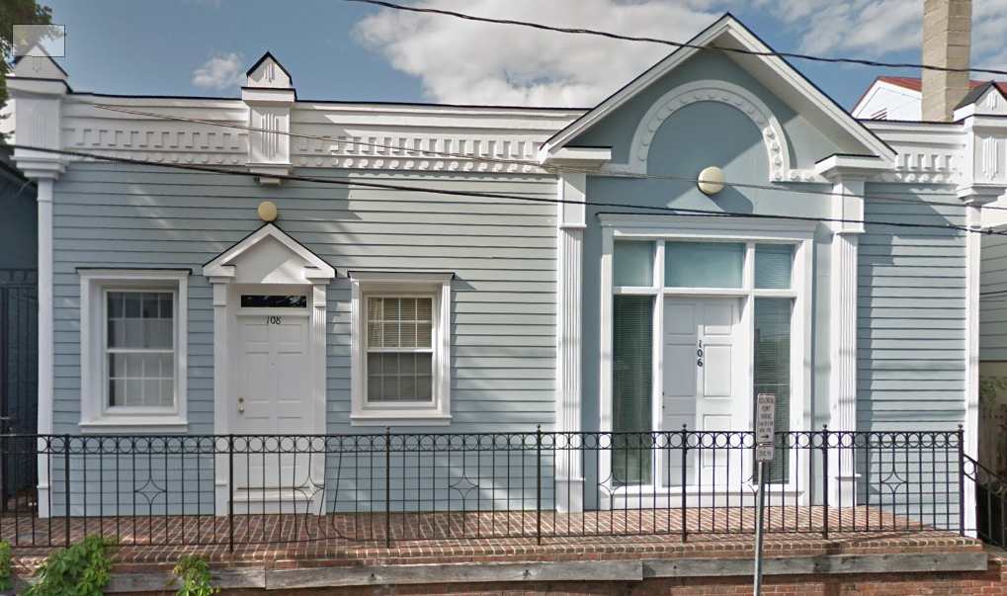
Where we are
Leesburg
    106 Royal St SW, Leesburg, VA 20175 (official mailing address)

Slide 11
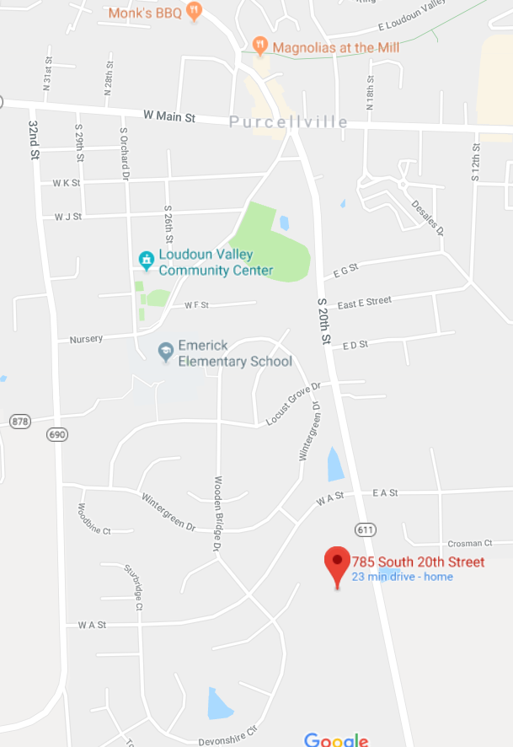
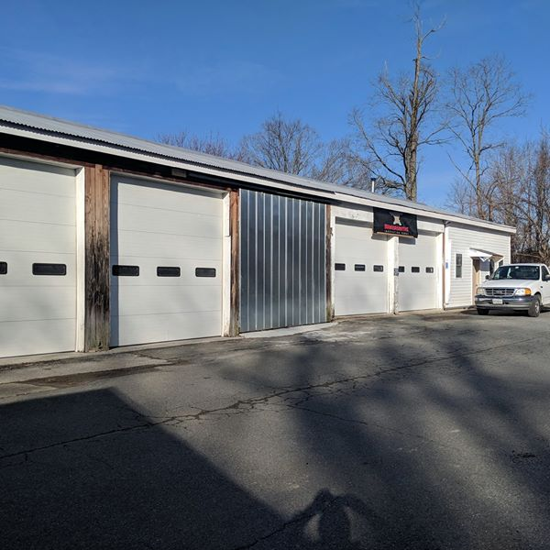
Where we are
Purcellville
    785 S. 20th St, Purcellville, VA 20132

Slide 12
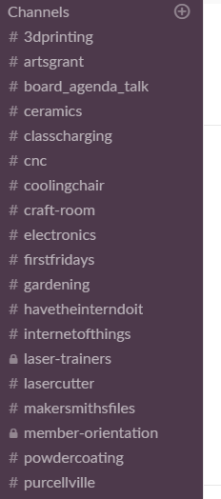
How we communicate
  Makersmiths.org
    Holds all the membership info
    Runs membership billing
    Backend is a membership management system called “Wild Apricot”
    Becoming how we sign people up for events
  Slack
    Collaboration area for Makersmiths
    Several channels or topic areas
    Running blog
  Makersmiths Wiki
    Place to hold “longer term” information
    Corporate archive (Standing Rules, Bylaws, Board Meeting Agendas)
    Tool information
  Meetup
    Place to post upcoming events
    May phase this out
  Door tweets (https://twitter.com/makersmithsdoor)
    Leesburg stop light status
    Track when the door is open or closed
  Wifi
    Guest (low data rate)
    Members (full throttle) – setup your password on your account profile (makersmiths.org)

Slide 13
Membership
We have three levels of membership to choose from – below are benefits of the respective levels:
Guest Members:
Invitations to our events.
Receive our periodic Newsletters keeping you informed of what's happening here and events.
Use of space at invitation of Associate or Full Members.
Can pay online for classes, workshops, tool time, etc.
Associate Members:
All of the Guest Member benefits noted above.
Special Discounts on classes, workshops, materials and tool use time like discounts on use of laser cutter.
Can bring along 1 guest.
Mentorship by a Full Member who can answer most all of your questions and concerns.
Use of space anytime a Full Member is present
Use of all our tools (subject to safety and training requirements)
The Associate Monthly Membership fee is $50 per month
Full Members:
Must be voted in at a Member Meeting after a trial period as an Associate Member
All of the Associate Member benefits noted above
Key Holder with 24/7 access to the space
Can bring along up to 3 guests.
The Full Monthly Membership fee is $100 per month
Go to https://makersmiths.wildapricot.org/join-us for more info and to choose a membership.

Slide 14
Training
Discounts
    Members get discounts now with the switch over to makermsith.org for event signup
Instructor pay guidelines:
    Must be a full member in good standing and current on dues.
    Notify the board of directors and treasurer before classes are scheduled that they would like compensation.
    They will split the class fees (after class supplies and other charges) with Makersmiths 50/50.
    The instructors next month's dues will be taken out of any compensation before payment is made to the instructor.
    Makersmiths will follow the IRS rules on compensation. An IRS 1099 will be issued at the end of the year for those that meet the minimum requirements. Instructors are not employees of Makersmiths and no taxes will be withheld. The payment of the next month’s dues is considered compensation.
    The board of directors can modify this policy on a case by case basis.
Tool Signoff
    Several machines require safety training before they can be operated
    Wood shop tools, Metal shop tools, Laser Cutter are exaamples

Slide 15
How to help/get involved
Members are ask to give back 2 hours a month
Getting involved
    Attend Membership Meetings (first Wednesday night of the month)
    Watch for opportunities on Slack
    Post to the makersmiths.org blog
    Show us what you’re making on Slack
Volunteer Opportunities
    Several community out reach events are planned through out the year that need support
    Scouting, parades, Leesburg flower shop, science fair judges, county fairs
Tool/room stewards
    Badly need to get both facilities organized
    No prior experience required
    You are ask to be the advocate for the tool or room, meaning doing light maintenance, coordinated repair if broken, letting members know of the status of the tool or room
Donations
    We are a 501(c)3 organization so donations are tax deductible
    Before donating equipment or items check with the Treasure or room steward
    Monetary donations are easy to make via credit card on makersmith.org
    You will ger a tax receipt for you doantion

Slide 16
Getting Started - Making
Hours - The space is open 24/7 for Full Members. Associates need Full Member present to enter.
    Leesburg
    Open Woodshop Hours on Mondays
    Fridays Craft Nights
    Thursday Open house
    First Friday
    Purcellville (Tentative)
    Brag Thursdays
    Open Shop Saturdays
    Tuesday Open house
Go to the Makersmiths Meetup page for a listing of events
https://www.meetup.com/Makersmiths/events/

Slide 17
Getting Started - Making
Mentorships -
    There are stewards allocated to each room.
    A Full Member can mentor an Associate Member
    The best way to find a mentor is to turn up at the meetings and network with the people.
    Talk to the folks about what you want to do, or where you need help.
    Below is a small sample of the type of MS meetings available :
                Open Woodshop,
                3D Printing - Level 1,
                Arduino Introduction 101 Class,
                MS-P Brag Thursday,
                MS-P Open Shop/Work Day,
                Block of the Month Quilting Party,
                MS-P Fix-it First Thursday,
                Leesburg Makersmiths Craft Night,
                Laser Cutter Introduction

Slide 18
Getting Started - Making
Resources
    In addition to the Makersmith support and classes, there are numerous local and online classes
    Below are just a few options:
    YouTube – Slack Video Guides,
    CorelDraw guides for Laser Cutting,
    Fusion 360 with Lars Christensen.
    Leesburg Woodcraft classes –
    Others
    https://get.slack.help/hc/en-us/articles/115002990986
    https://www.youtube.com/watch?v=dOUfEiRts38 https://www.inventables.com/projects
    https://www.craftsyles.com/projects.com/woodworking/shop/woodworking-classes
    The plan is to use the Makerspace Wiki page, to list learning and reference links
    http://wiki.makersmiths.org/display/MAK/Makerspace+Resources

